Slide 1
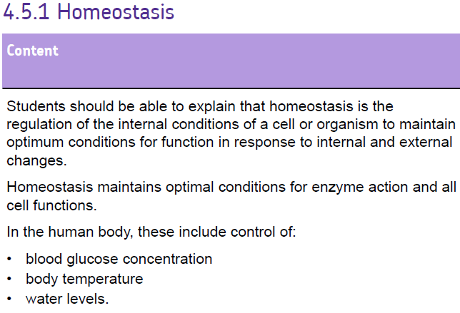
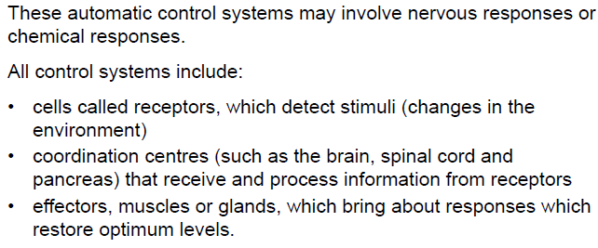

Slide 2


Slide 3
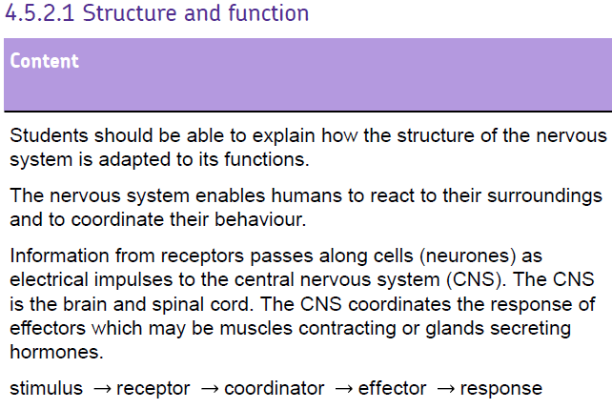
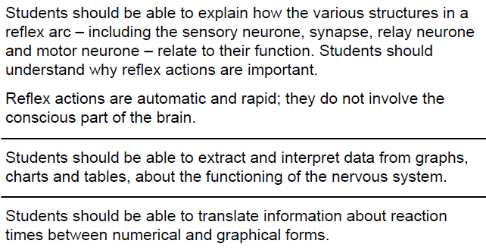

Slide 5
How does the nervous system enable organisms to react to their surroundings?
Stimulus
Receptor
Sensory Neurone
Effector (muscle or gland)
CNS
Motor Neurone

Slide 6
Parts of the nervous system
CNS – The central nervous system, made up of the brain & spinal cord
Receptor – cells in the body that pick up stimuli
Sensory Neurone – the neurone that transfers electrical impulses TO the brain
Motor Neurone – the neurone that transfers electrical impulses AWAY from the brain to the rest of the body
Effector – Muscles or glands that elicit a response to an impulse from the CNS

Slide 7
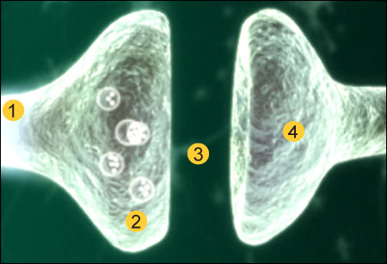
Synapses
An electrical impulse travels along an axon.
This triggers the nerve-ending of a neuron to release chemical messengers called neurotransmitters.
These chemicals diffuse across the synapse (the gap) and bind with receptor molecules on the membrane of the next neuron.
The receptor molecules on the second neuron bind only to the specific chemicals released from the first neuron. This stimulates the second neuron to transmit the electrical impulse.

Slide 8
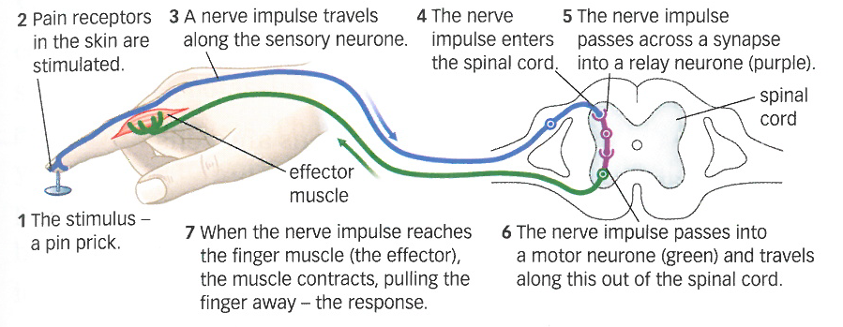
What’s happening when we detect a stimulus which causes a reflex?
Each reflex action takes the follows the pathway:
stimulus → receptor → sensory neurone → relay neurone → motor neurone → effector → response

Slide 9
Required practical – reaction time

Slide 10
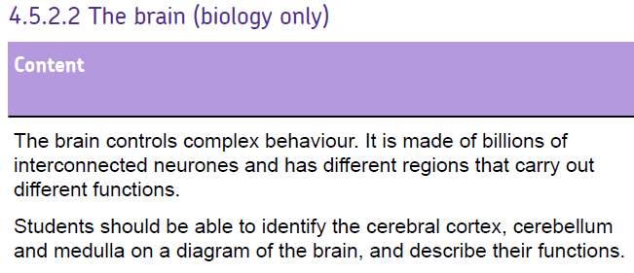
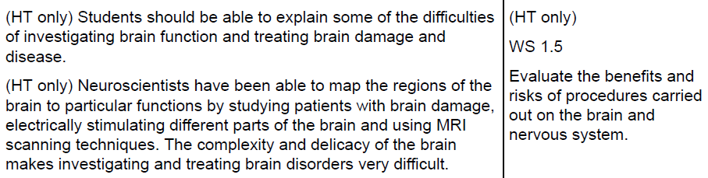

Slide 12
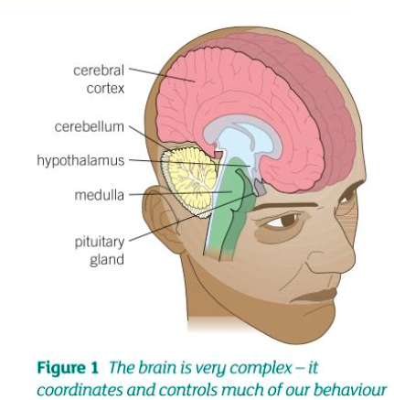
The brain
The brain is made up of billions of interconnected neurones that form different regions. The different regions carry out different functions:
Cerebral cortex – this controls consciousness, intelligence, memory and language
Cerebellum – controls the co-ordination of muscular activity and balance
Medulla – controls unconscious activities, such as controlling the heartbeat, the movements of the gut and breathing

Slide 13
How do neuroscientists know?
Looking at pathological specimens
Examining damaged areas
Animal studies
Study during surgery
Non-invasive techniques

Slide 14
Studies of individuals with damaged brain regions
By studying the consequences of accidental brain damage it is possible to determine the functions of certain regions of the brain
  Injuries
  Destroyed neurones produce lesions
  Non-human animal ‘models’
  Removal of brain tissue
MRI (magnetic resonance imaging) scans can also help us understand the brain by identifying areas of the brain that are affected.

Slide 15
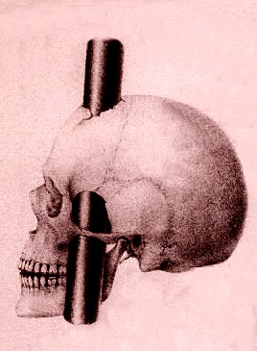
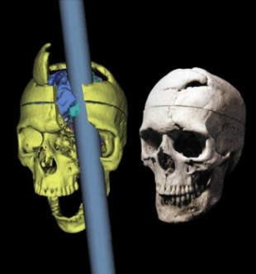
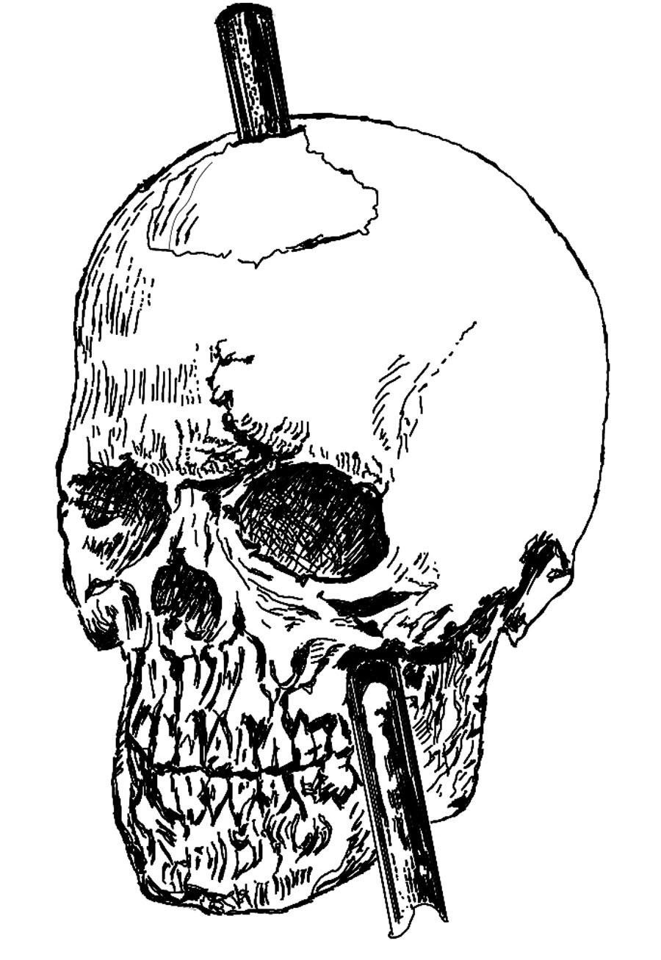
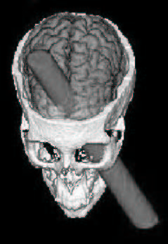
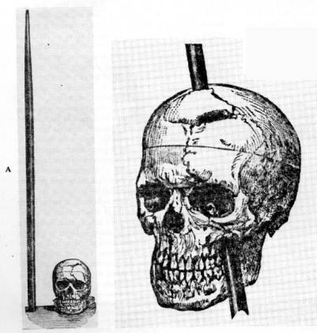
Phineas Gage

Slide 16
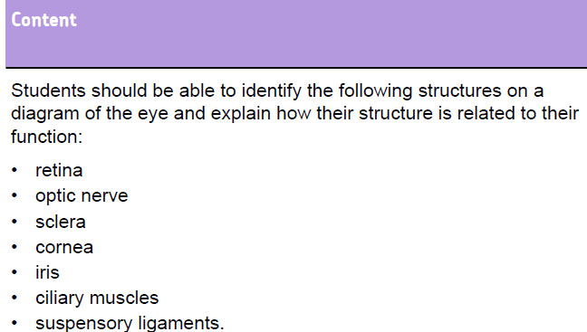

Slide 18
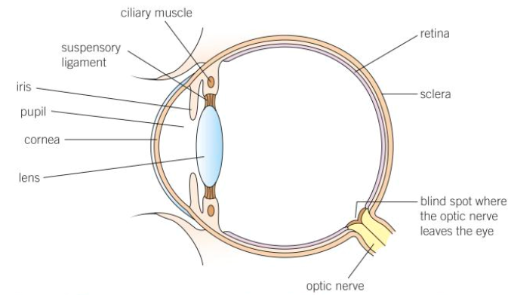


Slide 19
The eye
Sclera – white outer layer of the eye. It is tough and strong so the eyeball is not easily damaged
Cornea – transparent area at the front of the eyeball to let light in. Changes the direction of light due to it’s curved surface.
Iris – controls the size of the pupil
Lens – focuses the light on the retina
Suspensory ligaments & ciliary muscles – holds the lens in place. Tighten and relax to change the shape of the lens

Slide 20
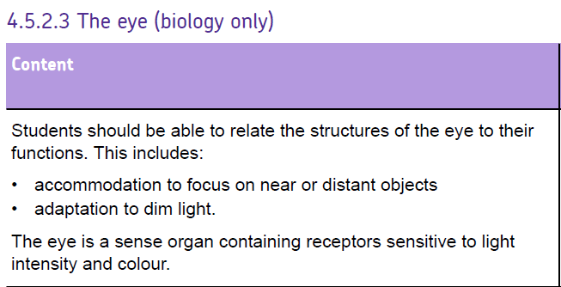
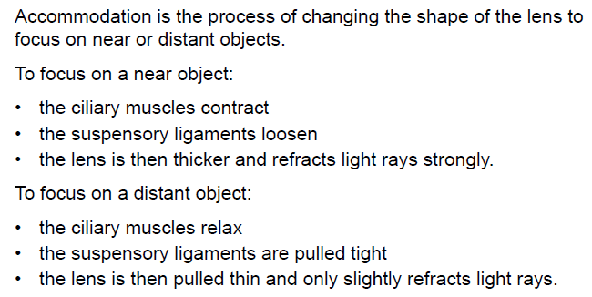

Slide 22
Seeing things at different distances - accomodation
For distant objects the ciliary muscles relax and the suspensory ligaments pull tight making the lens pull thin – the light doesn’t bend as much.
For close objects the ciliary muscles contract allowing the lens to go fat, thus bending the light more.

Slide 23
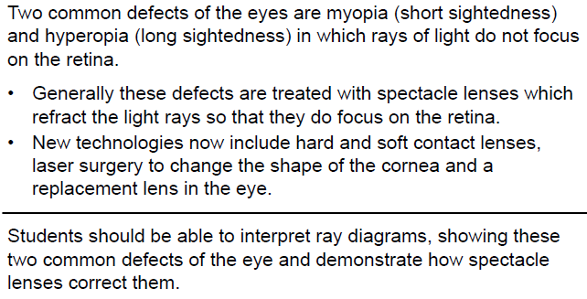

Slide 24
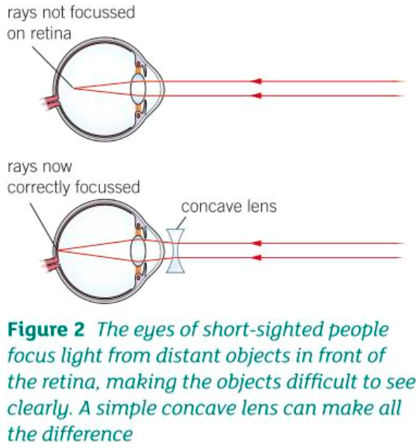
Myopia
If you have myopia you can see close objects in clear focus, but distant objects look blurred. This could be as a results of a lens that is too curved or a particularly long eyeball.
It is treated with a concave lens

Slide 25
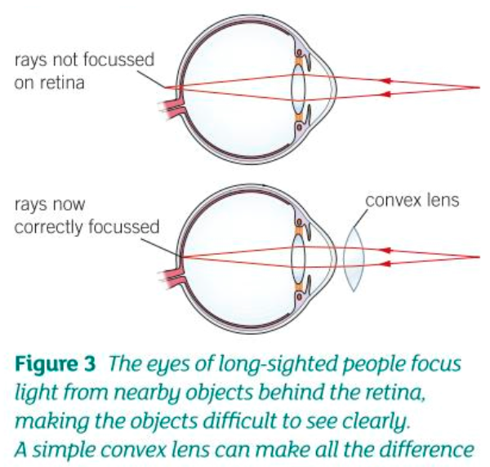
Hyperopia
If you have hyperopia you can focus clearly on distant objects but close objects appear blurred. The could be as a result of a lens that is too flat and thin, or a particularly short eyeball.
It is treated with a convex lens

Slide 26
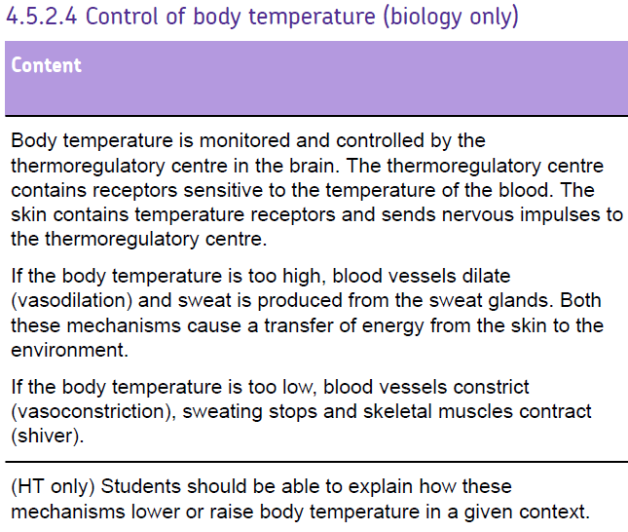

Slide 28
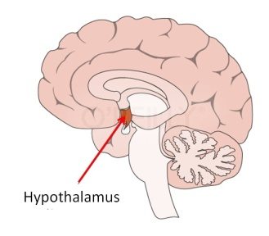
Change detected by thermoregulatory centre
Vasodilation
Sweating
Triggers responses
Skin receptors detect changes
Blood Temperature Rises
Temperature falls again
Normal Body Temperature 37˚C
Skin receptors detect changes
Blood Temperature Falls
Temperature rises again
Triggers responses
Change detected by thermoregulatory centre
Vasoconstriction
Shivering

Slide 29
Thermoregulatory mechanisms
Too cold
Shivering – muscles contract rapidly and release energy through respiration
Vasoconstriction – blood vessels supplying the skin constrict stopping blood flow to the skin so less energy is lost

Slide 30
Thermoregulatory mechanisms
Too hot
Sweating – sweat glands release sweat which evaporates off the skin taking energy
Vasodilation – blood vessels supplying the skin dilate allowing blood flow to the skin so more energy is lost

Slide 31
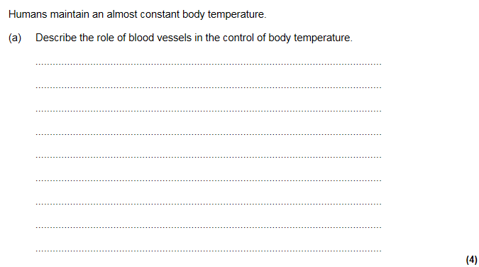
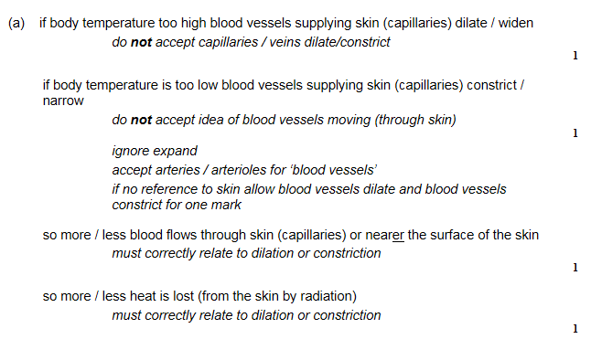

Slide 32
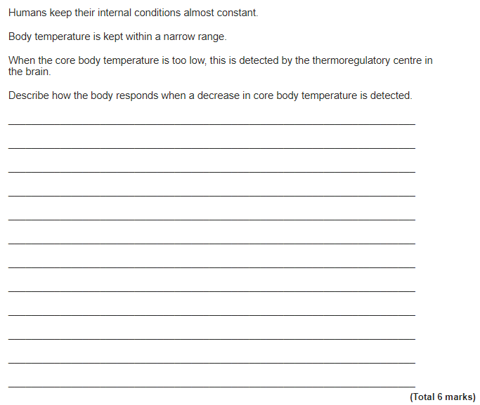
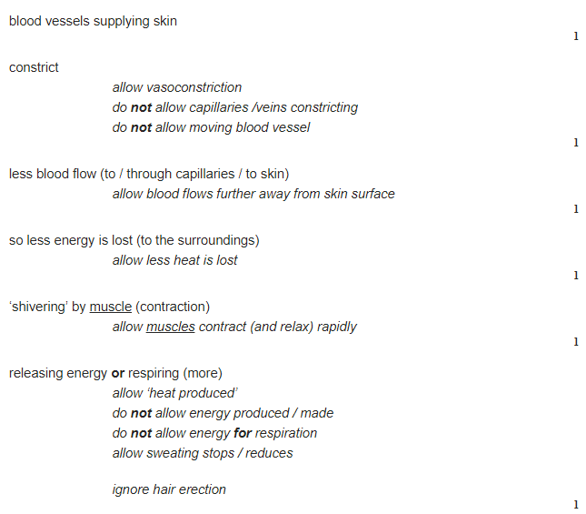

Slide 33
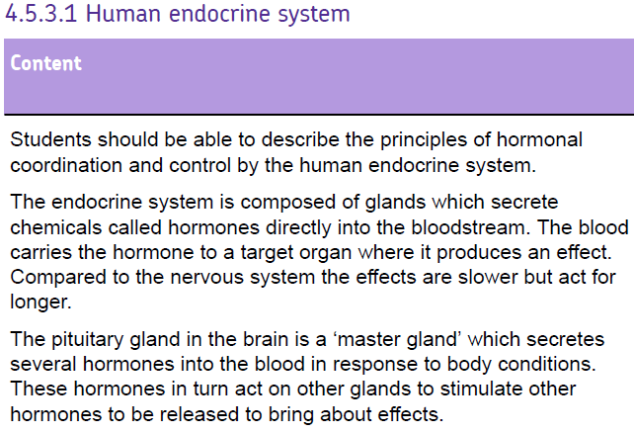
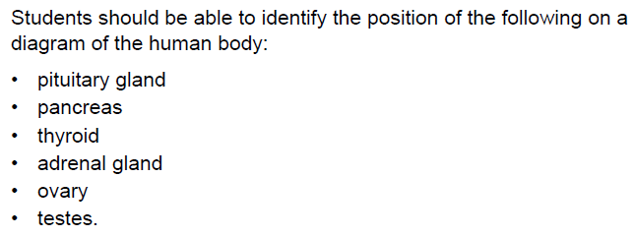

Slide 35
What is the endocrine system and what are hormones?
Hormones are chemicals
Are produced (secreted) from glands into the bloodstream
Travel in the blood to target organs
Regulate the functions of many organs and cells
Coordinate many processes in the body (such as maturing - puberty)

Slide 36
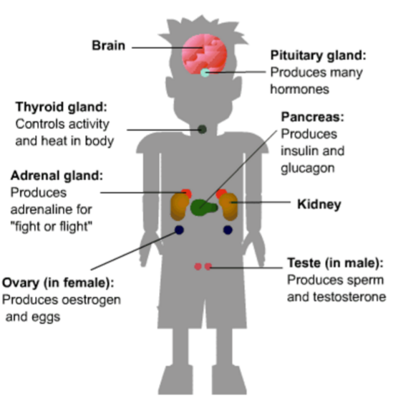
Location of glands in the body

Slide 37
Gland | Hormones | Target organs | Role/effect
Adrenal gland | Adrenalin | Vital organs, eg liver and heart | Prepares body for action- fight or flight
ovary | Oestrogen | Ovaries, uterus, pituitary gland | Controls puberty and the menstrual cycle in females
ovary | Progesterone | uterus | Maintains the lining of the womb
Pancreas | Insulin | liver | Controls blood sugar levels
Pituitary gland | Anti-diuretic hormone (ADH) | kidney | Controls blood water level by triggering uptake of water and producing urine by kidney.
Pituitary gland | Oestrogen Testosterone | Ovaries testes | produce and release eggs and make the female sex hormone oestrogen. stimulates the testes to make sperm and the male sex hormone testosterone.
Thyroid | TSH | Thyroid gland | Helps control the rate of metabolism.
testes | Testosterone | Male reproductive organs | Controls puberty in males and production of sperm.

Slide 38
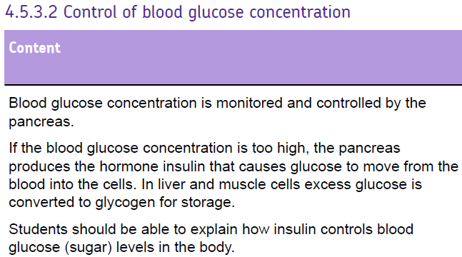
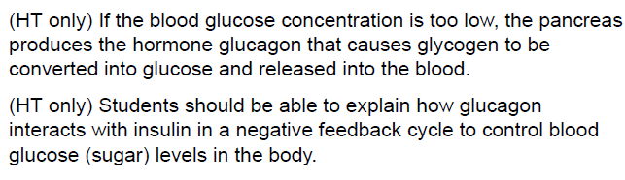

Slide 40
Blood Sugar – what are my key words?
Glucose - A simple sugar broken down in respiration to release energy
Glycogen - A storage substance made up of the monomer glucose. It is stored in the liver and muscles.
Insulin - Released when blood glucose levels gets too HIGH. A hormone that increases the permeability of cells to glucose. It stimulates the formation of glycogen from glucose.
Glucagon - Released by the pancreas when blood glucose levels are too LOW. It stimulates the breakdown of glycogen to glucose.

Slide 41
Insulin stimulates glucose uptake from blood into LIVER and muscles
INSULIN is
secreted
PANCREAS
is stimulated
Negative feedback
control on
blood glucose
Normal level =
72 – 108 mg/dL
Blood glucose
level falls
Blood glucose
level rises
PANCREAS
is stimulated
GLUCAGON is secreted
Glucagon stimulates LIVER to release glucose

Slide 42
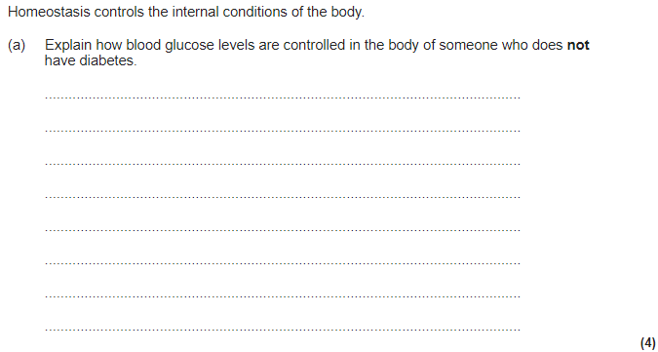
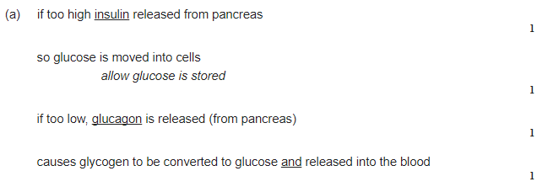

Slide 43
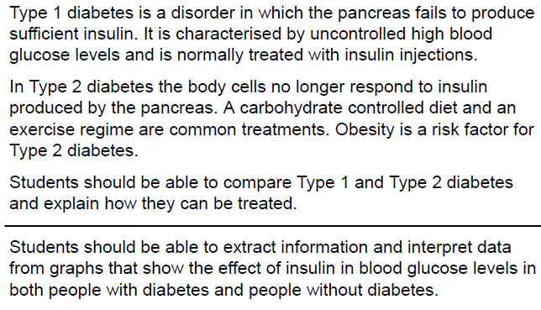

Slide 44
Diabetes
Type I or II | Cause | Symptoms | Treated by…
Type I | Pancreas fails to produce insulin | Uncontrolled high blood glucose levels | Insulin injections
Type II | Body cells no longer respond to insulin produced by the pancreas |  | Carbohydrate controlled diet and exercise regime

Slide 45
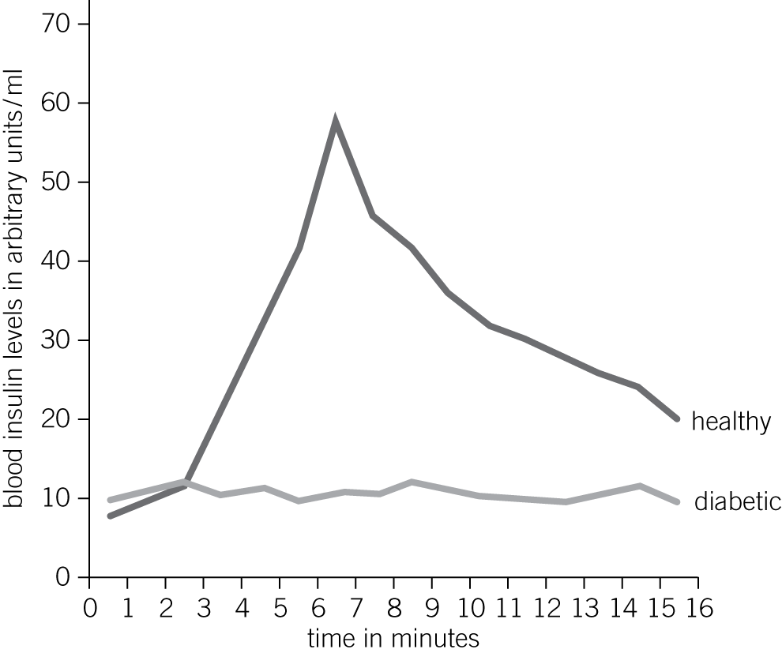
Analysing data
The graph below shows how insulin levels in the body change after eating. Describe the difference in insulin levels between a diabetic person and a healthy person. (4)

Slide 46
Mark scheme
The diabetic’s insulin level remains fairly constant/has only minor fluctuations after eating. (1)
The healthy person’s insulin level rises significantly after eating (1),
Reaching a peak of 60 AU at around 6 minutes (1).
It then decreases back to the starting level (1).

Slide 47
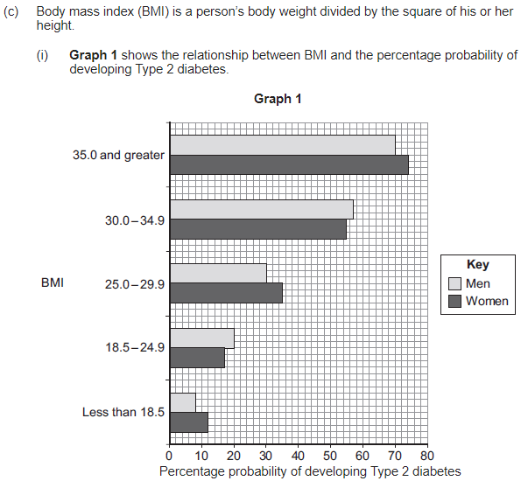
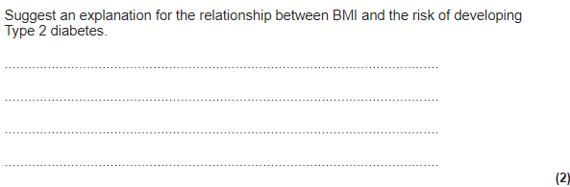
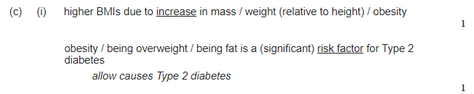

Slide 48
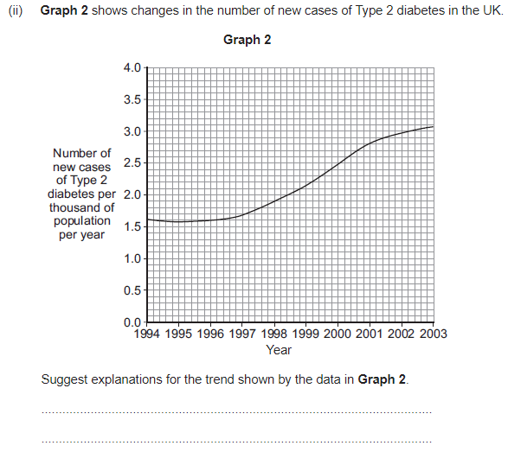
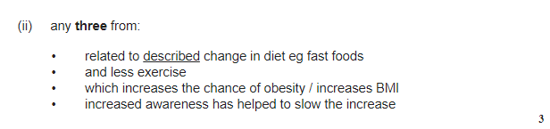

Slide 49
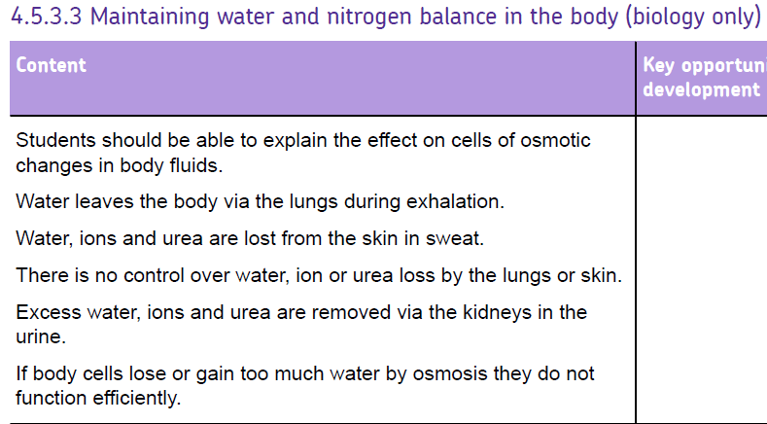
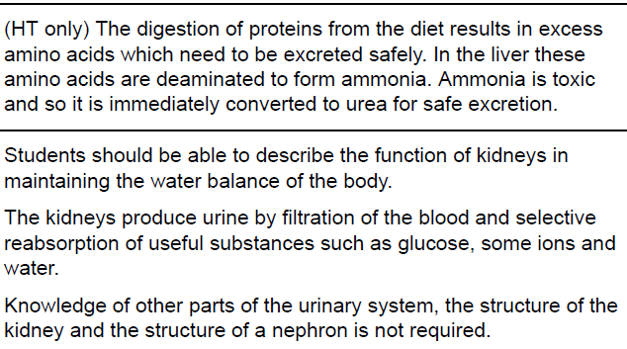
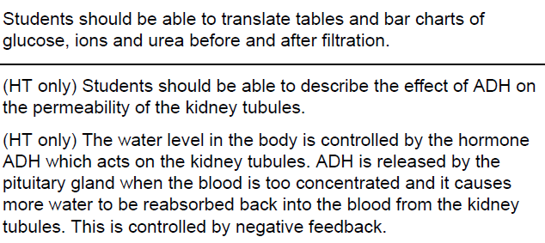

Slide 51
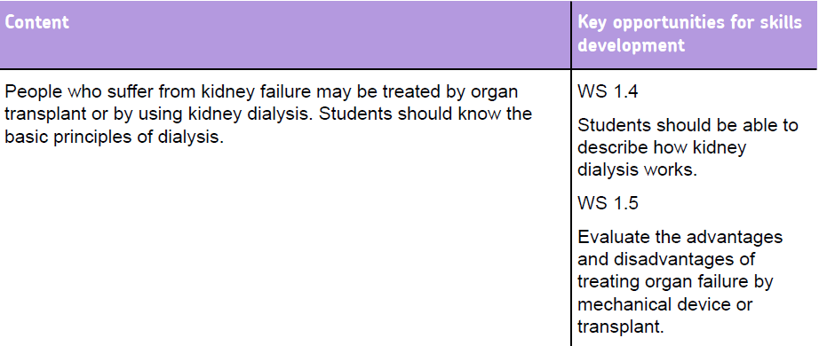

Slide 53
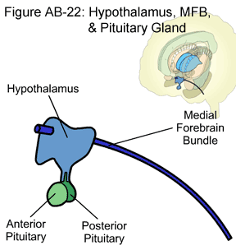
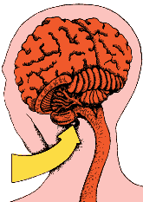
Dehydration
Decreased water potential of blood
Osmoreceptors cells in hypothalamus lose water (so shrink)
Stimulates nerve cells in the hypothalamus
Increased ADH (antidiuretic hormone) production by posterior pituitary gland
ADH carried in the blood
ADH arrives at the collecting duct

Slide 54
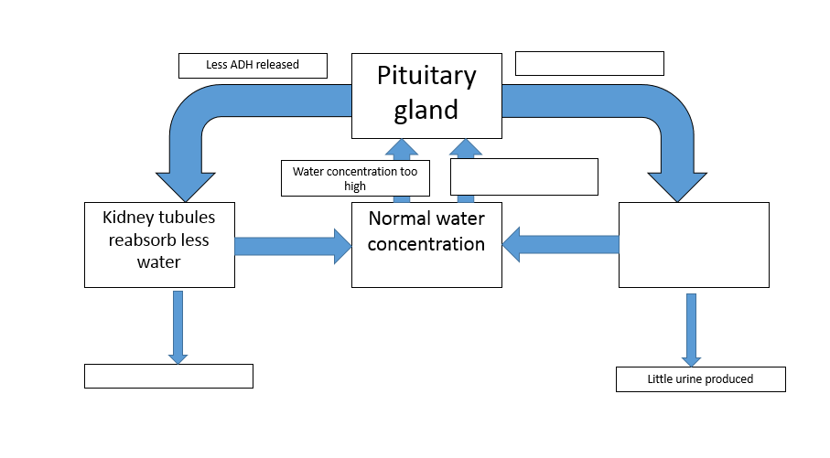
More ADH released
Water concentration too low
Kidney Tubules reabsorb more water into body
Lots of urine produced

Slide 55
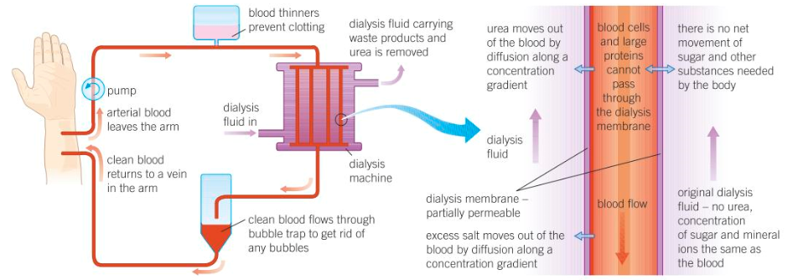

Slide 56
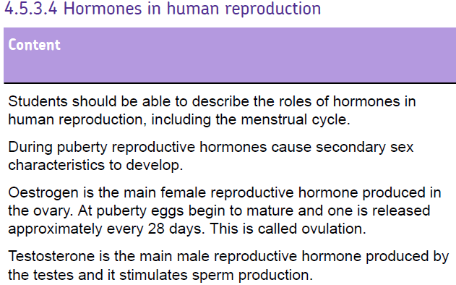


Slide 58
Hormones made in the ovary
Oestrogen
Stimulates the lining of the uterus to grow again after menstruation
Stimulate the release of LH
Inhibits the release of FSH (when in high concentrations)
Progesterone
Secreted by the empty follicle (in the ovary)
Inhibits the release of both FSH and LH
Maintains lining of the uterus in the second half of the cycle

Slide 59
Hormones made in the pituitary gland
FSH (follicle stimulating hormone)
Makes eggs mature in their follicles in the ovary
Stimulates the ovary to produce oestrogen
LH (luteinising hormone)
Stimulates the release of a mature egg from the ovary (triggers ovulation)

Slide 60

Progesterone
LH
FSH

Slide 61



Slide 62


Slide 64
Methods of contraception
Contraceptive method | Brief description
Oral contraceptive | Contain hormones to inhibit FSH
Injection, implant or skin patch | Slow release of progesterone to inhibit maturation of release of eggs
Barrier methods (condom/ diaphragm/cap) | Prevent the sperm meeting the egg
IUD | Prevents implantation of an embryo
Spermicides | Kill or disable sperm
Abstinence | Not having intercourse
Sterilisation | Surgical method of permanently preventing fertilisation

Slide 65


Important

Slide 67



LH & FSH

Slide 68


Slide 70

Negative feedback

Slide 71
Thyroxine – an example of negative feedback
Thyroid gland uses iodine from you diet to produce the hormone Thyroxine. Thyroxine production is stimulated by TSH, which is released by the pituitary gland. This controls the basal metabolic rate of your body. How quickly substances are broken down and built up.
Pituitary gland – stops releasing Thyroid stimulating hormone (TSH)
Hypothalamus detects cells have enough energy
Thyroid gland stops producing Thyroxine
Thyroxine level normal
Thyroid gland starts producing Thyroxine
Hypothalamus detects cells need more energy
Pituitary gland – starts releasing Thyroid stimulating hormone (TSH)

Slide 72



Slide 73


Slide 75

Hormones and plant growth
Plants are sensitive, they need to grow the right way..
Plant roots grow towards moisture and in the direction of force of gravity
Plant shoots grow towards light and against the force of gravity
Phototropism – response of a plant to light
Gravitropism/geotropism – response of a plant to gravity
Auxin – hormone that controls responses of roots and shoots
The opposite occurs in the roots

Slide 76



Slide 77




Slide 78
Required practical – light and gravity on plants

Slide 79



