Slide 1

Quick Accounts
Walkthrough

Slide 2
Student Perspective

Slide 3
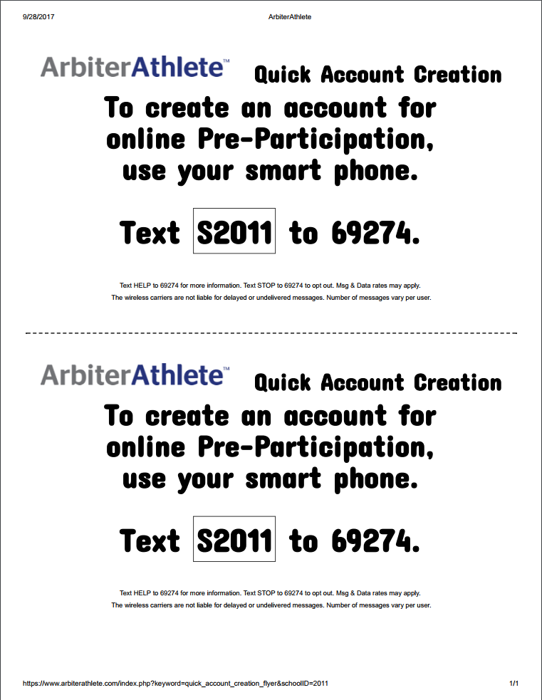
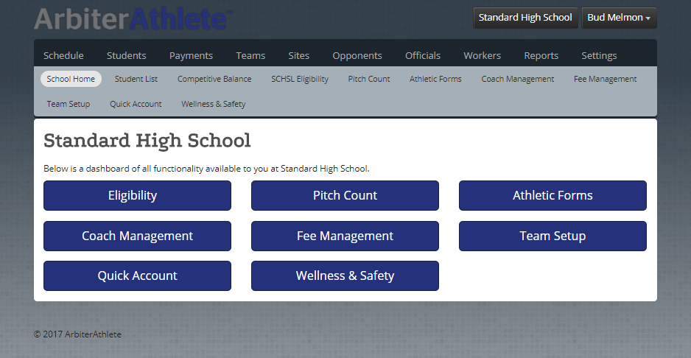
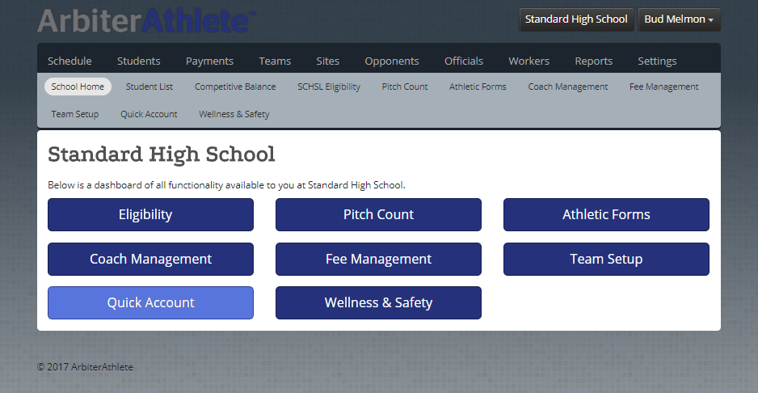
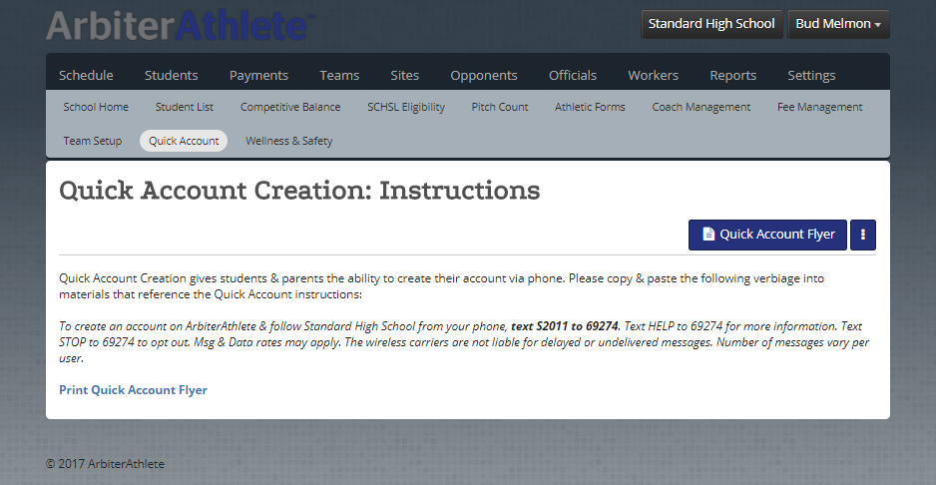

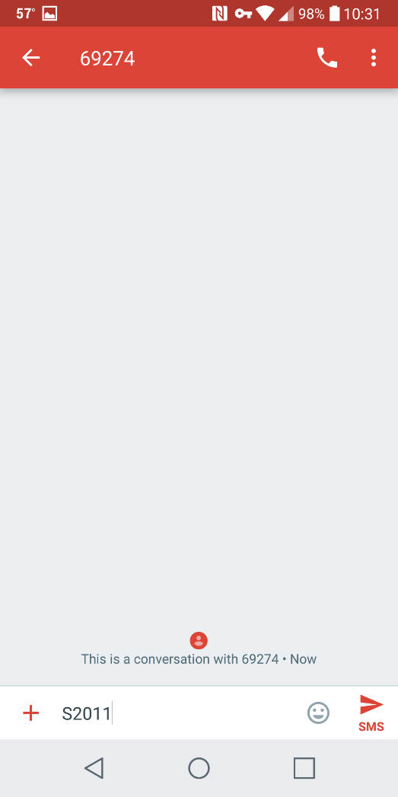
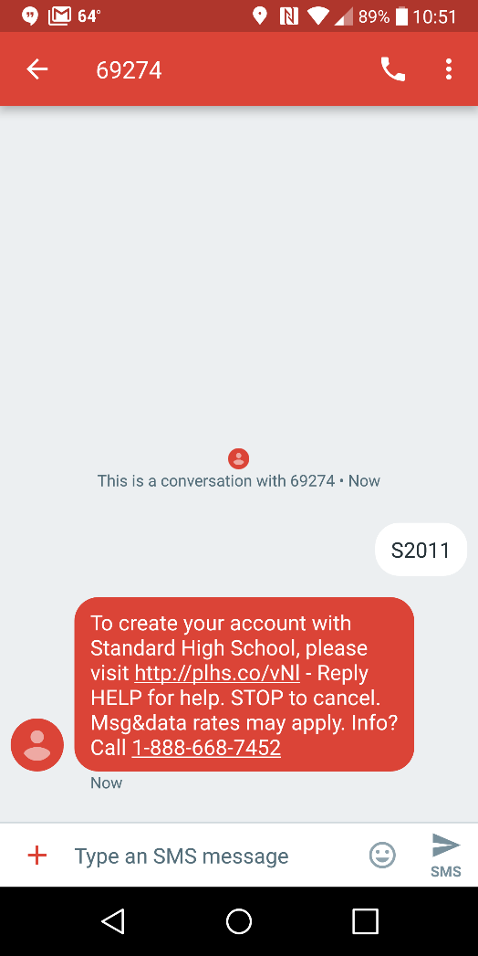
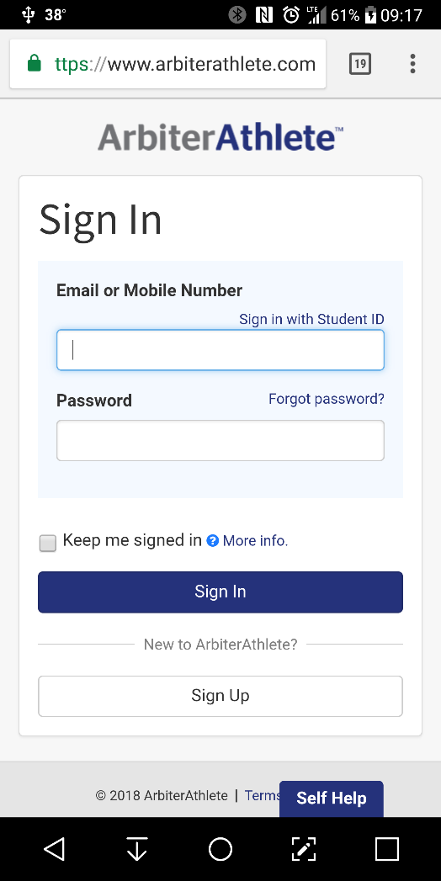

For the purposes of this demonstration we will be viewing everything from the point of view of using a computer to sign up.
Accounts can be created by either logging into the website via a computer at www.arbiterathlete.com, or via a cell phone using the quick account creation by texting the school’s unique code to 69274.
These codes can be found easily upon first login by the Athletic Director for quick distribution during the initial account creation process to significantly speed up the creation of accounts by students and parents.
The returned text message contains a link that takes the user right to the account creation page for their school.

Slide 4
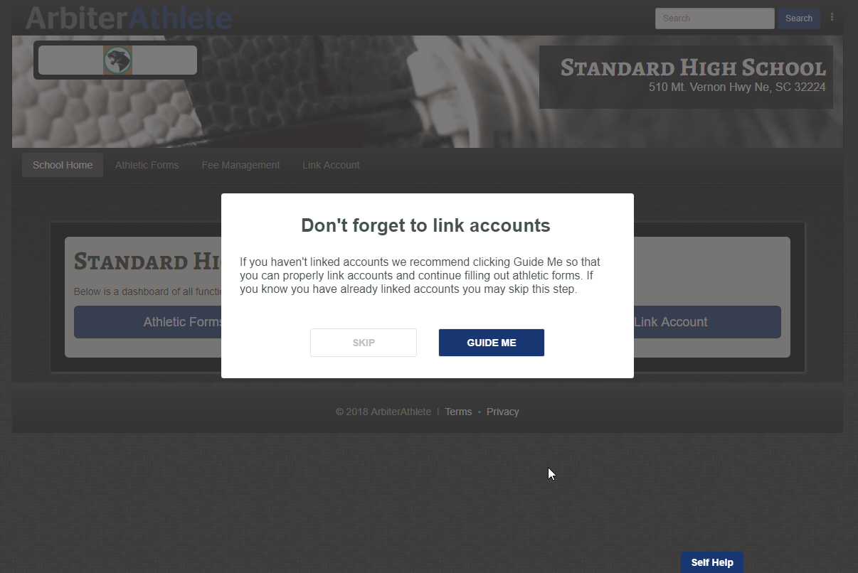
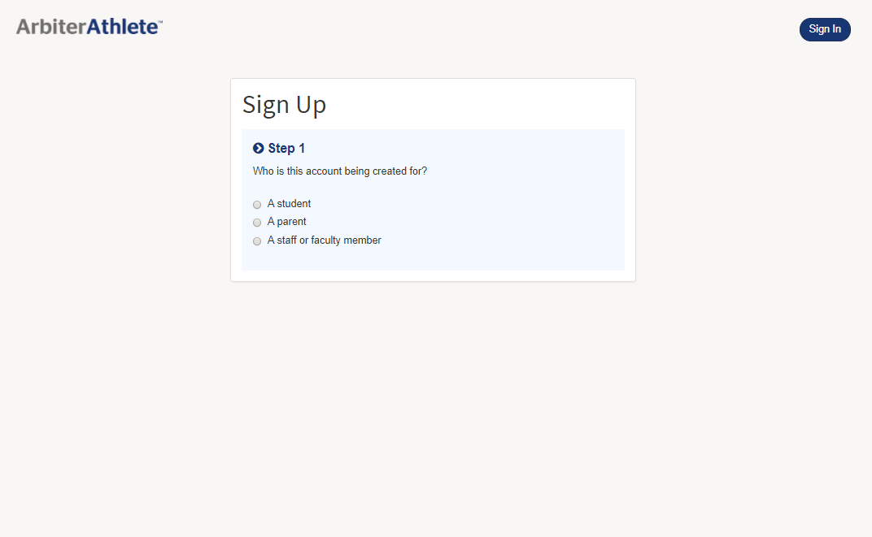
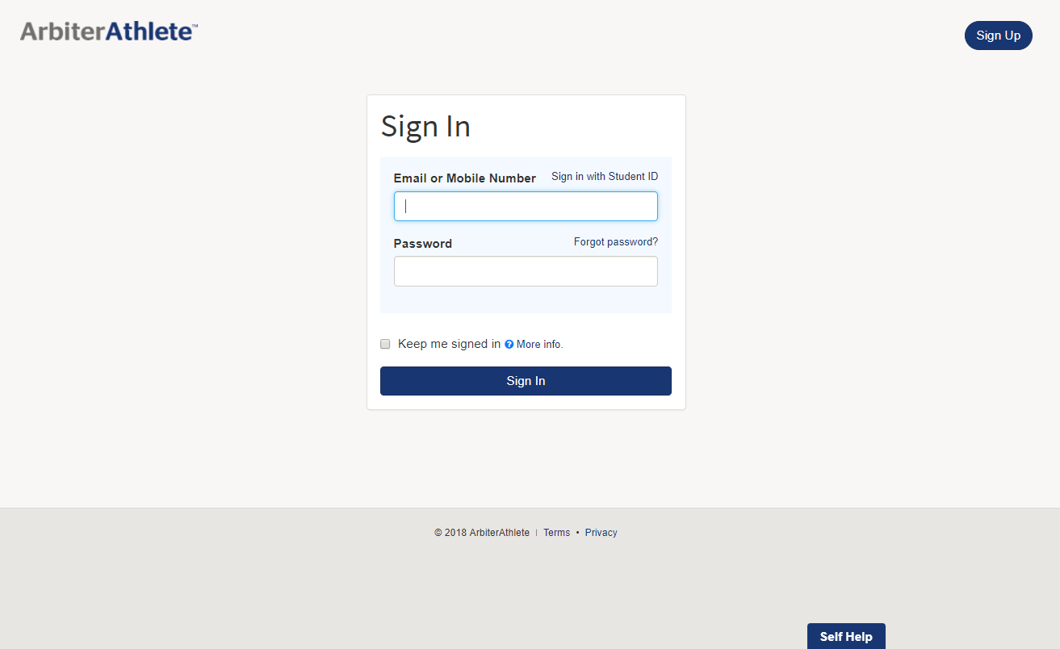
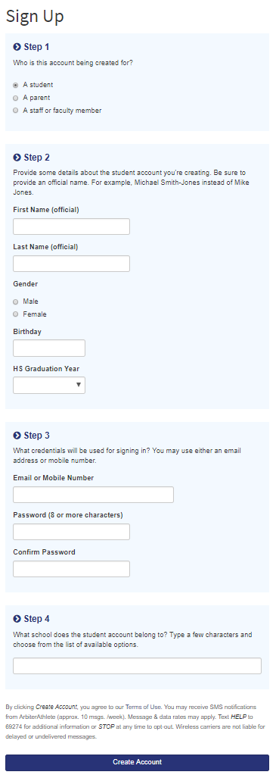
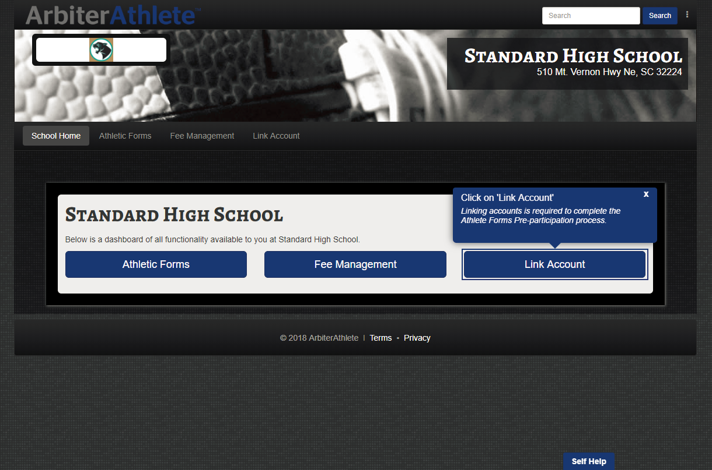
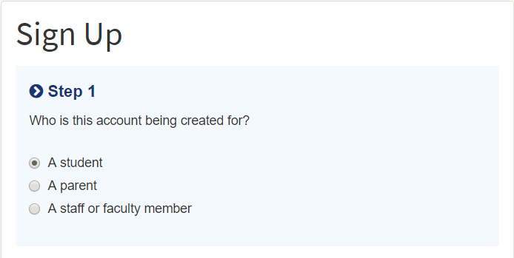
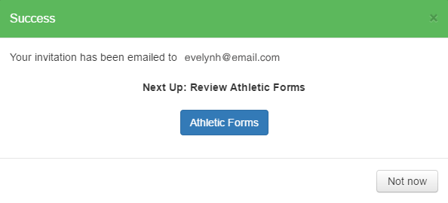
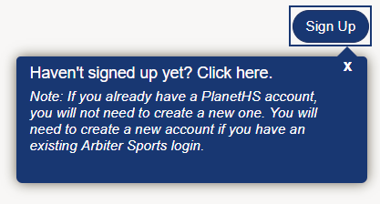
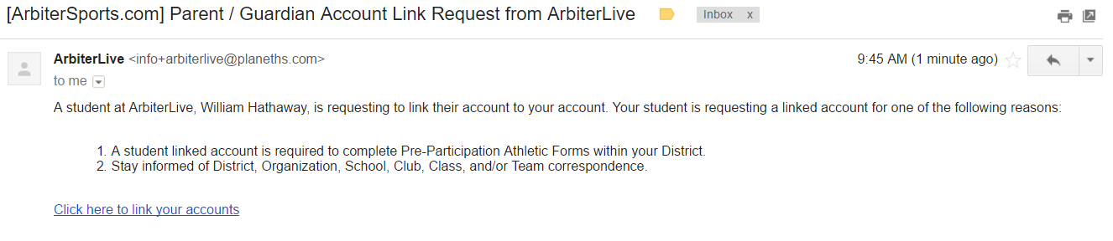
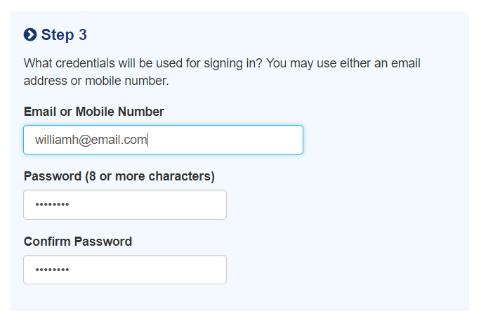
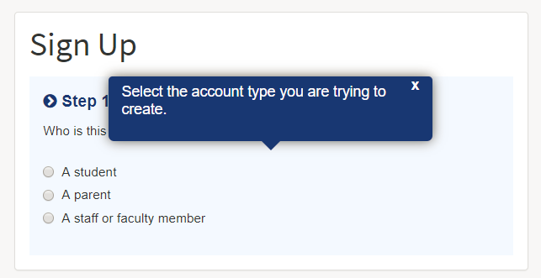
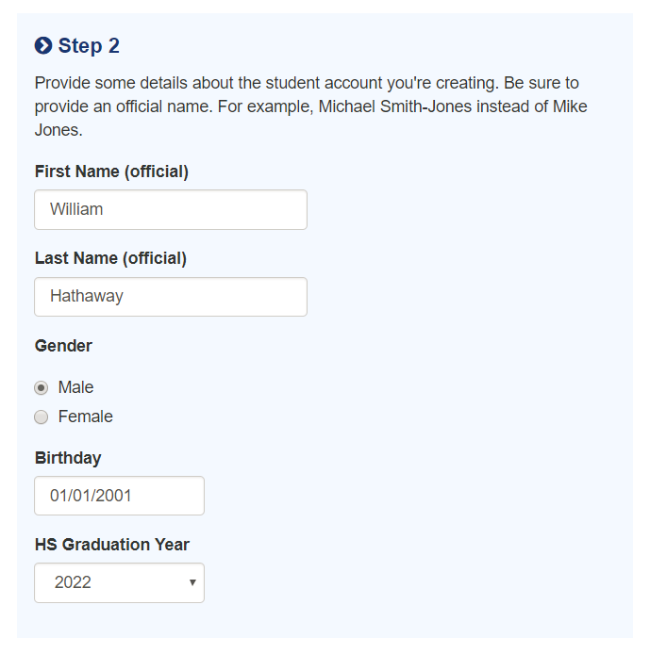
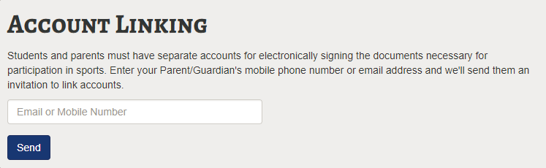
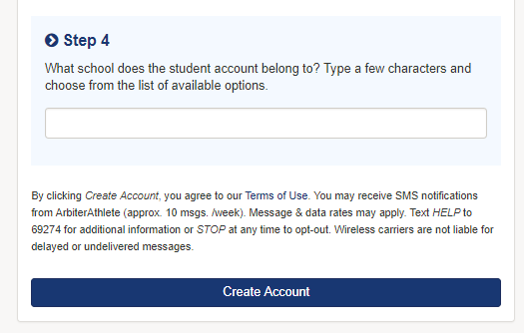
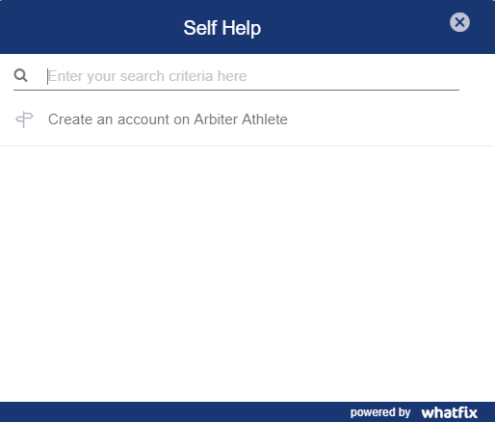
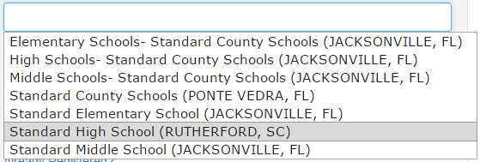
But, before we see what the parent sees, lets go ahead and finish with the student filling out the forms. After sending the invitation they were left with the option of moving directly on to the forms.
The parent will then receive the following message with a link to create an account. Clicking on the link will take them to the main signup page and prompt them to create an account or log in to an existing account they have previously created.
A mobile number may also be used instead of an email when sending an invitation.
evelynh@email.com
Multiple parents can be invited to link to a student account.
Standard
Standard High School (RUTHERFORD, SC)

Slide 5
Parent Perspective

Slide 6
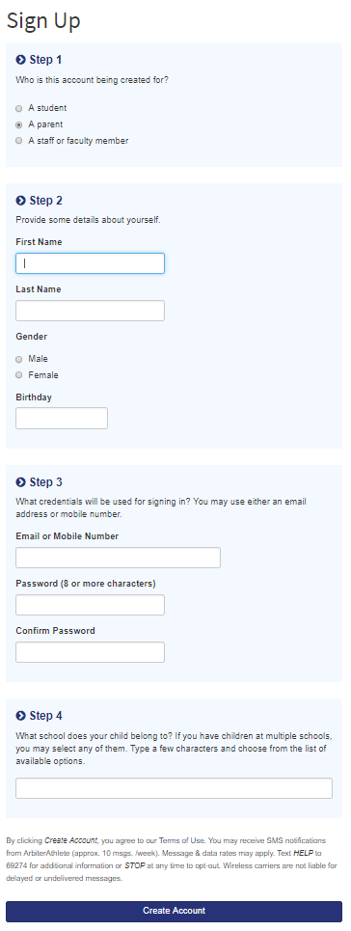
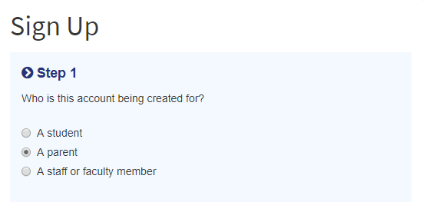
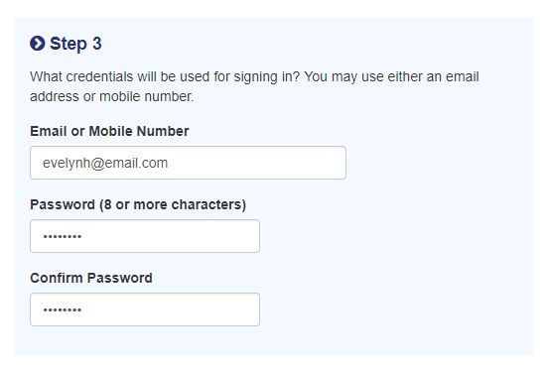
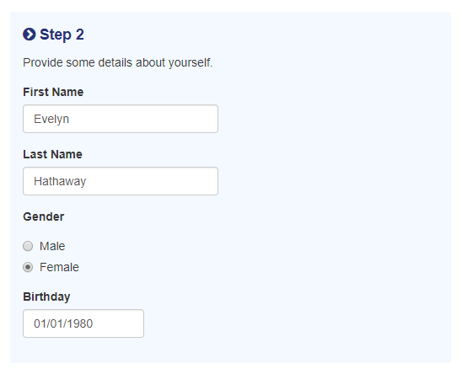
Standard
Standard High School (RUTHERFORD, SC)

