Slide 1
NOTE TO PRESENTER
This presentation provides information on the FSA ID that can be used in outreach to students and parents. The presentation was created by Federal Student Aid, an office of the U.S. Department of Education (ED). You may add or delete content to/from it. However, you must ensure that any edits made to this presentation and/or any uses of this presentation are done in a manner that furthers the goals of ED. [This presentation was updated in May 2017.]
[Delete this slide before you use the PowerPoint deck in your presentation.]
1

Slide 2
Creating and Using Your FSA ID: An Overview
[Presenter Name] | [Presenter Date]

Slide 3
Topics Covered
What is the FSA ID?
Do parents need FSA IDs?
How do you create your FSA ID?
Where can you use your FSA ID?
What to do if
  you forget your username or password or
  you’re locked out of your account
Where to get more information
3

Slide 4
What is the FSA ID?
The FSA ID is a username and password used by students, parents, and borrowers to
  log in to some U.S. Department of Education websites and
  electronically sign documents.
You use it to
  apply for federal student aid at fafsa.gov;
  receive a federal student loan; and
  perform important activities such as choosing a repayment plan or applying for a deferment on your federal student loan.
4

Slide 5
Do parents need FSA IDs?
If you’re a dependent student, then your parent will need an FSA ID in order to sign your Free Application for Federal Student Aid (FAFSA®) form electronically.
Not sure if you’re considered a dependent student for FAFSA purposes? Go to StudentAid.gov/dependency to find out.
IMPORTANT
You and your parent must have different FSA IDs.
You must create your own FSA ID—it’s your electronic signature and you need to own it.
Your parent must create his or her own FSA ID.
You and your parent should each use your own email address and mobile phone number when creating an FSA ID (you can’t use/share the same email address and mobile phone number).
5

Slide 6
How do you create your FSA ID?
6

Slide 7
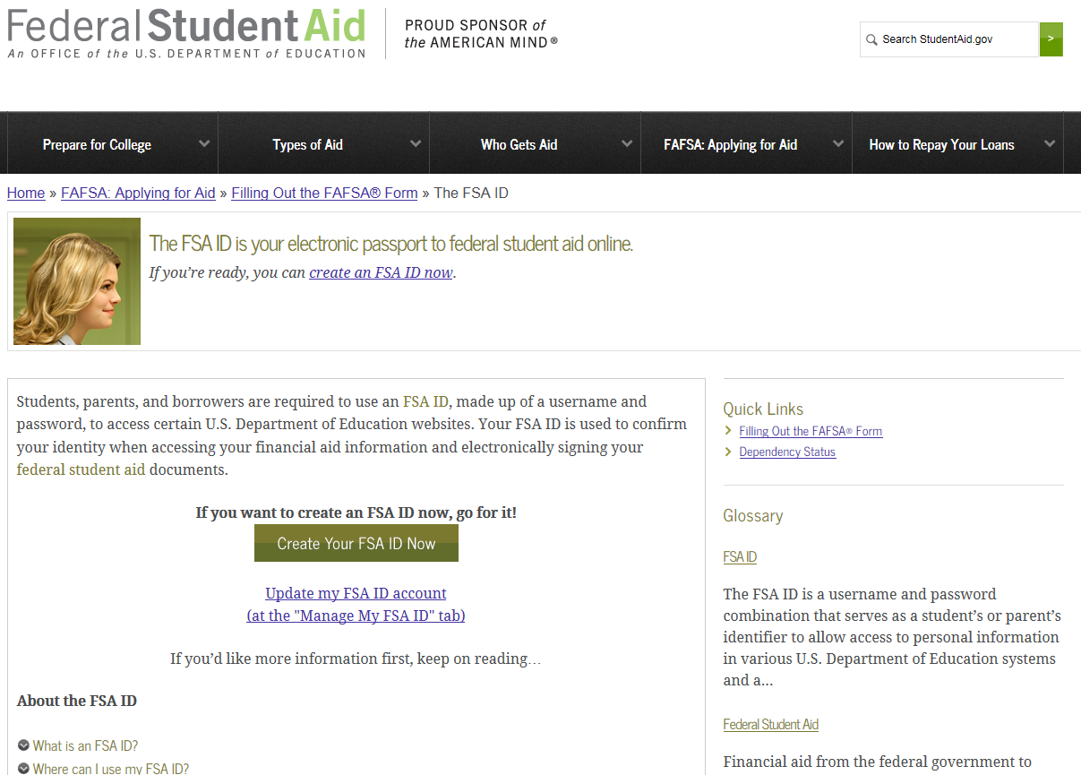
Getting Started
Go to StudentAid.gov/fsaid.
Click the “Create Your FSA ID Now” button.
7

Slide 8
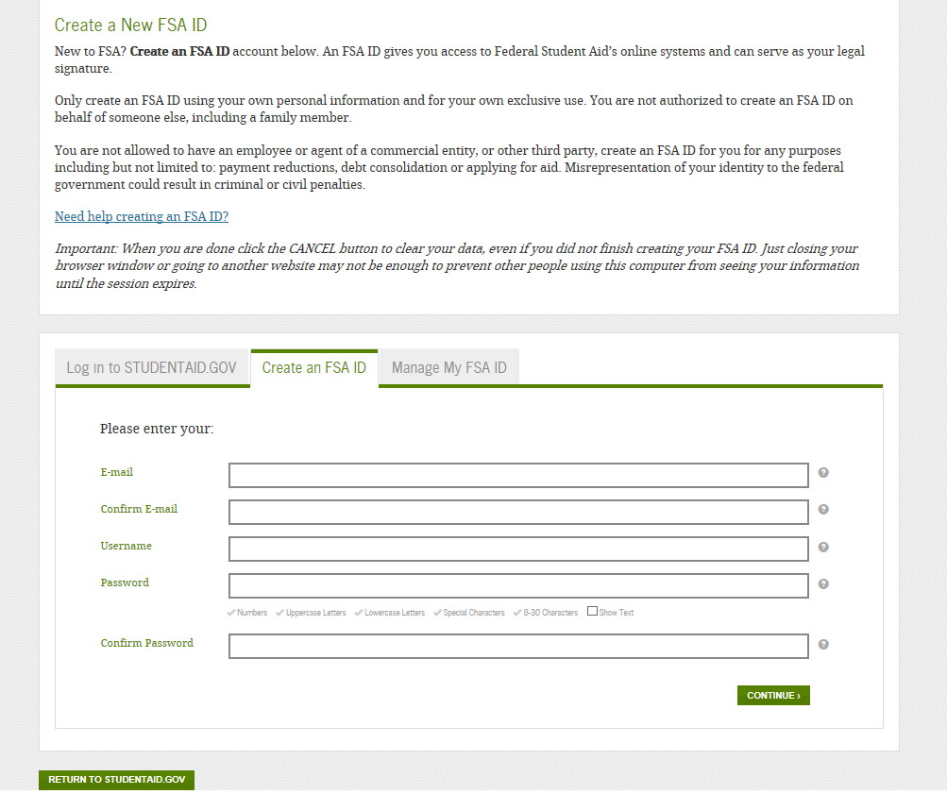
Create Your FSA ID (Username and Password)
Email:
Optional but strongly recommended
Each FSA ID must have a unique email address (you and your parent cannot use the same email address).
You must have access to this email account.
Username:
Don’t include personal info such as date of birth or name.
If you see a message “Username taken, create a different username,” then someone has already used that username.
You can select “Show Text” to see what you’re typing.
8

Slide 9
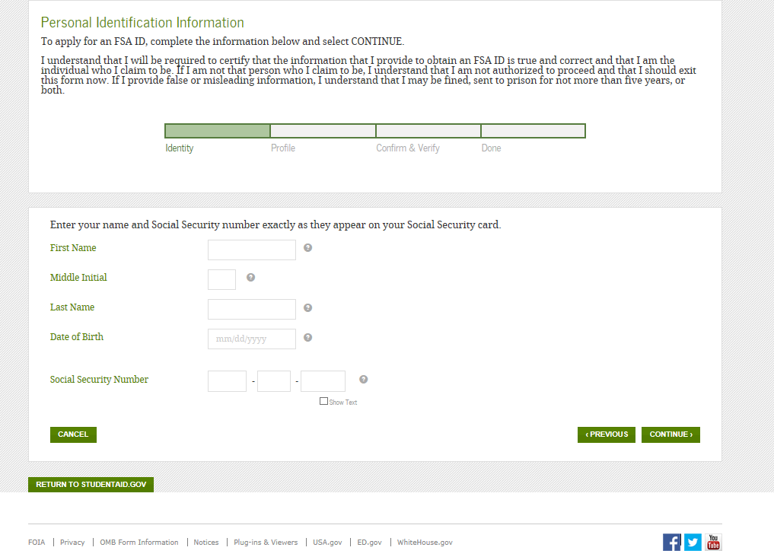
Provide Personal Identification Information
Make sure your Social Security number, date of birth, and name match what’s on your Social Security card.
You must have a Social Security number to create an FSA ID.
9

Slide 10
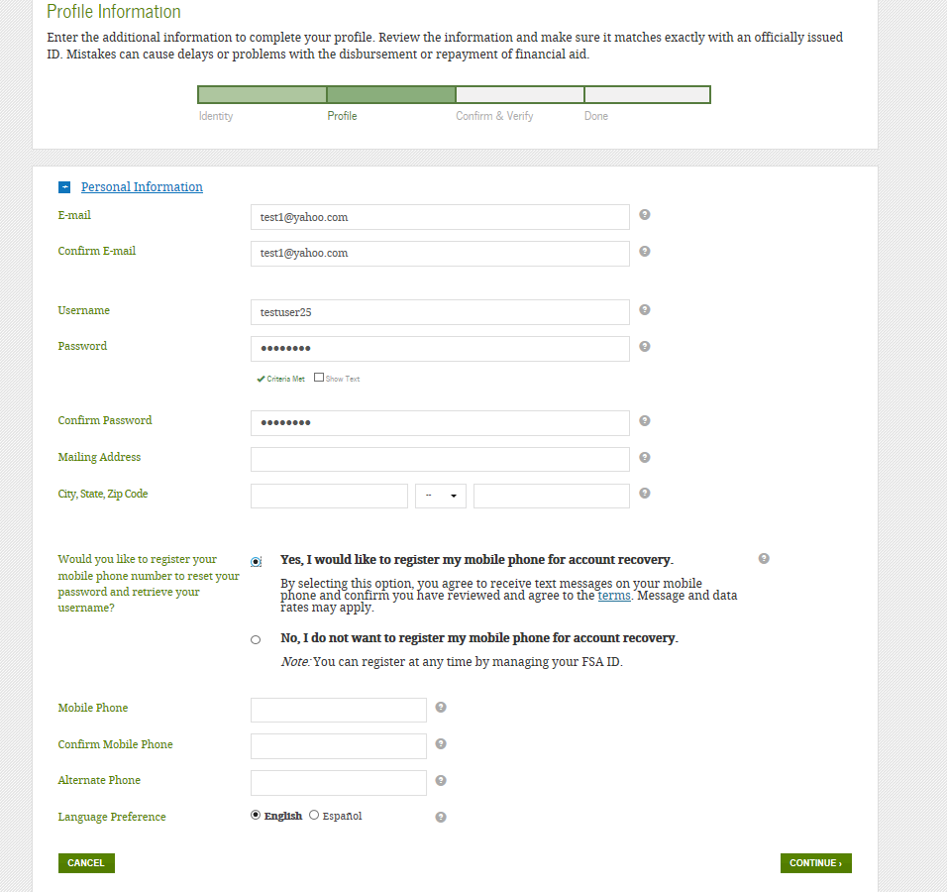
Provide Profile Information
Confirm information you entered previously and provide additional information.
Make sure your information is correct; any errors could result in a delay or problem in your receiving financial aid (or in the repayment of your federal student loans).
You can now register your mobile phone number for account recovery.
10

Slide 11
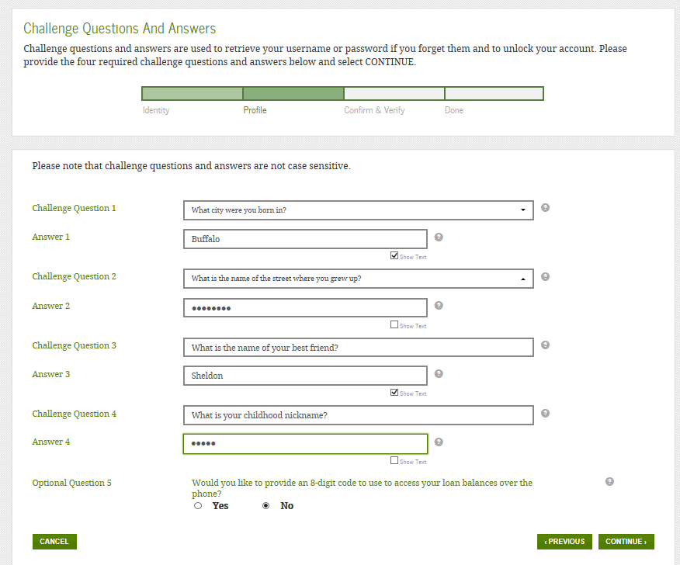
Select/Create Challenge Questions and Answers
Answering your challenge questions is one way to unlock your account or reset your username and password.
Questions 1 and 2:
Select a question from the dropdown menu and then enter your answer.
Questions 3 and 4:
Make up your own question and enter your answer.
Make sure the answers will be easy to remember.
Examples of questions:
  What city was I born in?
  Who was my first boss?
You can select “Show Text” to see what you’re typing.
11

Slide 12
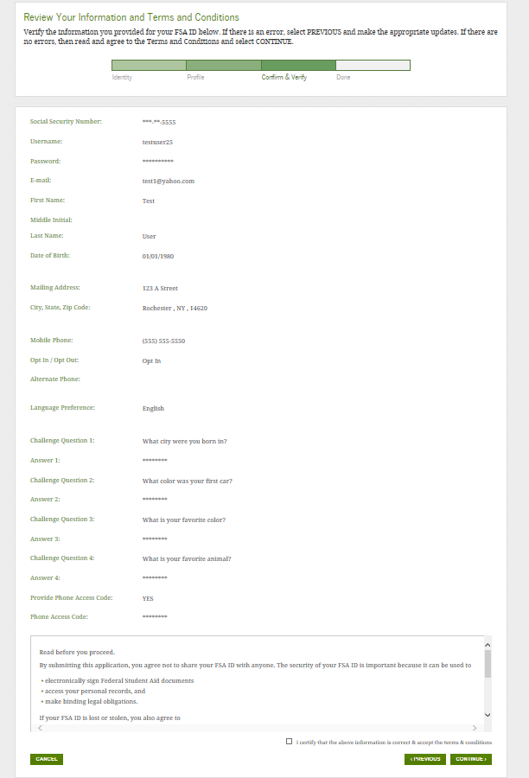
Review Info and Agree to Terms
Review and confirm your information.
If you need to make a correction, use the “Previous” button.
Review and agree to the terms and conditions for using your FSA ID.
12

Slide 13
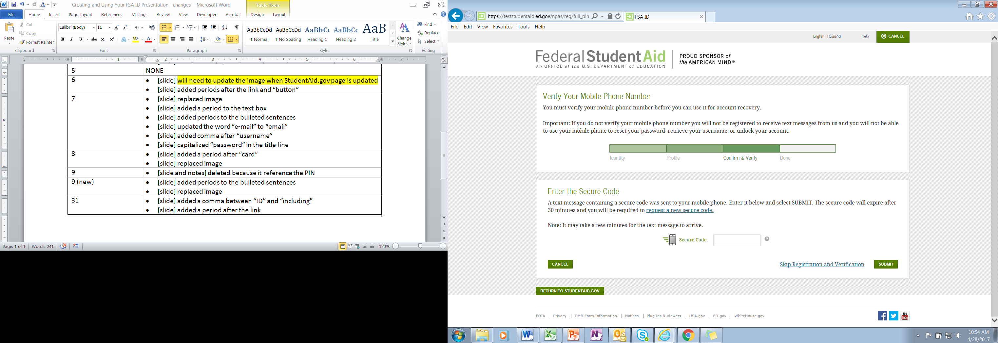
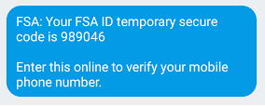
Verify Your Mobile Phone Number
Mobile Phone Number Verification Page
If you provided a mobile phone number, then you’ll be taken to the Mobile Phone Number Verification page.
Once you verify your mobile phone number, you can use your mobile phone to unlock your account, retrieve your username, or reset your password.
You can also continue without verifying.
How to Verify Your Mobile Phone Number
Do not close the Mobile Phone Number Verification page.
You’ll receive a text message with a secure code.
The text message will include a six-digit numeric code that you will enter in the “Secure Code” data field.
Text Message With Your Secure Code
13

Slide 14
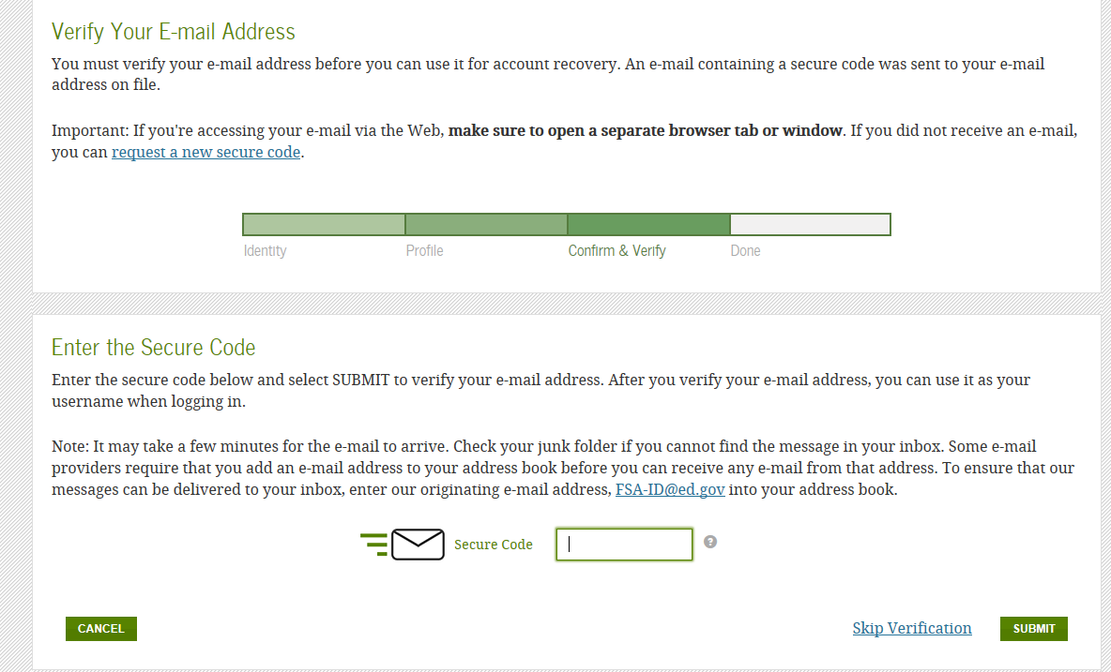
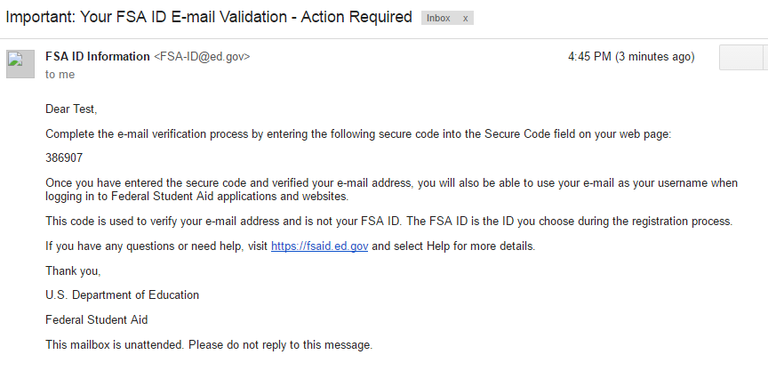
Verify Your Email
Email Verification Page
If you provided an email address, then you’ll be taken to the Email Verification page.
Once you verify your email, you can use your email address as your username when logging in to Department of Education websites.
You can also continue without verifying.
How to Verify Your Email
Do not close the Email Verification page.
You’ll receive an email with a secure code.
Log in to your email account using a different tab or browser window or another device.
Look for an email with the subject line, “Important: Your FSA ID E-mail Validation - Action Required.”
The email will include a six-digit numeric code that you will enter in the “Secure Code” data field.
Email With Your Secure Code
14

Slide 15
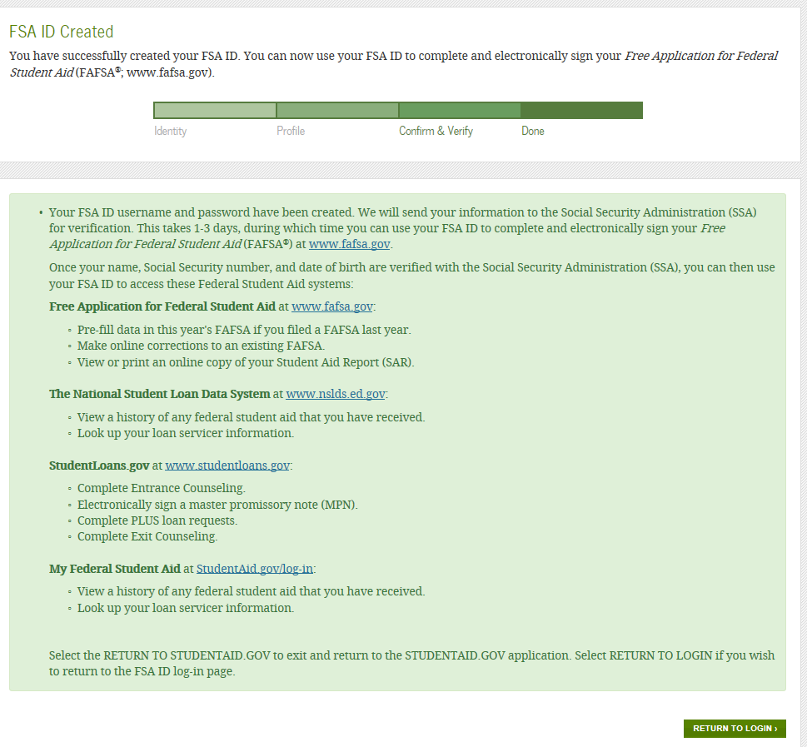
Your FSA ID is created!
Your FSA ID was created.
If you provided an email address, then you’ll receive a confirmation email.
Using Your FSA ID
You can log in to fafsa.gov and complete, sign, and submit a new (original) FAFSA® form.
Your info will be sent to the Social Security Administration (SSA) for confirmation.
SSA review will take 1–3 days.
Until your info is verified, you won’t be able to take certain actions, such as correcting your FAFSA form, submitting a renewal FAFSA form, or signing a Master Promissory Note.
15

Slide 16
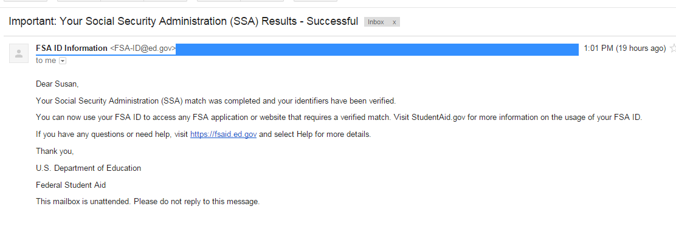
Social Security Administration Matching
You should receive an email informing you of the results of the SSA review. If you did not provide an email when creating your FSA ID, you can check the status by logging in at FSAID.ed.gov using the “Manage My FSA ID” tab.
If there is an issue, log in at FSAID.ed.gov using the “Manage My FSA ID” tab and review/update your profile info. If your info is correct, you’ll need to contact the SSA (to find your local SSA office, call 1-800-772-1213 or go to ssa.gov).
16

Slide 17
Where can you use your FSA ID?
17

Slide 18
Using Your FSA ID
Website | What You Can Do at the Site
fafsa.gov | Electronically sign your (or your child's) FAFSA® form. Prefill data in this year´s FAFSA form if you filed a FAFSA form last year (Renewal FAFSA form). Make online corrections to an existing FAFSA form. View or print an online copy of your Student Aid Report (SAR).
“My Federal Student Aid” at StudentAid.gov/login or the National Student Loan Data System (NSLDS®) site at nslds.ed.gov | View a history of any federal student aid that you have received. Look up your loan servicer's contact information.
StudentLoans.gov | Complete entrance counseling, the Financial Awareness Counseling Tool, or exit counseling. Electronically sign a Master Promissory Note (MPN). Complete PLUS loan requests. Estimate your student loan payments using the Repayment Estimator. Apply for an income-driven repayment plan or a consolidation loan.
Agreement to Serve (ATS) at StudentLoans.gov/myDirectLoan /launchTeach.action | Sign your ATS for the Teacher Education Assistance for College and Higher Education (TEACH) Grant Program.
18

Slide 19
What to do if you forget your
username or password
19

Slide 20
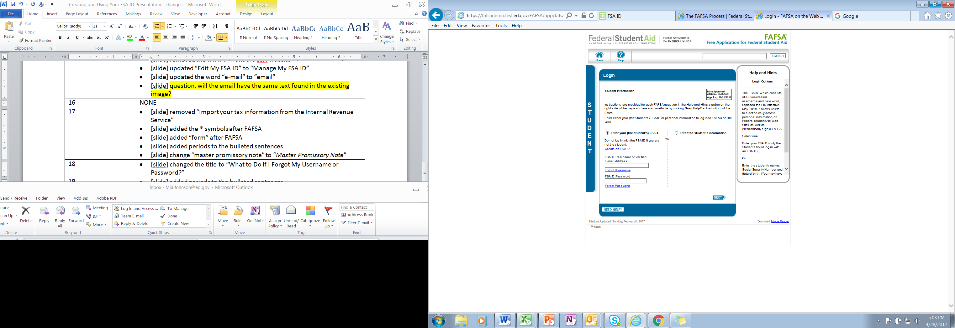
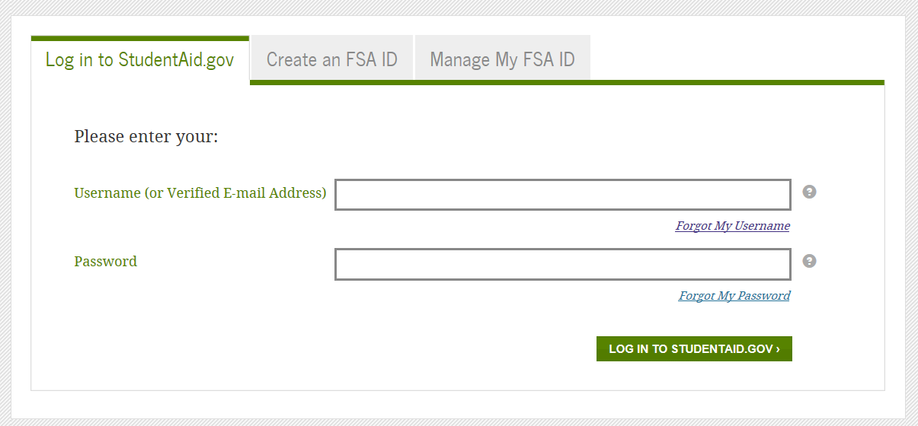
Forgot Username
Select “Forgot My Username” at the log-in screen.
The appearance of the link may vary depending on what website you are visiting.
StudentAid.gov Log-In Screen
20
FAFSA® Log-In Screen

Slide 21
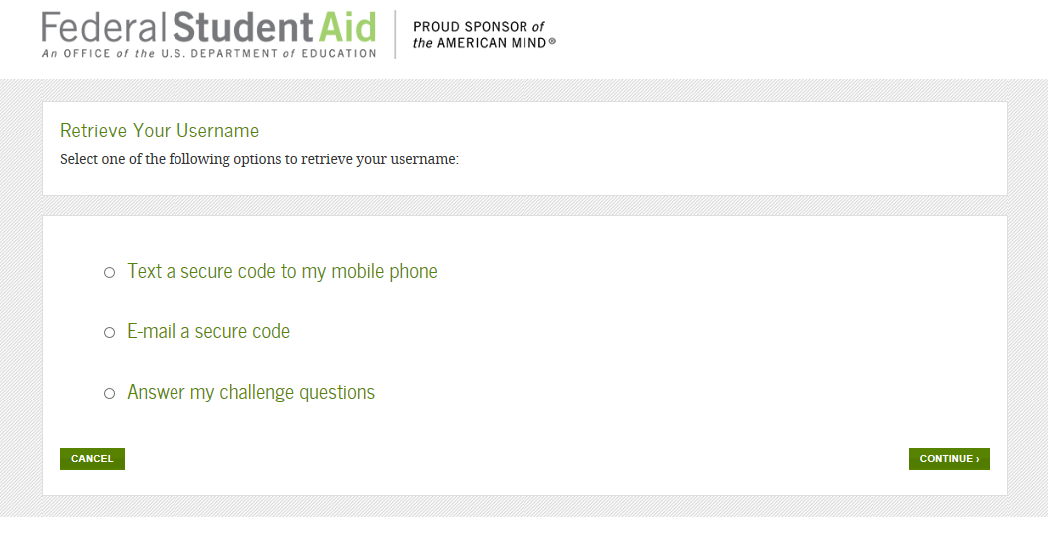
Forgot Username
You can retrieve your username by either
having a secure code texted to you (enter your verified mobile phone number and date of birth),
having a secure code emailed to you (enter your verified email address and date of birth), or
providing personal information and answering your challenge questions (select the “Answer my challenge questions” option and click the “Continue” button).
21

Slide 22
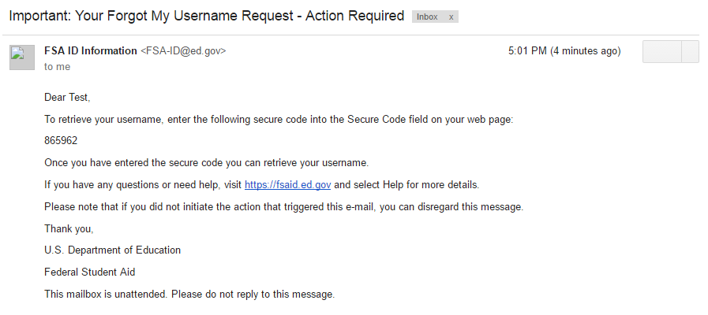
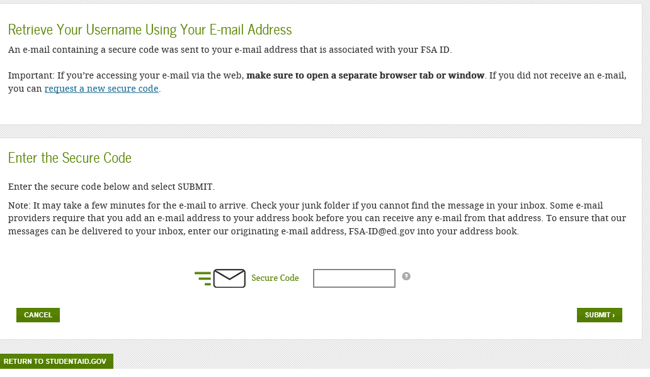
Retrieving Username Using Email Secure Code
If you selected “E-mail a secure code,” an email will be sent to your email account and you will be taken to a page where you can enter a secure code.
Do not close this page!
Open your email in a new browser window or tab or different device and copy the code from your email and enter it into the “Secure Code” box.
Email With Your Secure Code
22

Slide 23
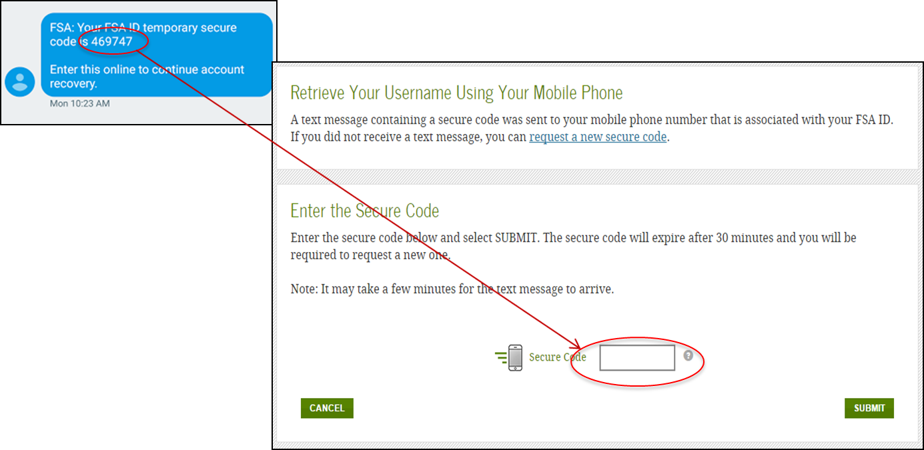
Retrieving Username Using Text Secure Code
If you selected “Text a secure code to my mobile phone,” a text message will be sent to your mobile phone and you will be taken to a page where you can enter a secure code.
Enter the secure code into the “Secure Code” box.
23

Slide 24
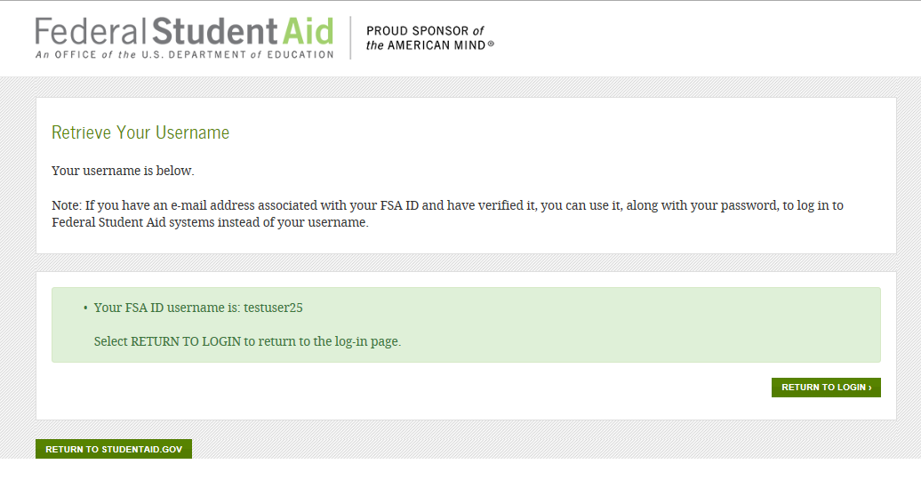
Retrieving Username Using Secure Code
Once you enter the secure code, the screen will display your username.
24

Slide 25
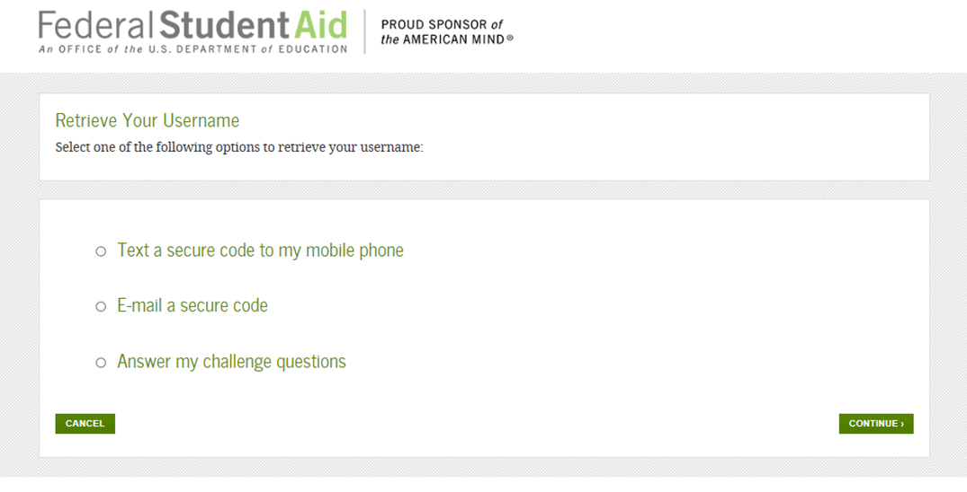
Retrieving Username Using Challenge Questions
If you prefer to retrieve your username by answering your challenge questions, click the “Challenge Questions” button. Then, click the “Continue” button.
25

Slide 26
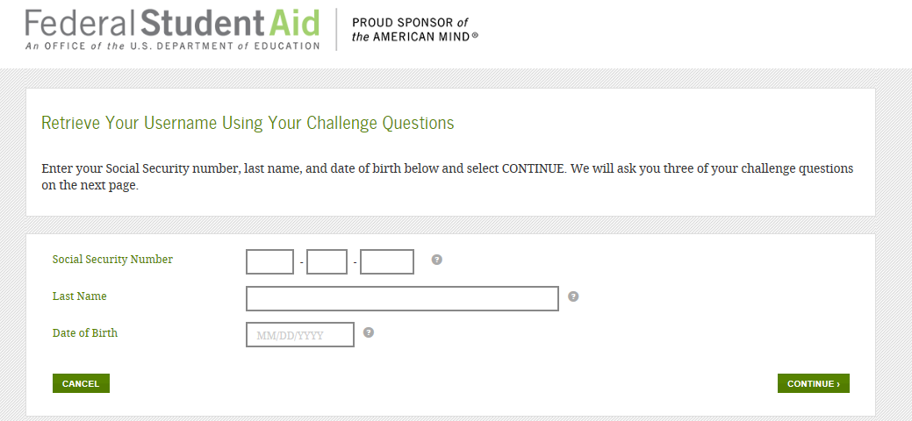
Retrieving Username Using Challenge Questions
If you selected “Challenge Questions,” enter your Social Security number, last name, and date of birth.
26

Slide 27
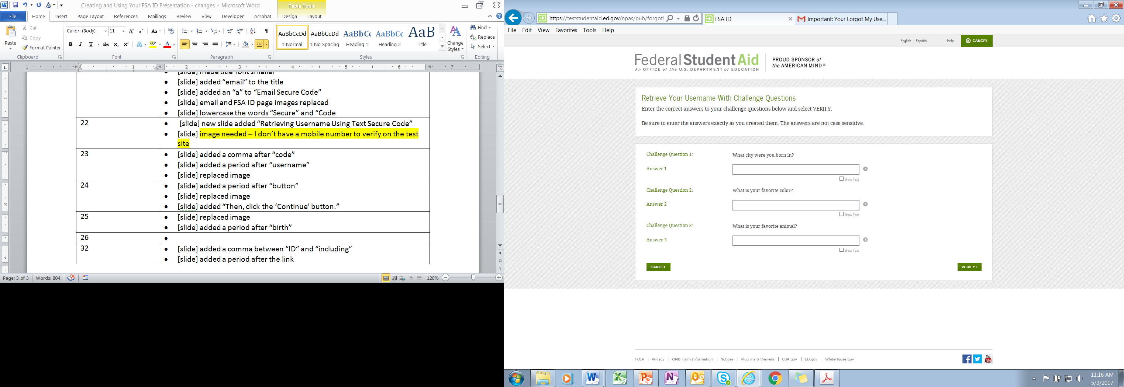
Retrieving Username Using Challenge Questions
You will be taken to a page where you will need to answer three of your challenge questions.
After answering the challenge questions, you will be taken to page that displays your username.
27

Slide 28
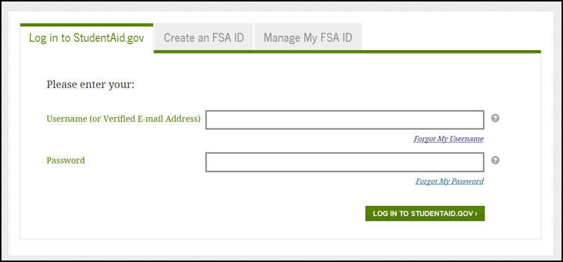
Forgot Password
Select “Forgot My Password” link at the log-in screen.
The appearance of the link may vary depending on what website you are visiting.
StudentAid.gov Log-in Screen
FAFSA® Log-In Screen
28

Slide 29
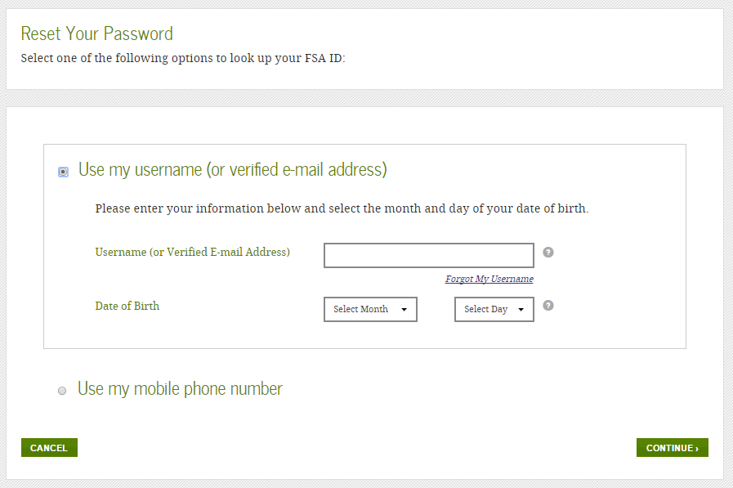
Forgot Password
You can reset your password by providing
your username (or verified email address) and the month and day of your date of birth
or
your verified mobile phone number and the month and day of your date of birth.
29

Slide 30
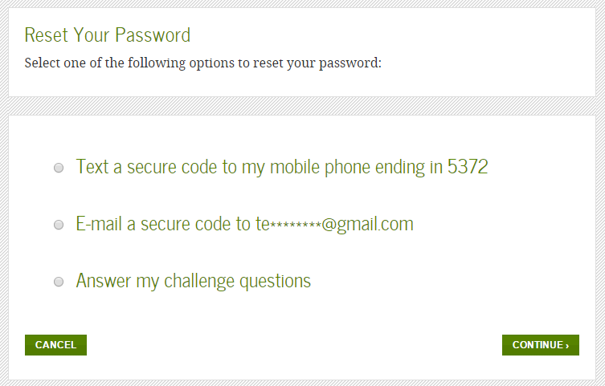
Forgot Password
You can reset your password by
having a secure code texted to you,
having a secure code emailed to you, or
answering your challenge questions.
IMPORTANT
You will need to create a new password.
30

Slide 31
What to do if
you’re locked out
of your account
31

Slide 32
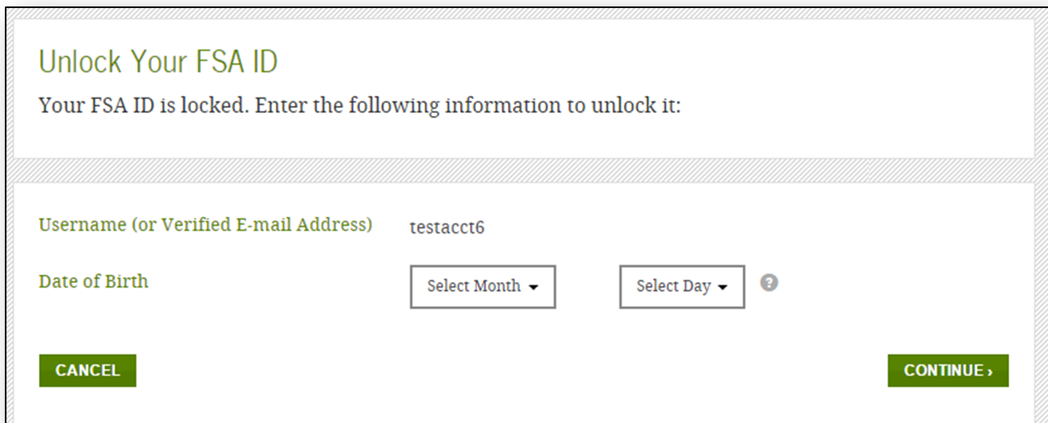
Locked Out
If you’ve been locked out of your FSA ID account for providing the wrong username or password, you will need to provide the date of birth (month and day only) associated with the account to begin the unlock process.
32

Slide 33
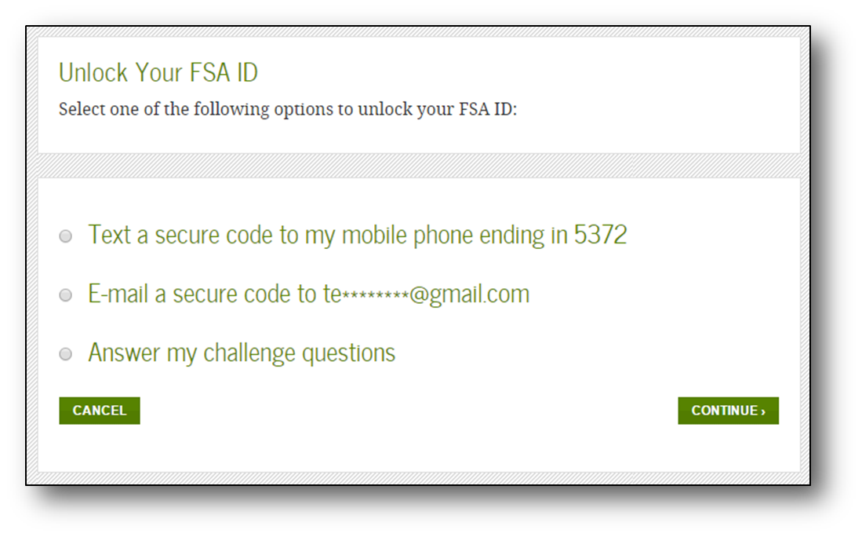
Locked Out
If you have verified your email address or mobile phone number, you can unlock your account using either the email or mobile phone options. Otherwise, you can unlock your account by answering your challenge questions.
33

Slide 34
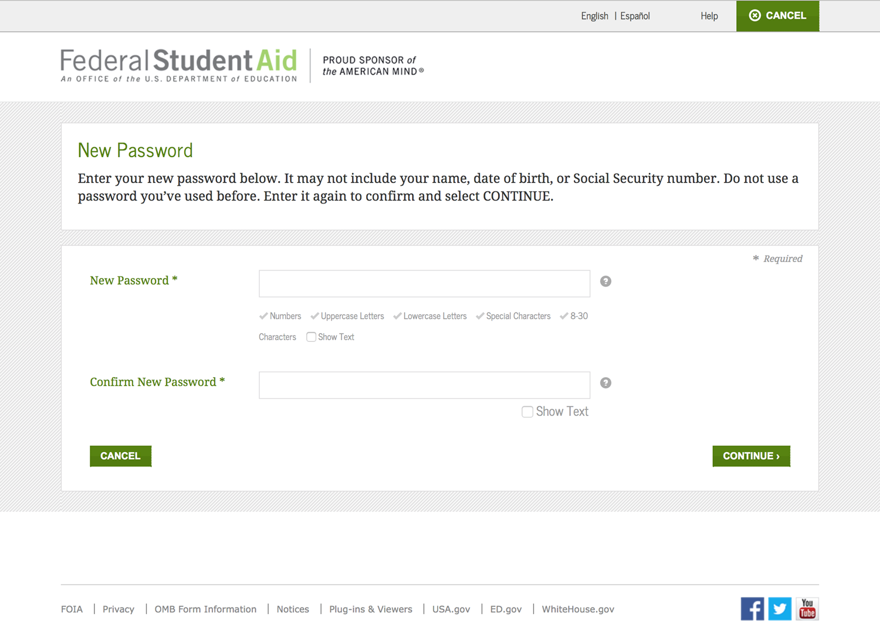
Locked Out
Once you successfully enter the secure code or answer your challenge questions, you will be taken to this screen to change your password.
34

Slide 35
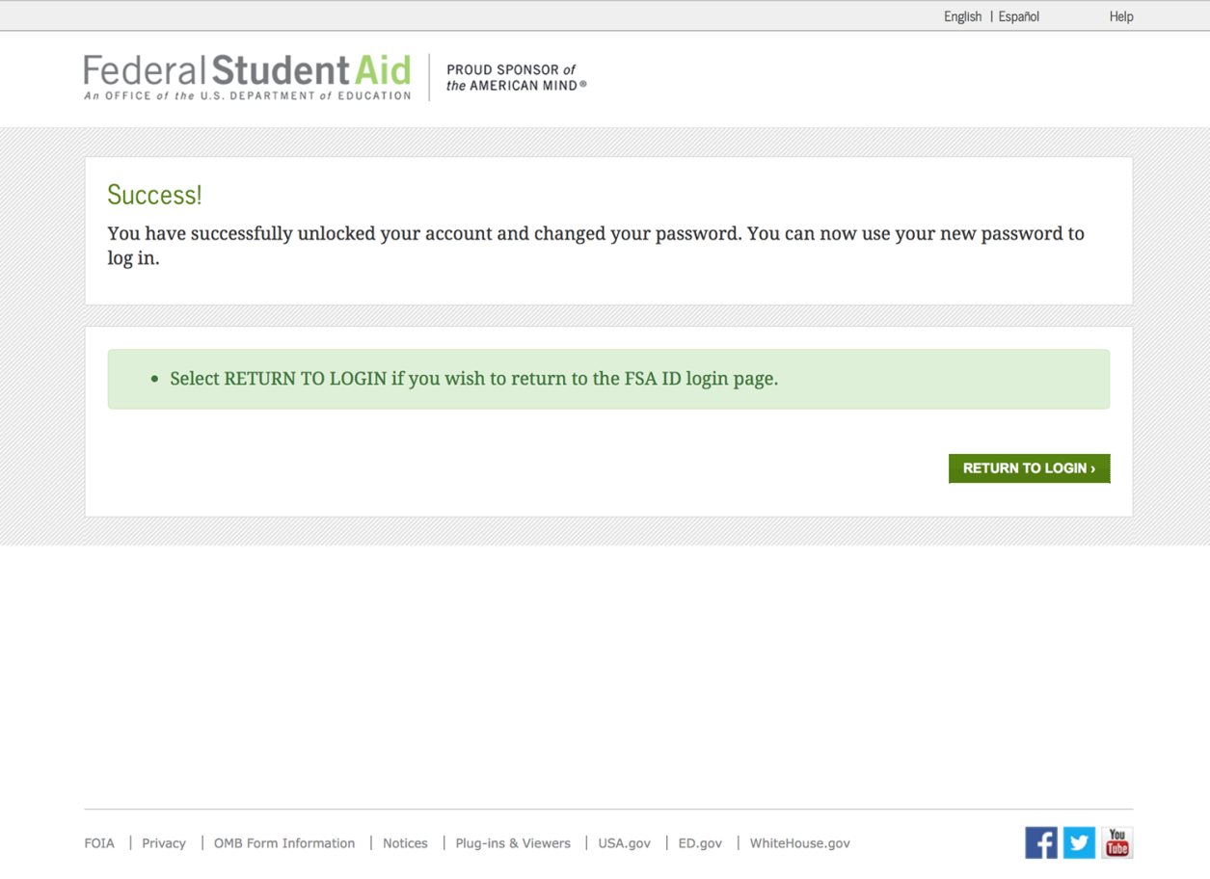
Locked Out
Once you enter a new password and reenter it successfully, you will receive this message.
35

Slide 36
Where to get more information
36

Slide 37
Where to get more information
Additional details on the FSA ID, including answers to frequently asked questions and tips on creating an FSA ID, can be found at StudentAid.gov/fsaid.
37

