Slide 1


Slide 2
In 2001, the District developed a master plan with regard to it’s facilities. As a result of that planning effort, the District embarked on a series of capital improvement projects, The projects included the following –
New Chestnutwold Elementary School 2006
New Manoa Elementary School 2008
Renovations to the Oakmont School Building 2007-2008
Renovations of the Haverford Middle School 2009-2012
New Maintenance Facility 2014

Slide 3
In 2015, Agoos Architecture was engaged to provide the District with information on the condition of the remaining elementary schools.
    Lynnewood Elementary School Built in 1953
    Coopertown Elementary School Built in 1955 / Addition 1990
    Chatham Park Elementary School Built in 1958 / Addition 1991
The assessment indicated that of the three schools, Lynnewood was in need of most attention.
    Both Coopertown and Chatham Elementary school’s mechanical systems were replaced in 1997/1998.
    Coopertown’s windows and Chatham Park’s façade/window system were replaced in 2006.

Slide 4
To address the conditions found at Lynnewood, in 2017 the District engaged CBD, Agoos, Architecture, and Kelly & Close to evaluate options.
Three options were evaluated -
  Renovate the existing Building
  Renovate the existing Building with an addition
  Replace Lynnewood with a new Building
At the January 18th 2018 Board meeting, the results of the study were presented.
At the February 2018 Board meeting, the Board authorized the District to move forward with the design of a new building and approved engaging KCBA as the Architect.

Slide 5
At that same meeting in February, the Board also approved KCBA to reevaluate the condition of the elementary schools - Chatham Park Elementary, Coopertown Elementary - and the High School.
KCBA presented the results of their evaluation in the June 2018 Board Meeting. They reported that the schools were generally in good condition but identified certain items that the District should consider in its capital planning and budget. These included -
  Upgrade the mechanical system at both Coopertown and Chatham Park Elementary schools.
  Replace the roof at Coopertown.
  Upgrade the HVAC controls at the High School

Slide 6
In conjunction with the Building Condition assessment by KCBA, the District had engaged Sundance Associates to perform a Demographic Study to project future enrollment.
The results of this study were also presented in the June Board meeting. Of significance was the enrollment projections for the High School.

Slide 7
At the July 2018 Board Meeting, considering the results of both the Building Assessment and the Enrollment projections, the Board took the following actions -
Engaged KCBA to move forward design and cost estimating to address the forecasted enrollment increases at the High School. The design was limited to schematic level.
Authorized the District Facility Team to address the upgrades to the mechanical systems at Chatham Park and Coopertown; the roof replacement at Coopertown; and, the upgrade to the High School HVAC control system.

Slide 8
High School Projected Timeline
Nov 15 KCBA presents to the Board the schematic design and cost estimates At this meeting we will Request Board approval to move forward with the design based on KCBA proposed fee of 7% of the schematic cost estimate.
Assuming Board authorizes the design to move forward –
Design and Land Development
Bid
Construction with occupancy of Phase I 2021 and Phase II 2022

Slide 9
Lynnewood Projected Timeline
Oct 25 Planning Commission
Nov 01 Zoning Hearing
Nov 06 KCBA and CBD update the PTO
Nov 15 Seek Board approval to advertise for the Act 34 Hearing
TBD ACT 34 Hearing
Dec 20 KCBA issues construction documents for pricing
Feb 07 KCBA presents final construction documents and budget
Request Board authorization to advertise to Bid
Apr 04 Present Bid results
Request Board approval to award Contracts for Construction
Jun 2019 Construction starts on site
Sep 2021 School opens

Slide 10
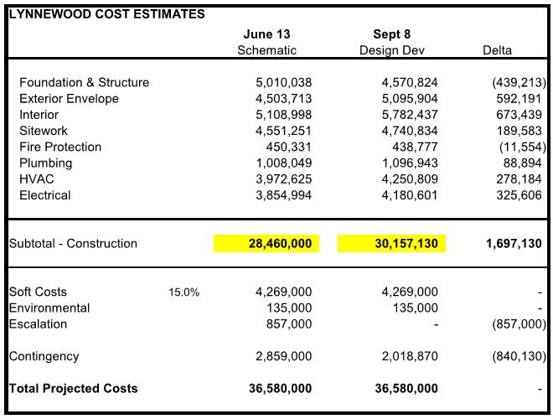
Lynnewood Budget Update

Slide 11
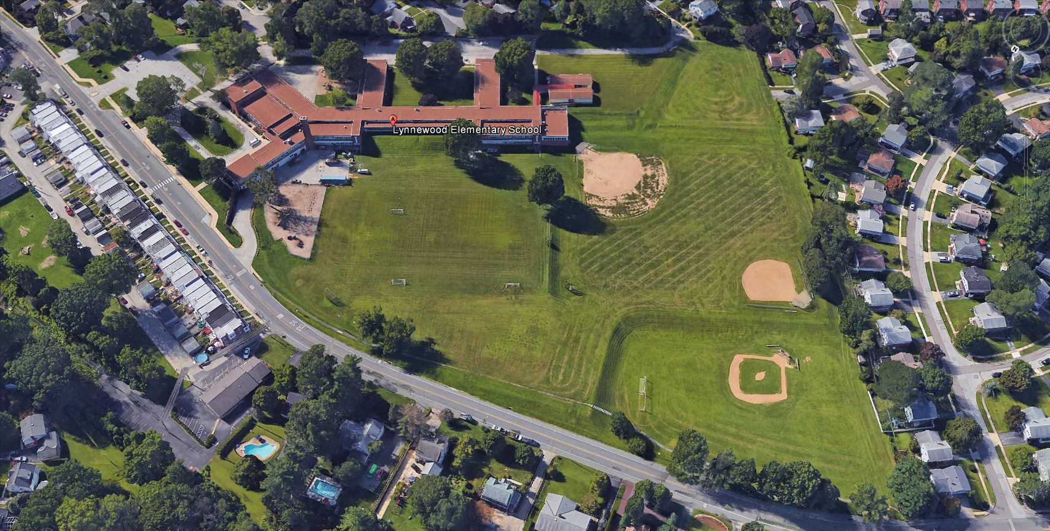
Lynnewood Elementary School Update

Slide 12
Lynnewood Elementary School
Actions since last Update
Zoning & Planning Commission Submissions [End of September]
Review with Township Fire Marshall [9/17]
District IT Meeting [9/18]
Teacher and Staff Meetings [9/21]
District Administration Project Review [10/15]
Food Service Meeting [10/18]

Slide 13
Lynnewood Elementary School
Act 34 Hearing
The board will authorize advertisement for the Act 34 Hearing on 11/15 and advertise for at least 20 days before the hearing.
At the hearing, the project will be presented along with project financing and a public commenting period will follow after the presentation.
The Act 34 booklet will be available for view at the district administration building by appointment.

Slide 14
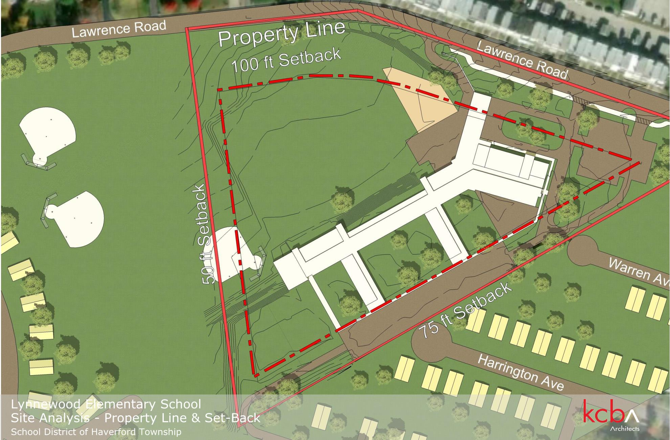

Slide 15
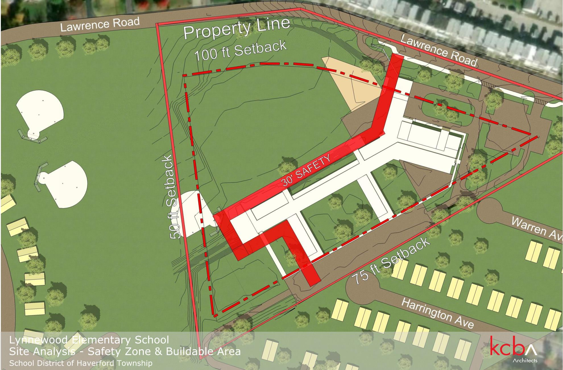

Slide 16
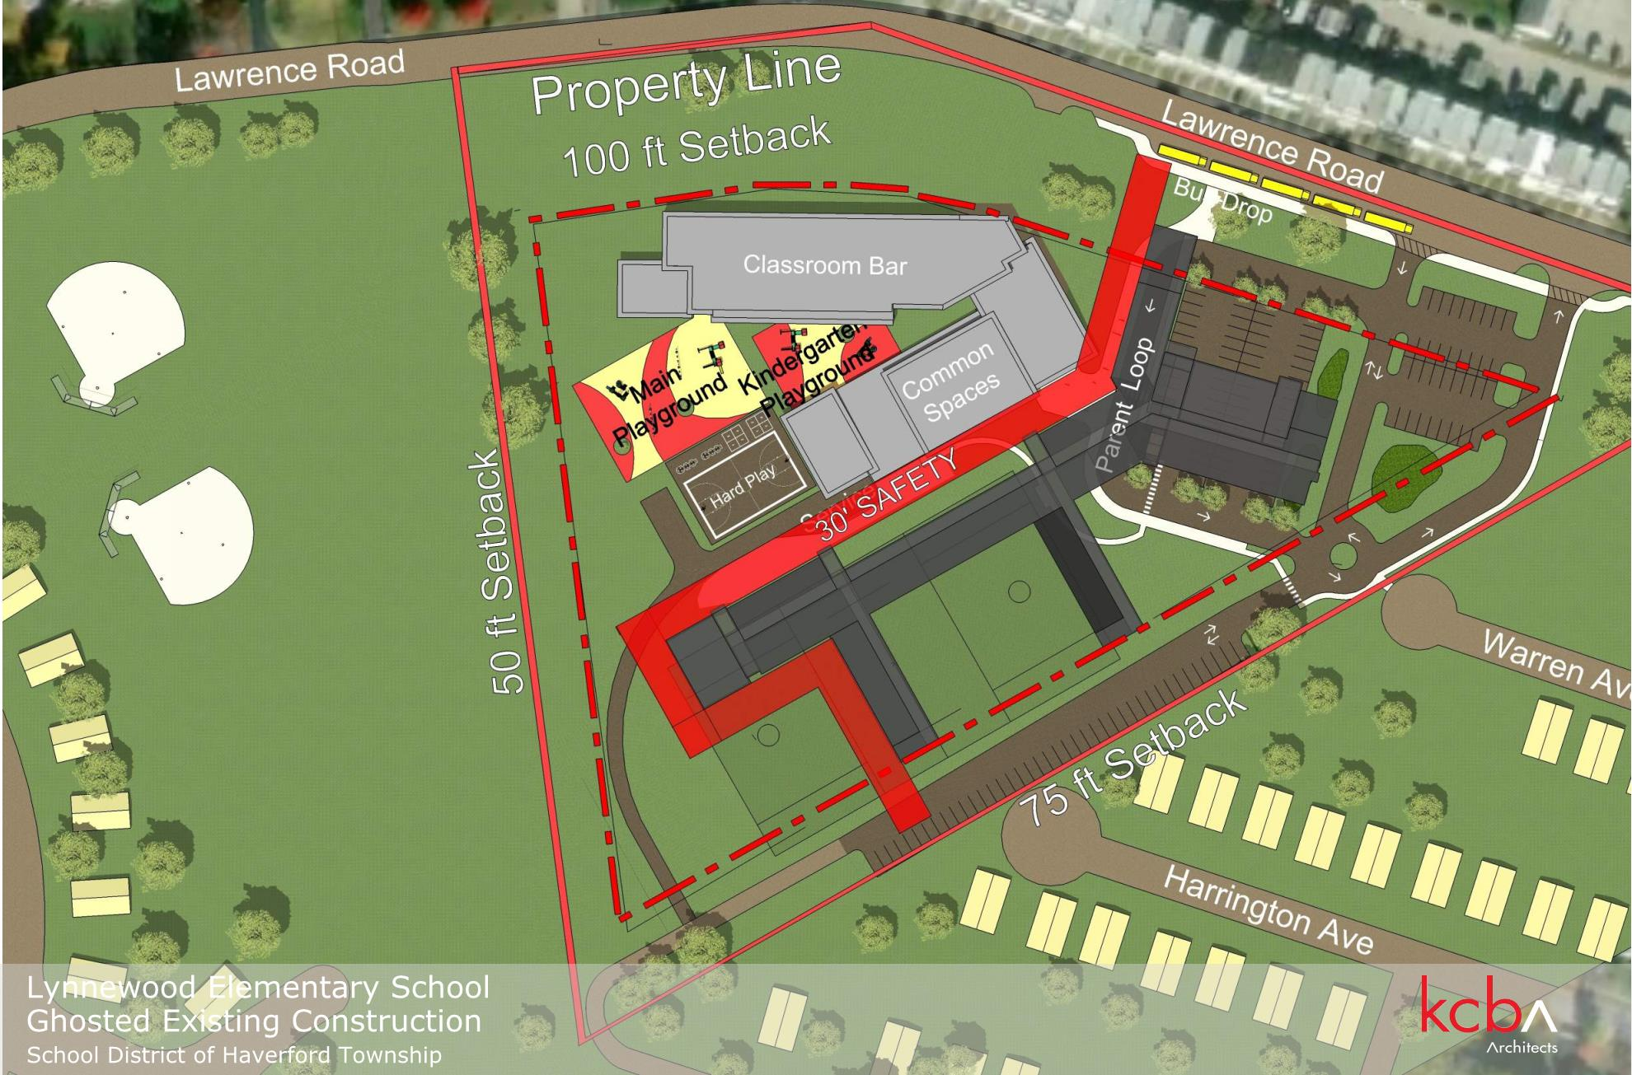

Slide 17
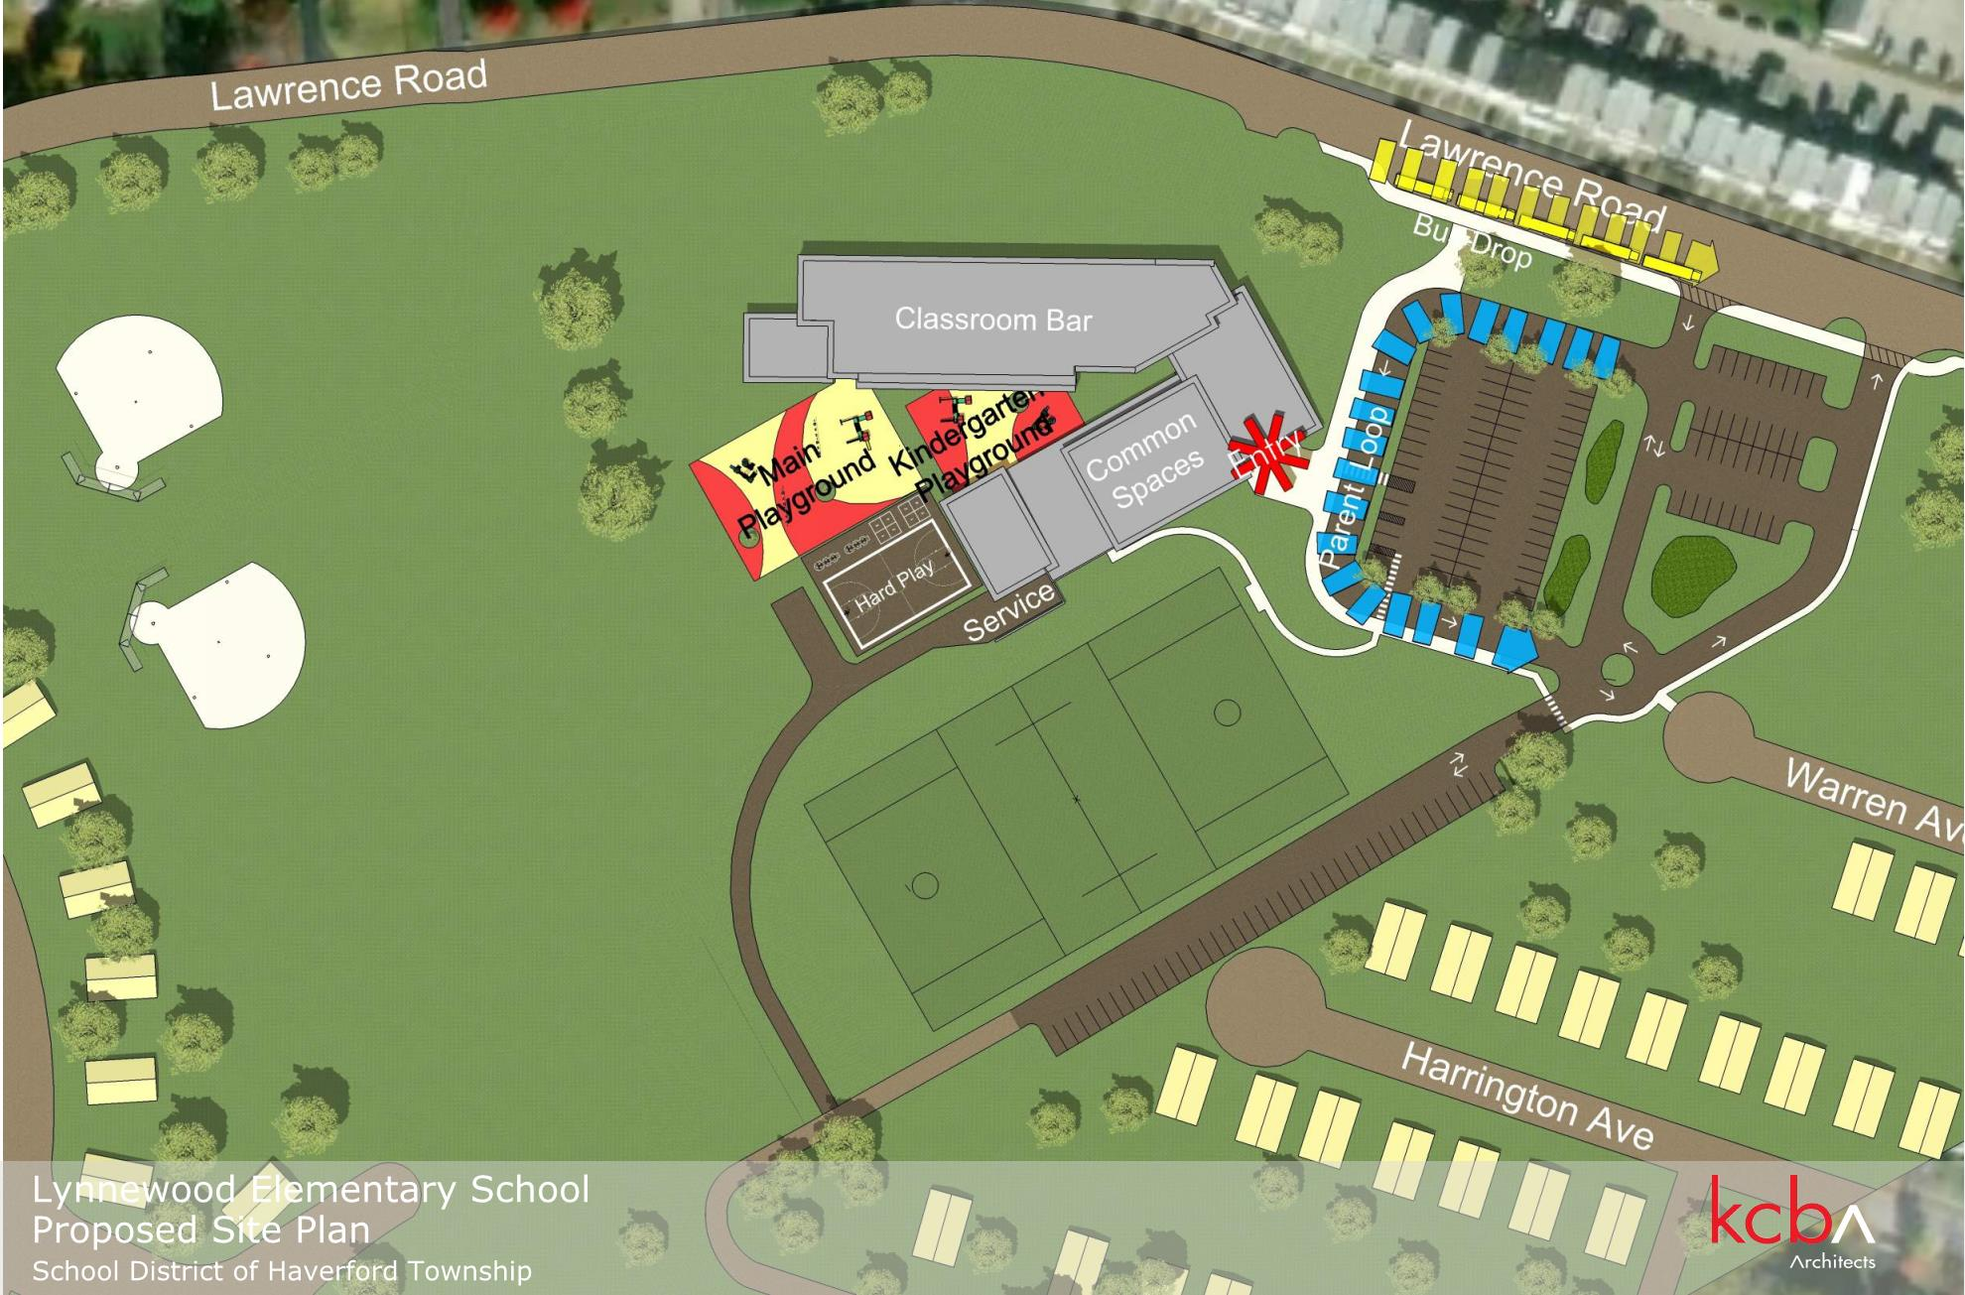

Slide 18
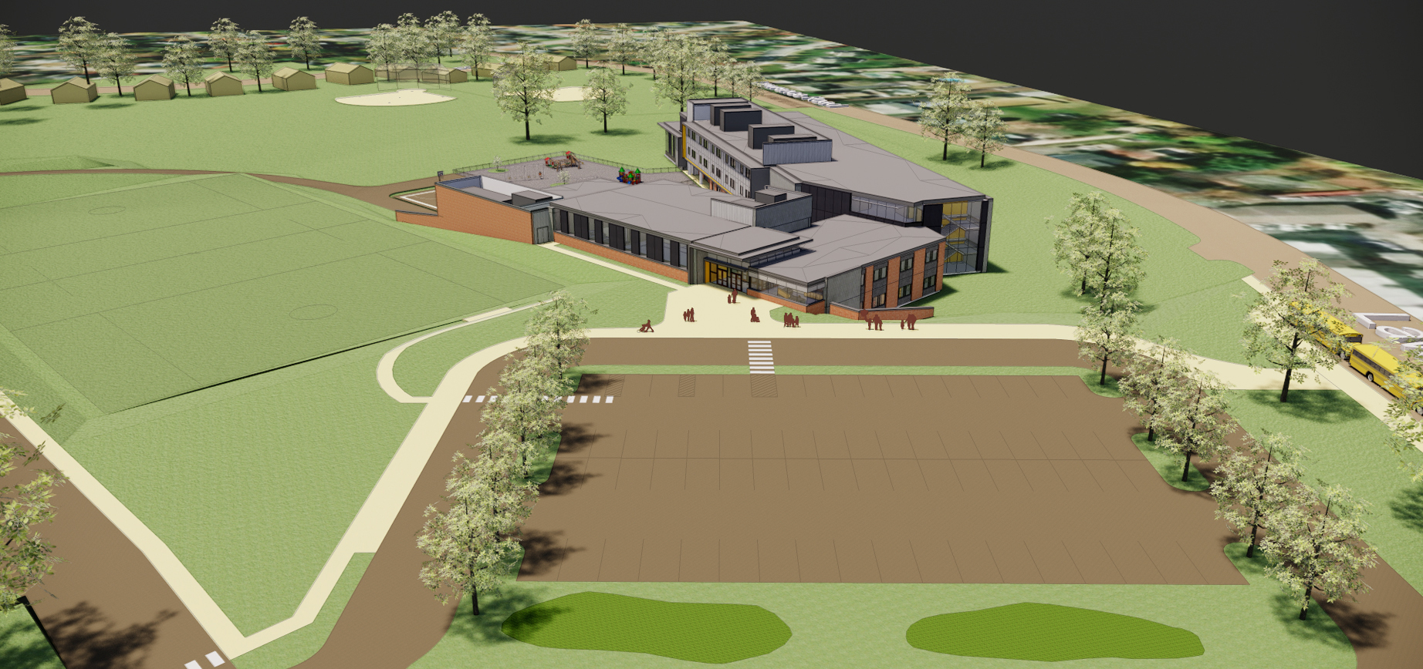
Front entrance Birdseye View

Slide 19
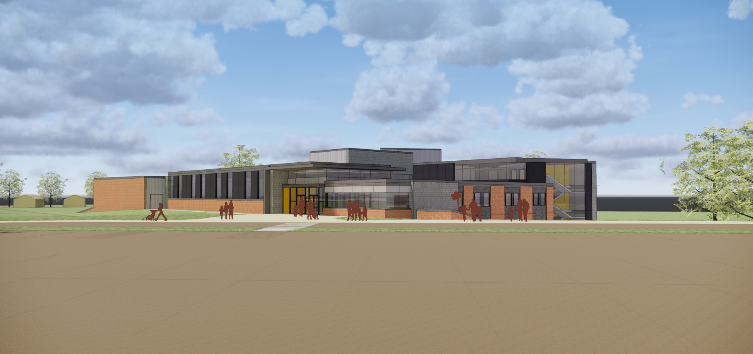
Front entrance exterior

Slide 20
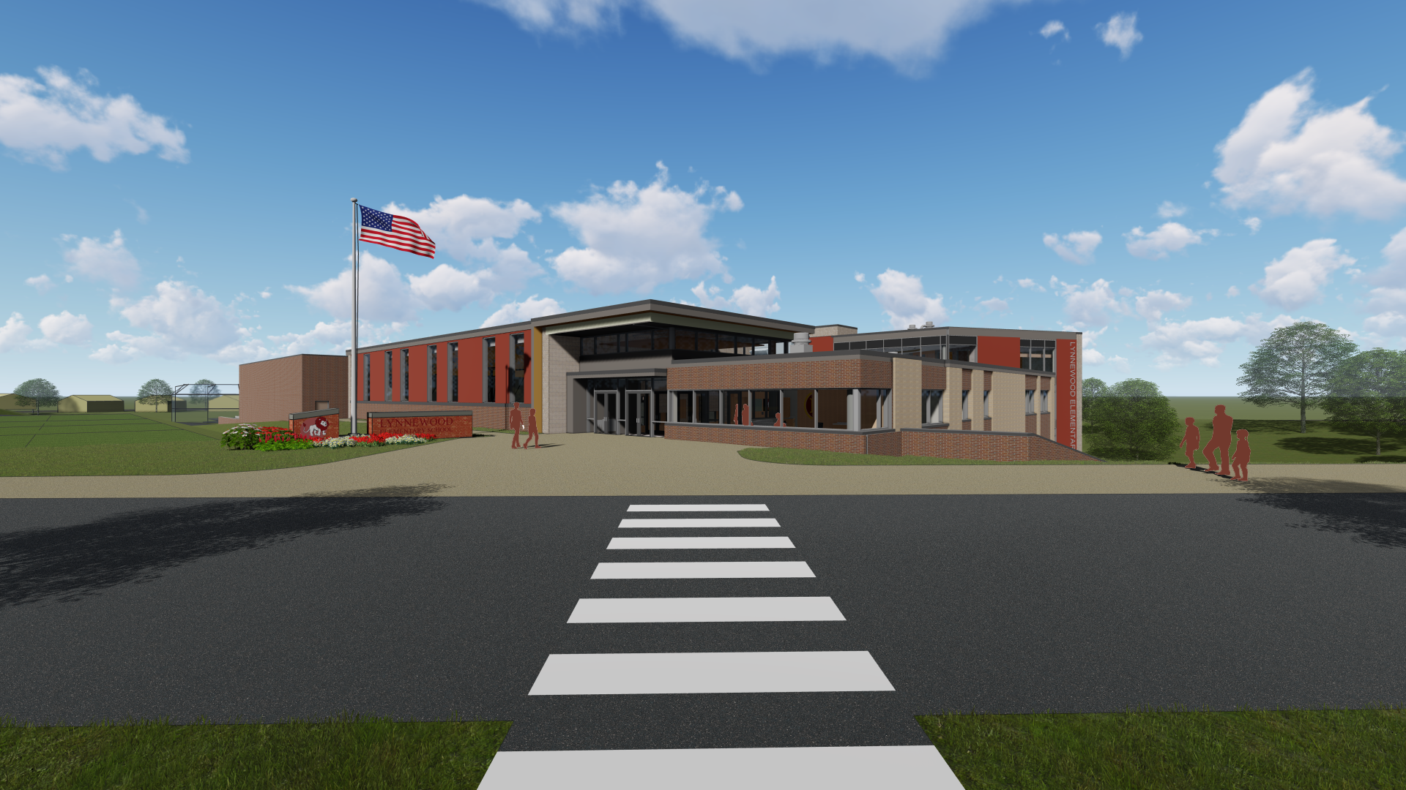
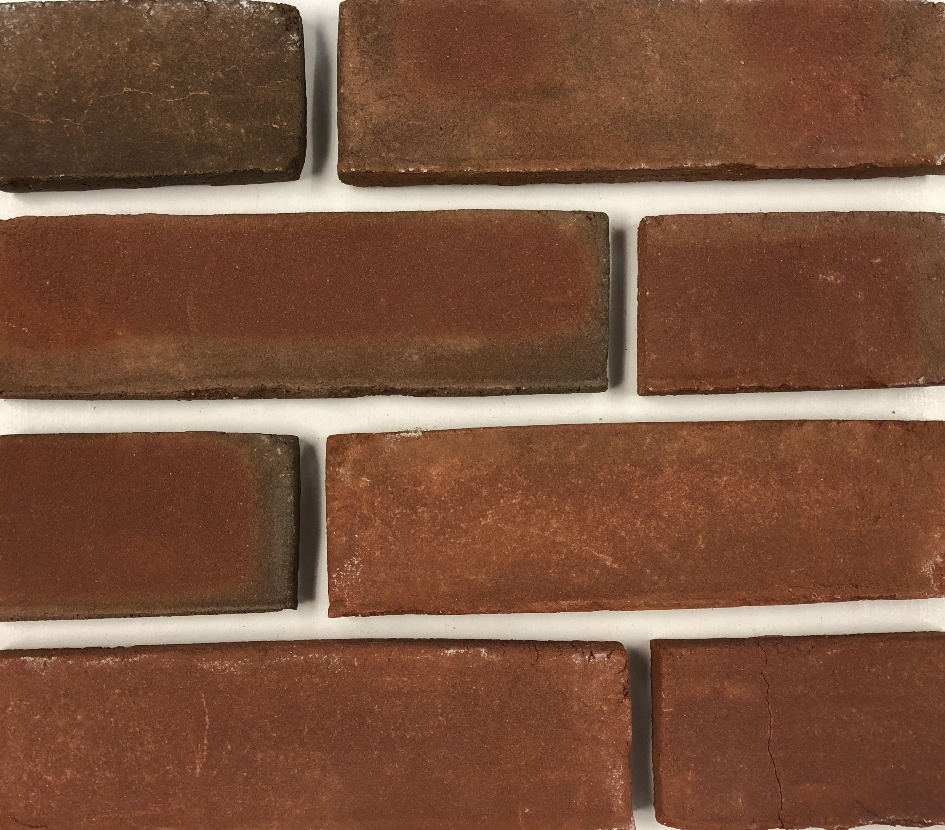
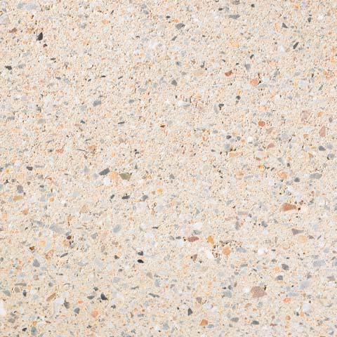

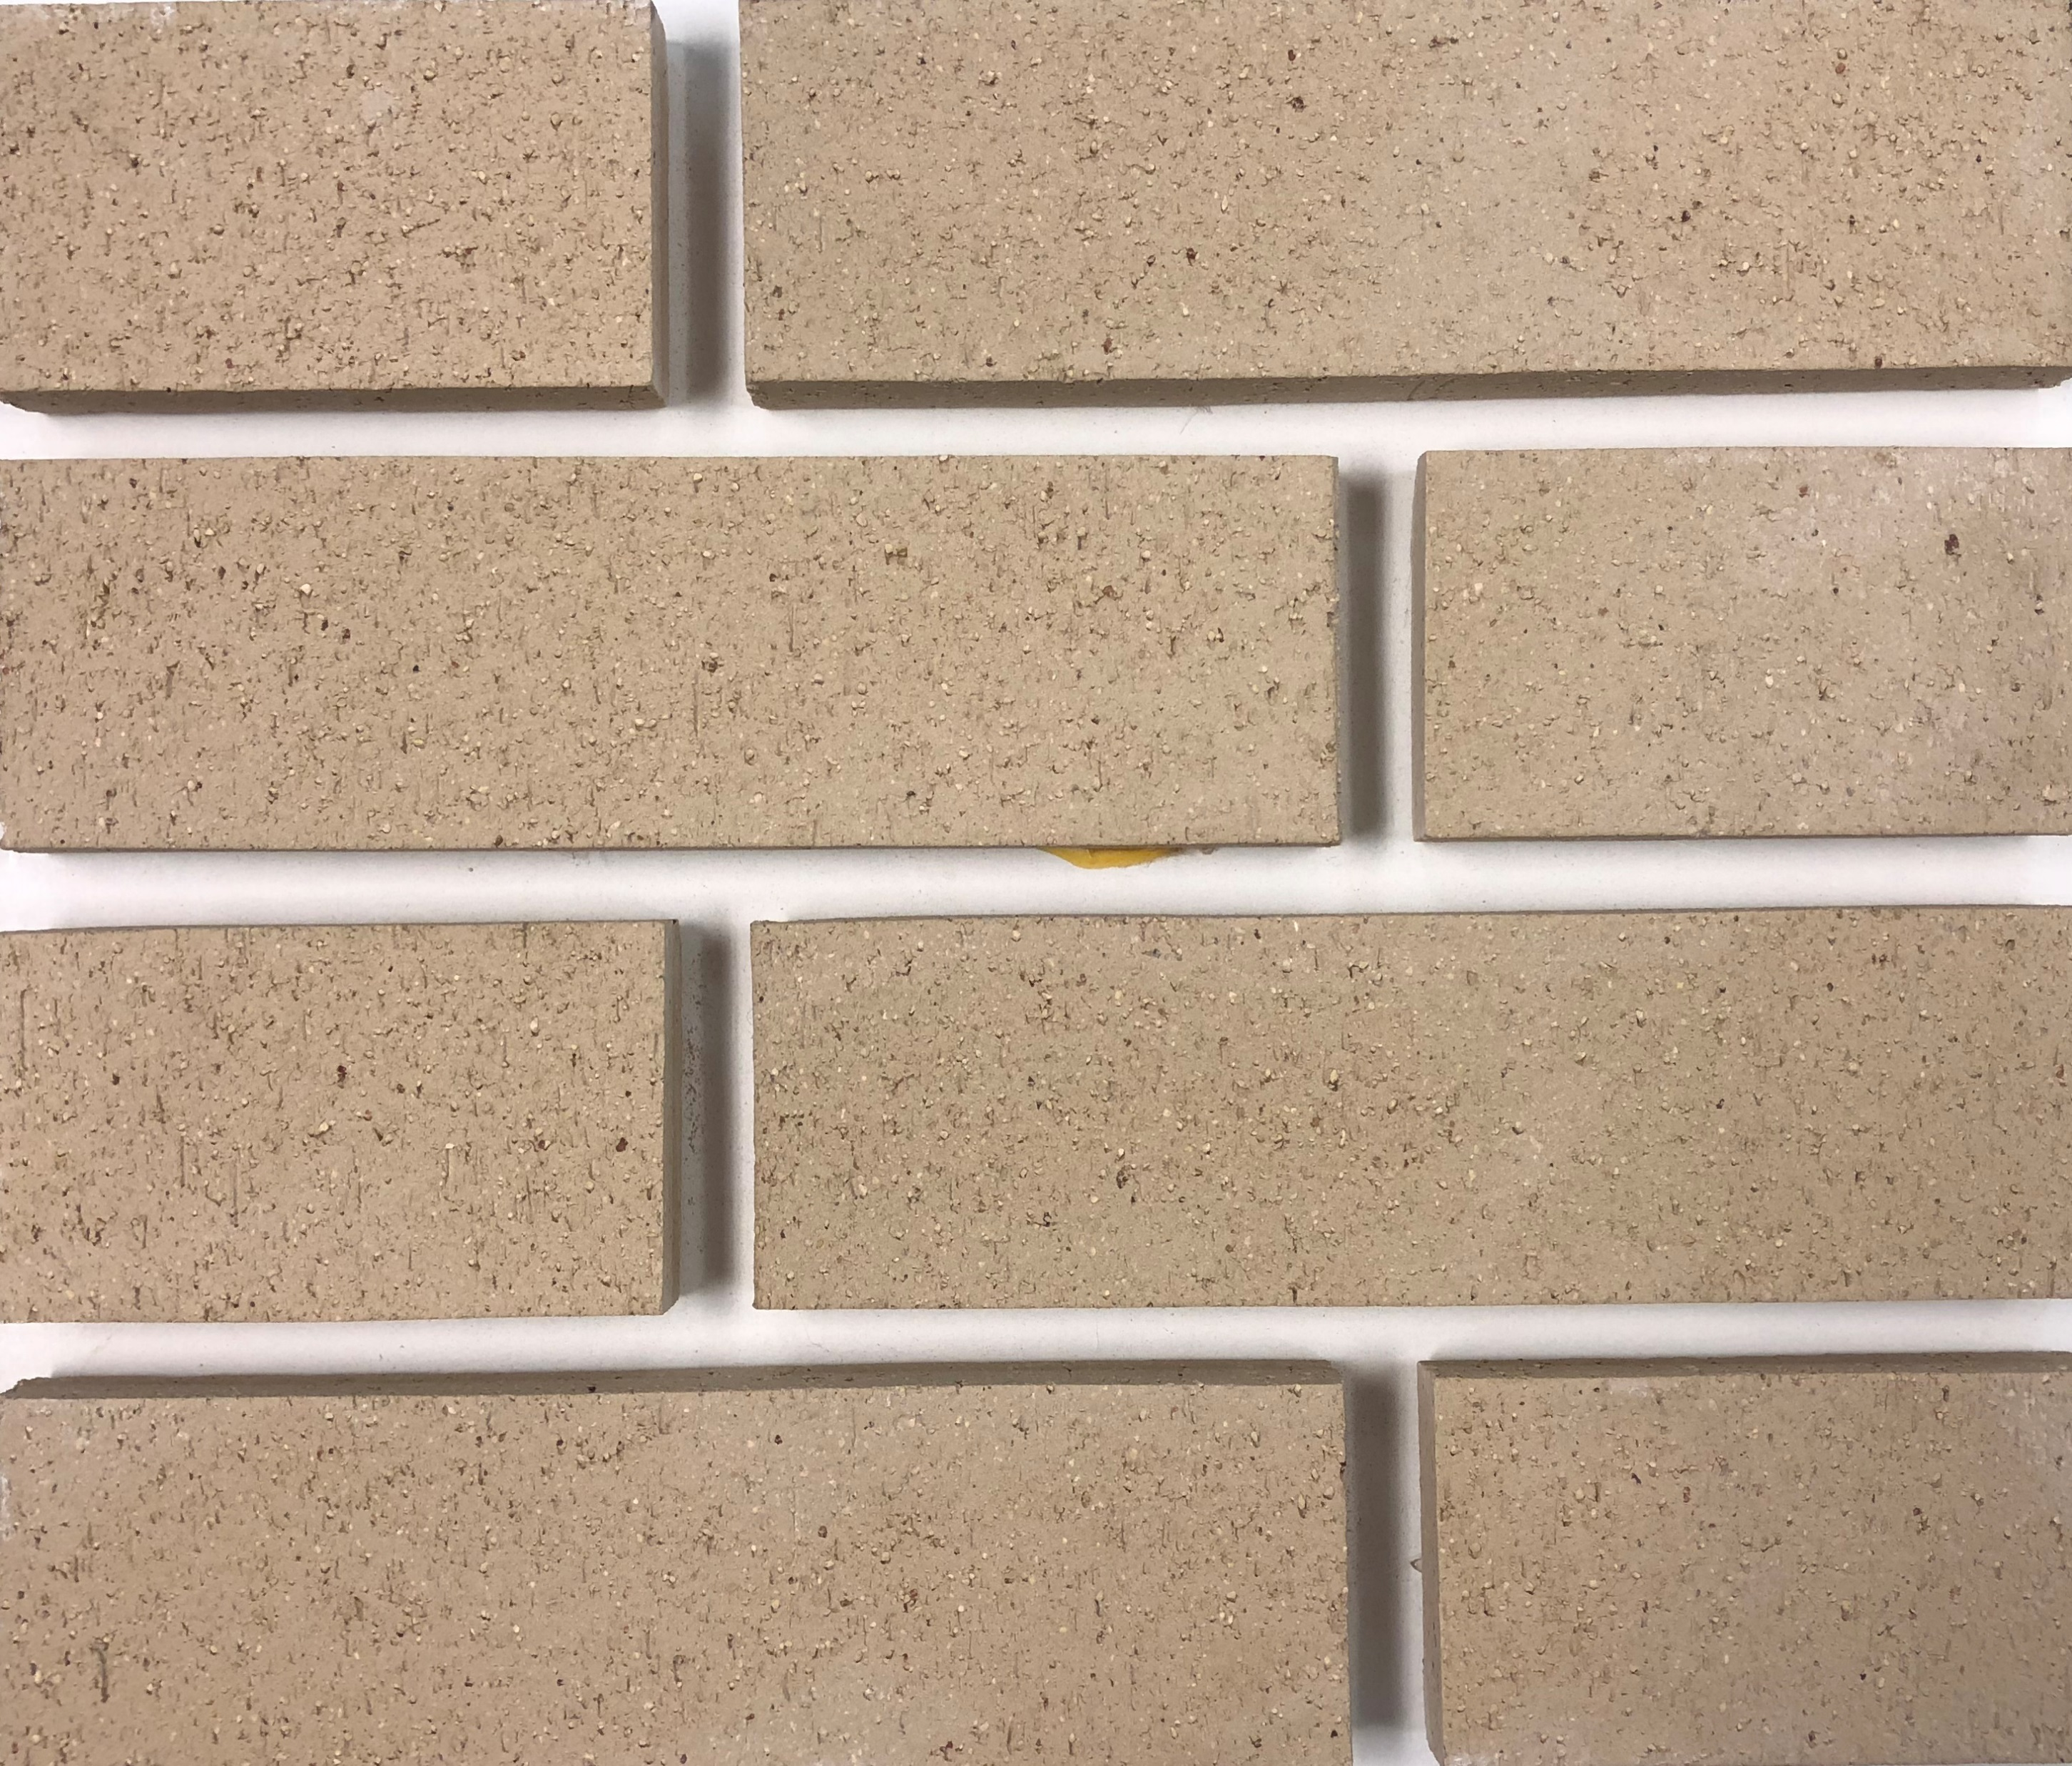
Red Brick
Masonry
Metal Panel
Accent
Light Brick
Front entrance exterior

Slide 21
EXTERIOR animation

Slide 22
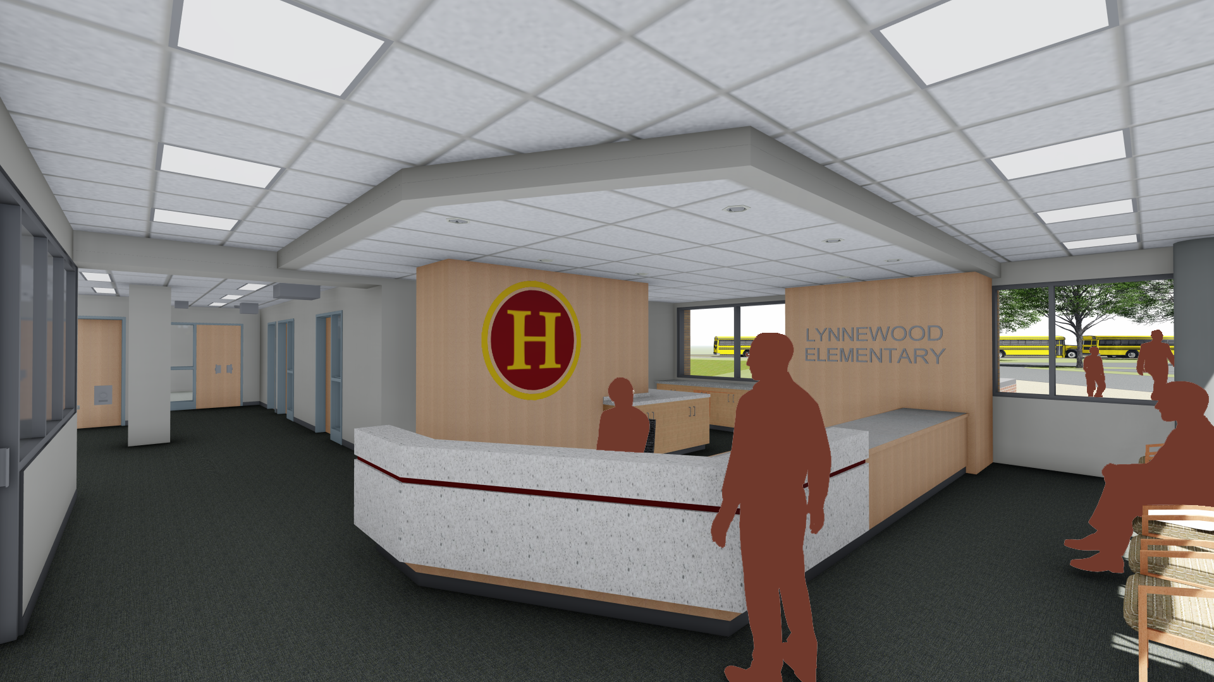


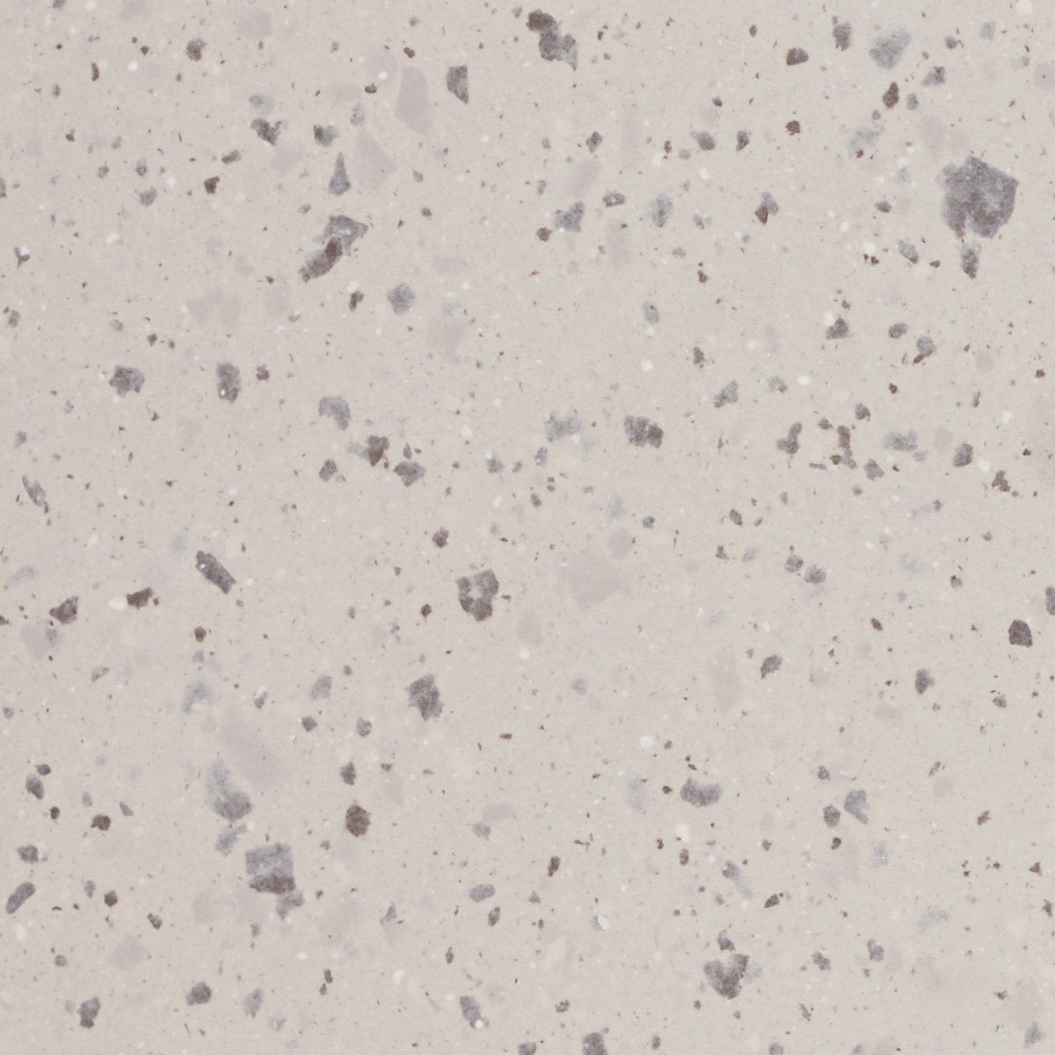
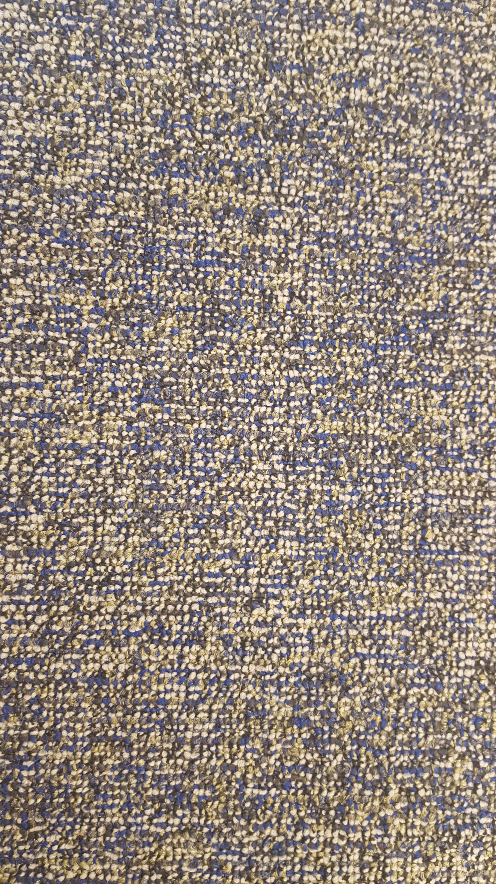
Maple Wood Veneer
Transaction Countertop
Low Countertop
Carpet Tile
Reception & Main Office

Slide 23
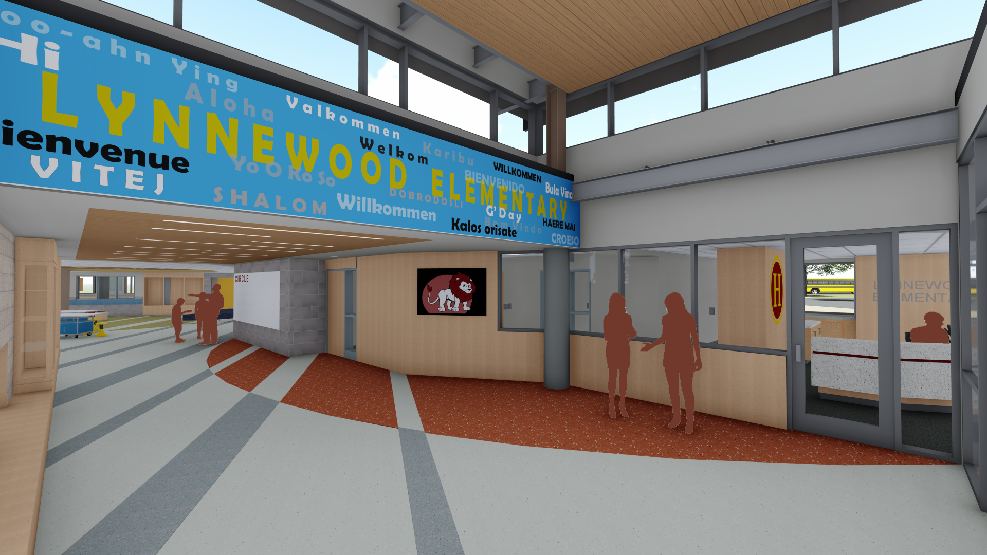


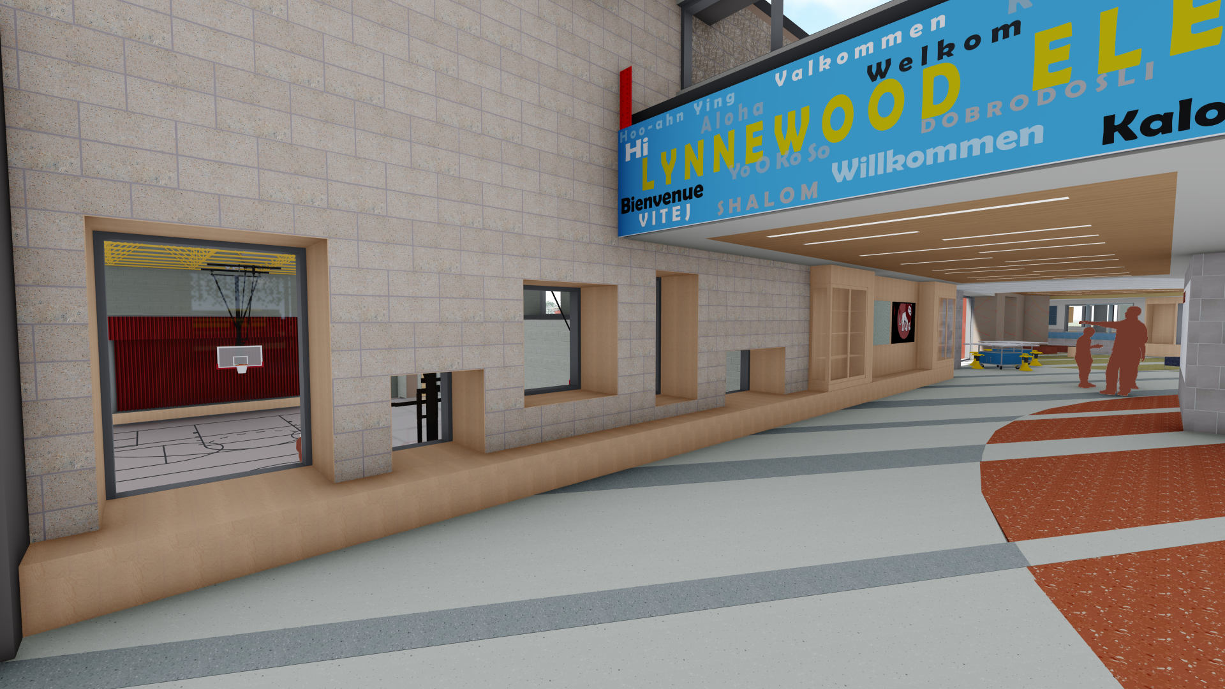
Quartz Tile
Digital Wall Covering
Masonry
MAIN LOBBY
Maple Wood Veneer

Slide 24
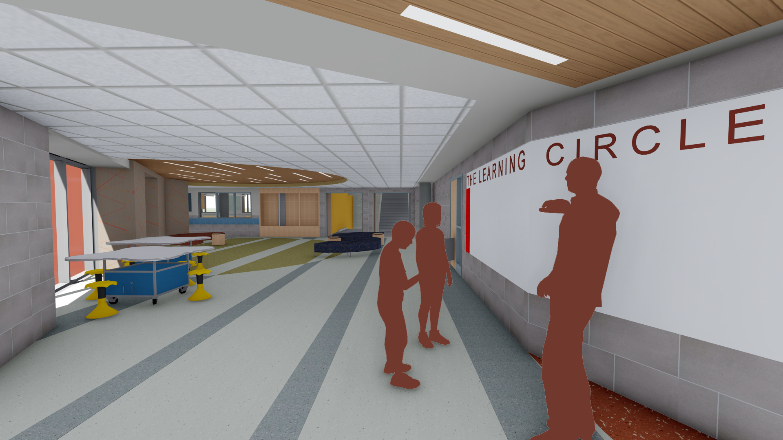

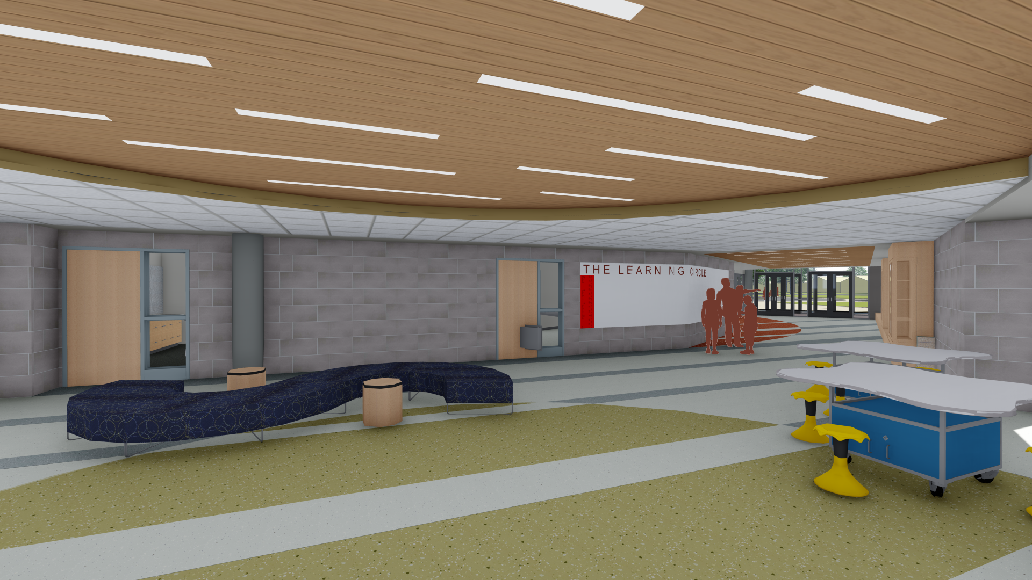

Quartz Tile
Frameless
Markerboard
Wall Paver Tile
The Learning Circle
Maple Wood Veneer

Slide 25
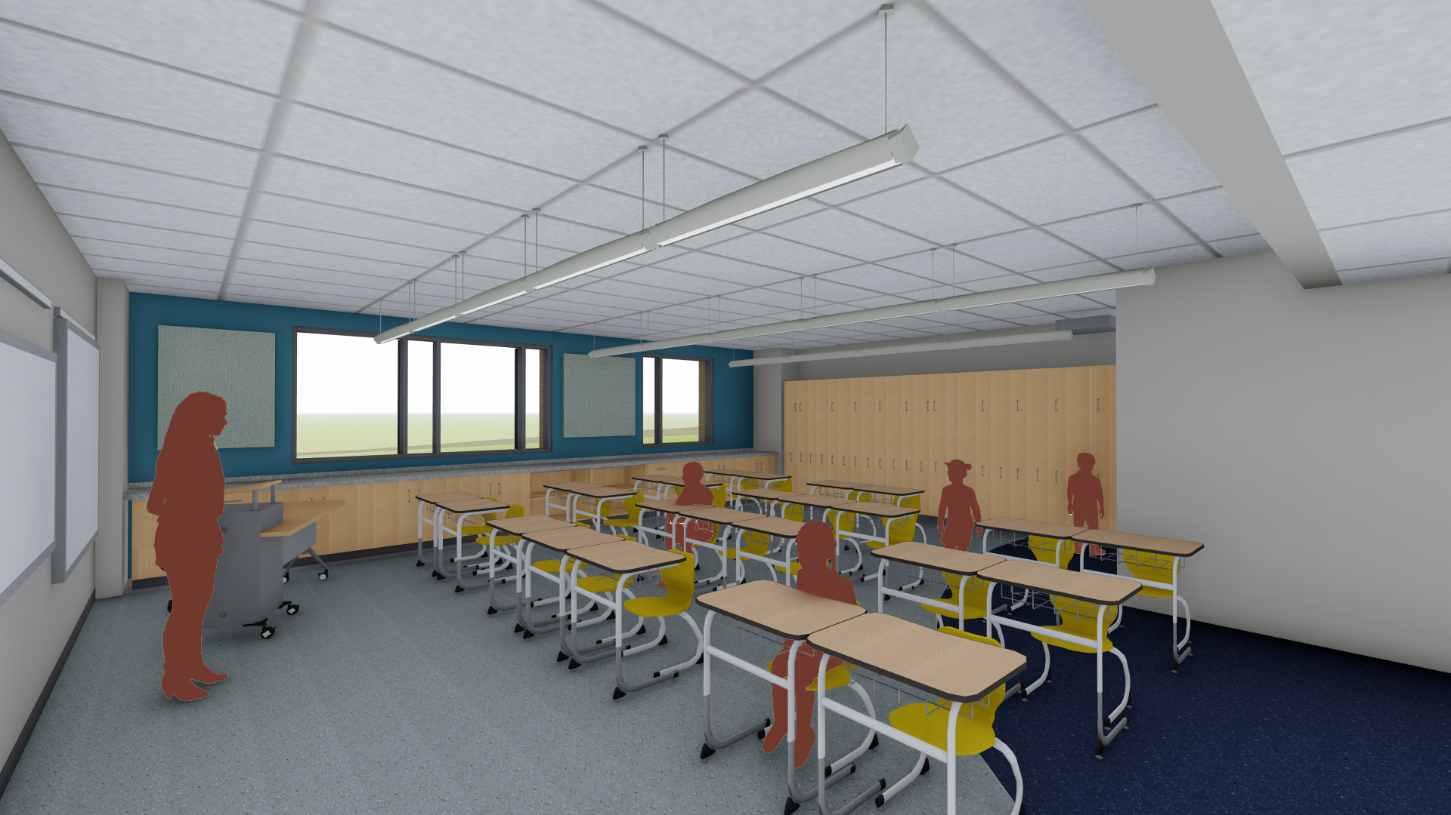


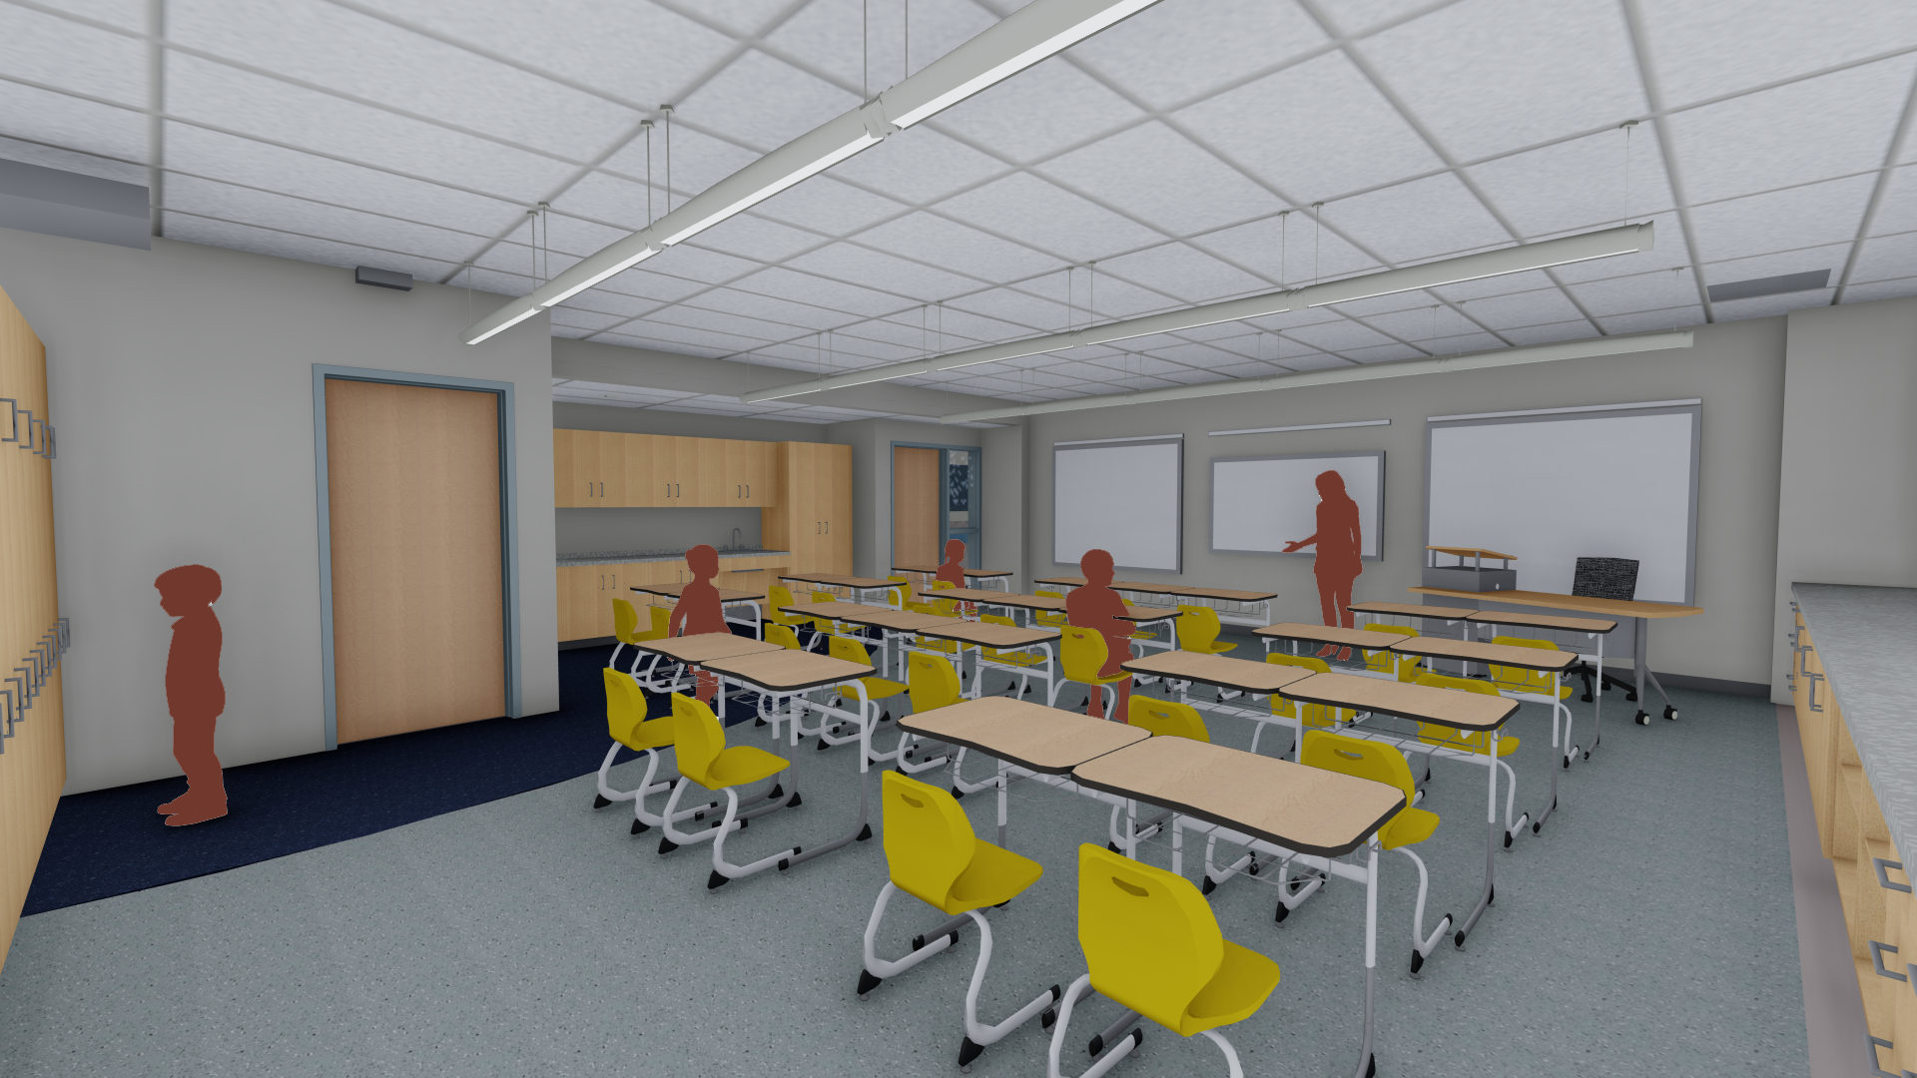


Maple Wood Veneer
Accent
Quartz Tile
Accent Paint
Classroom
Laminate Countertop

Slide 26
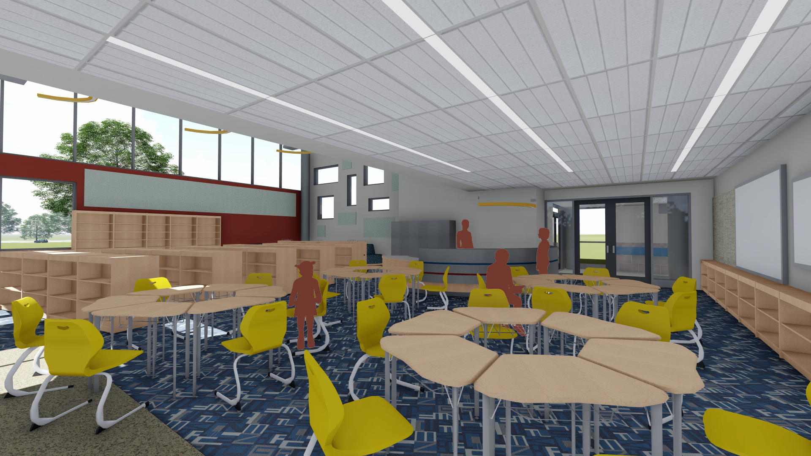
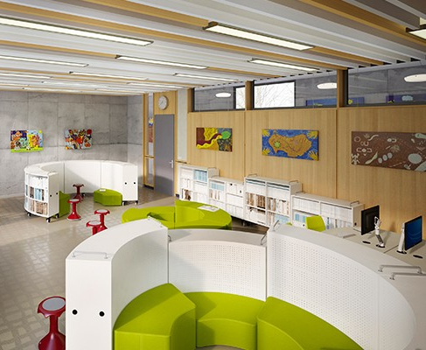

Moveable Shelving
Library
Carpet Tile

Slide 27
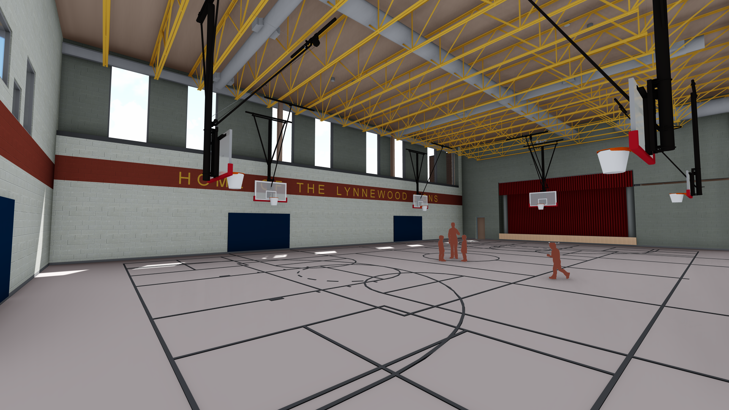


Mondo Sports Flooring
Accent Stripe
Painted Structure
Gymnasium

Slide 28
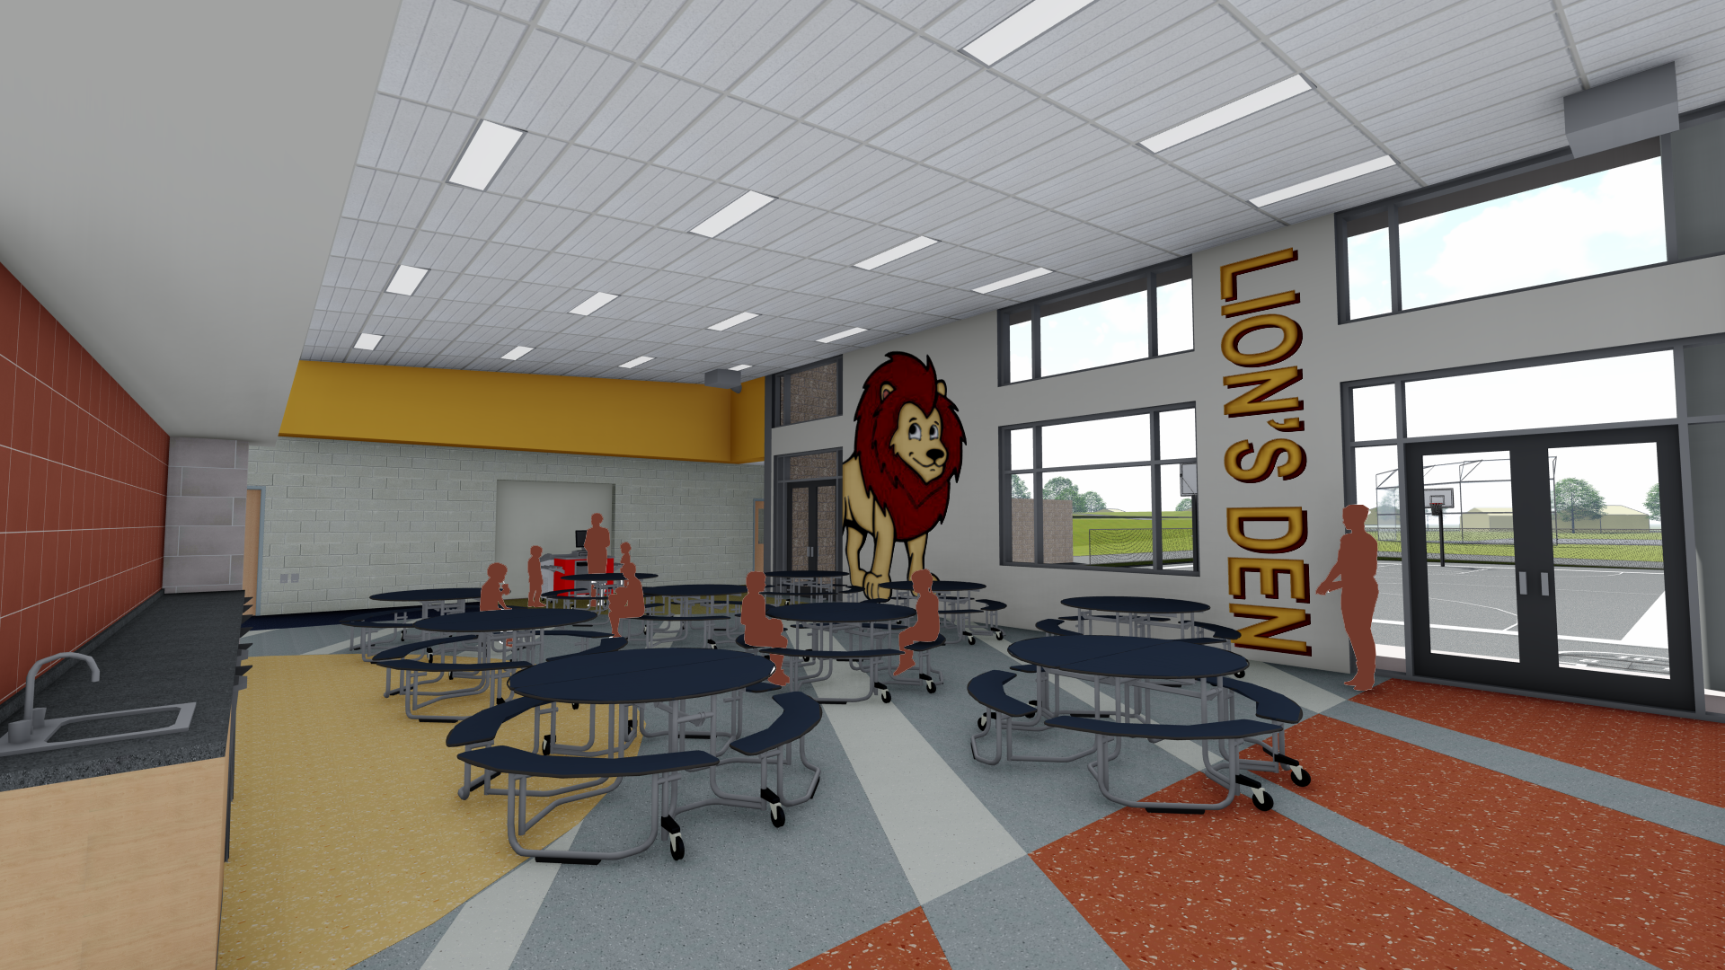


Countertop
Quartz Tile
Paver Wall Tile
CAFETERIA

Slide 29
Interior animation

Slide 30
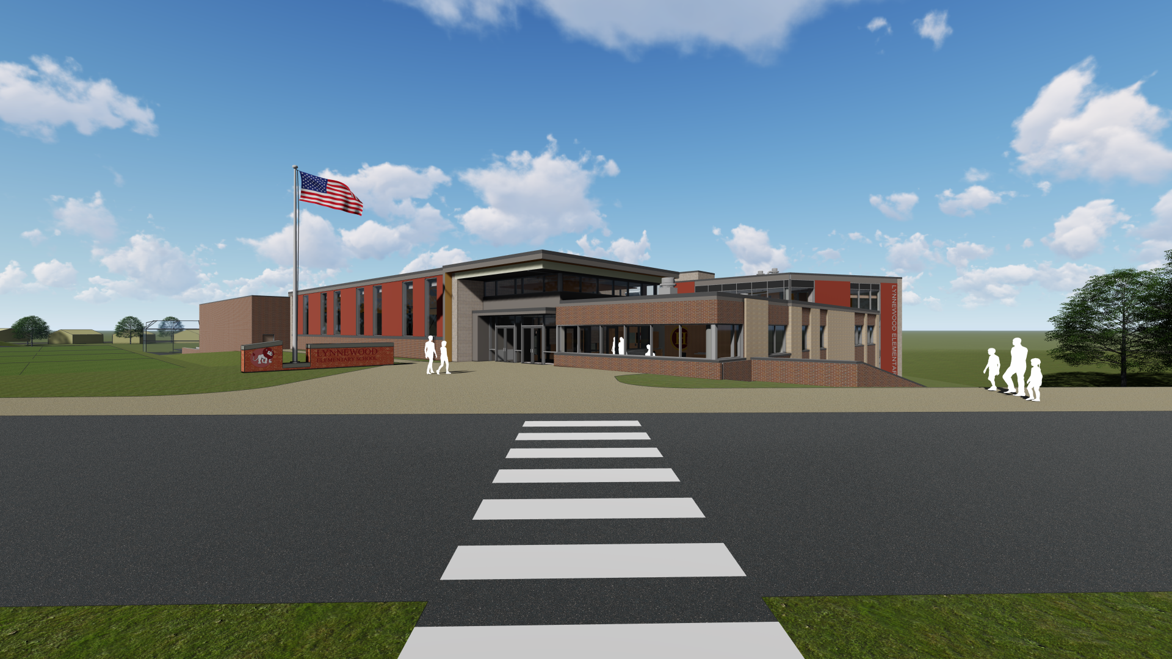
Questions

