Slide 1


Harassment, Intimidation, Bullying (HIB) Prevention
Schools Have A Duty to Protect ALL Students.
Schools must take reasonable steps to guard against HIB.
It’s the law. Schools must take their responsibility to address bullying very seriously.
Harassment, Intimidation, and Bullying Prevention Committee
Northshore School District 2011

Slide 2
Objectives
What is Harassment, Intimidation, Bullying (HIB)
  Physical? Verbal? Cyberbullying?
What does HIB look like?
What is the district policy on HIB?
What are your responsibilities as a district employee?
What should you do when you see HIB?

Slide 3
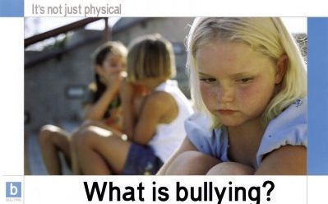
When you see it happening … it’s happening:
Harassment is Intimidation and Bullying
Intimidation is Bullying and Harassment
Bullying is Harassment and Intimidation

Slide 4

What is HIB?
"A person is bullied when he or she is exposed, repeatedly and over time, to negative actions
on the part of one or more other persons,
and he or she has difficulty defending himself or herself."
This definition includes three important components:
1. Bullying is aggressive behavior that involves unwanted, negative actions.
2. Bullying involves a pattern of behavior repeated over time.
3. Bullying involves an imbalance of power or strength.
- Olweus Bullying Prevention

Slide 5
Washington State Definition of HIB
Physically harms student or property.
Substantially interferes with student’s education.
So severe, persistent, or pervasive that it creates an intimidating or threatening educational environment.
Has the effect of substantially disrupting orderly operation of school.

Slide 6
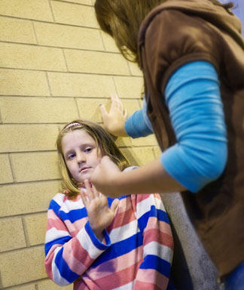


What does HIB look like?
Bullying can be…
direct or indirect

Slide 7
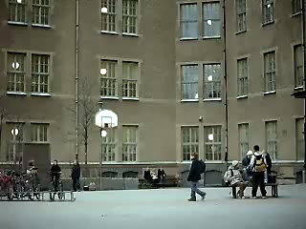

Direct Bullying
physical aggression such as: shoving and poking, throwing things, slapping, choking, punching and kicking, beating, jabbing, pulling hair, scratching, biting, tripping, groping, pants-ing, pinching
hurtful teasing, obscene gestures, name-calling
video bullying.org

Slide 8


Indirect Bullying
spreading gossip, lies, rumors, silent treatment,
staring, laughing at or mocking, deliberate exclusion, bullying others who socialize with the target, criticizing the target's manner of dress, race, religion, perceived sexual orientation, disability, appearance, height, weight, inciting others to bully the target, set-ups, intentional provoking
cyberbullying via mobile device, text, or computer

Slide 9
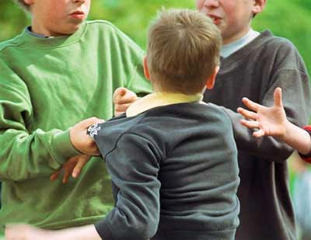

Teasing vs Bullying?
Duration
  how long?
  intensity
Power
  power of the bully, vulnerability of the victim, lack of support and the severity of consequences to the victim.
Intent to harm
Video Concerned Children's Advertisers
http://cca-kids.ca

Slide 10
Definition of Cyberbullying
“Cyberbullying is bullying through email, instant messaging (IM-ing), chatroom exchanges, website posts, or digital messages or images sent to a cellular phone or personal digital assistant (PDA) (Kowalski et al. 2008). Cyber bullying, like traditional bullying, involves an imbalance of power, aggression, and a negative action that is often repeated.”
- Olweus Bullying Prevention

Slide 11
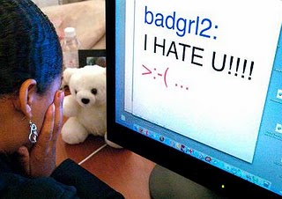
Forms of Cyberbullying
Harassment
Repeatedly sending offensive, rude, and insulting messages over digital media.
Center for Safe and Responsible Internet Use (CSRIU)

Slide 12

Forms of Cyberbullying
Denigration
Distributing information about another that is derogatory and untrue by posting it on a
web page
Sending it to others through email or instant messaging
Posting or sending digitally altered photos of someone
Center for Safe and Responsible Internet Use (CSRIU)

Slide 13
Forms of Cyberbullying
Flaming
online "fighting" using electronic messages with angry, vulgar language
Example:
Matt and Sam have gotten into an online argument about an incident that occurred at school. Each message has gotten angrier and more vulgar. Insults have been flying. In the latest exchange, Matt warned Sam to watch his back in school the next day.
- Center for Safe and Responsible Internet Use (CSRIU)

Slide 14
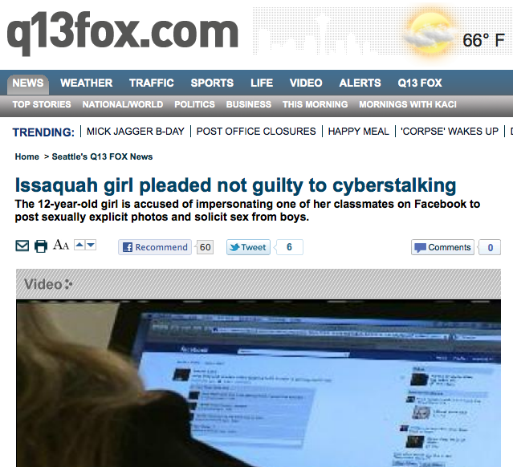
Forms of Cyberbullying
Impersonation:
breaking into an email or social networking account and using that person's online identity to send or post vicious or embarrassing material to/about others.
Center for Safe and Responsible Internet Use (CSRIU)

Slide 15

Forms of Cyberbullying
Outing and Trickery
Sharing someone's secrets or embarrassing information, or tricking someone into revealing secrets or embarrassing information and forwarding it to others
Center for Safe and Responsible Internet Use (CSRIU)

Slide 16

Forms of Cyberbullying
Cyber Stalking
Repeatedly sending messages that include threats of harm or are highly intimidating, or engaging in other online activities that make a person afraid for his or her safety (depending on the content of the message, it may be illegal)
Center for Safe and Responsible Internet Use (CSRIU)

Slide 17
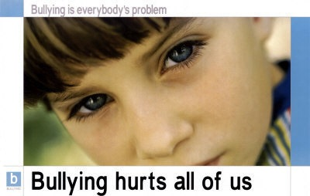
Effects of Bullying on Targets
The effects of bullying can be serious and even fatal. Targets of bullying (children and adult) are at risk of:
stress-related illness, emotional and
behavioral problems, loneliness, depression and anxiety, low self-esteem, weight loss or weight gain,
and even, suicide or self harm
#1 Peer Risk Factor for being bullied – Lack of close friends

Slide 18
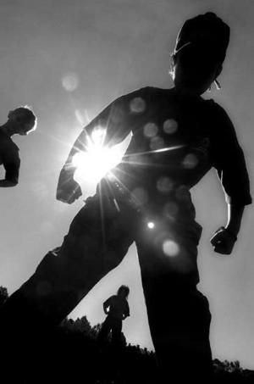
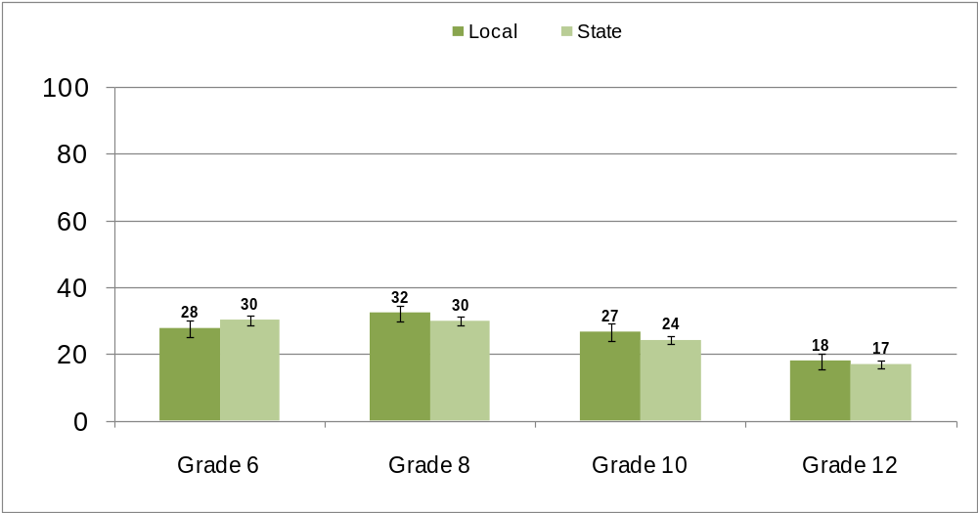
Northshore School District
Healthy Youth Survey | Fall 2010 Results
Percentage of students who said they had been bullied in the last 30 days

Slide 19

Northshore School District
Healthy Youth Survey | Fall 2010
Reported incidence in the last 30 days of bullying, harassment or intimidation using the computer or cell phone.
8th grade - 10.4%
10th grade - 9.9%
12th grade - 12.3%

Slide 20

Northshore School District HIB Policies
Follows State Law
  staff training
  student education
  reporting procedures – DOCUMENT THE INCIDENT
The administration will investigate all reports
The school will consider:
  surrounding circumstances
  nature of the behavior
  relationships between the parties
  context

Slide 21
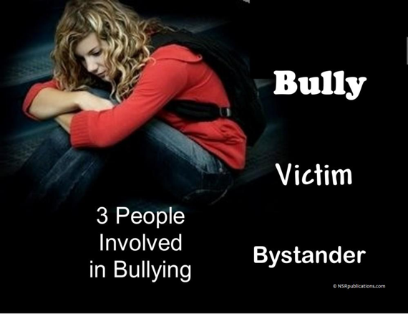
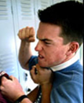


Bully
Target
6%
Bullies
9%
Regular Targets
Bystander
85%
Bystanders

Slide 22
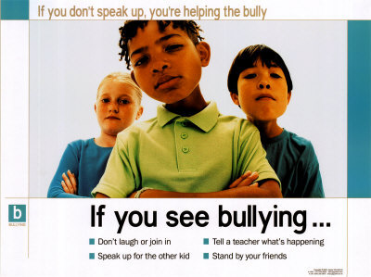
Help students understand what they should do:

Slide 23
Don’t be a Bystander
Video
“The Price of Silence” Museum of Tolerance

Slide 24

What Bystanders should do
Make bystanders aware that their own behavior can encourage or discourage bullying.
Make it clear to your friends that you won't be involved in bullying behavior.
Never stand by and watch or encourage bullying behavior.
Do not harass, tease or spread gossip about others.
Offer support to someone you see being bullied.
Report the incident to an adult.
PSA – b-free.ca

Slide 25

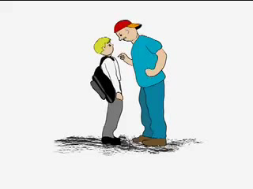
“In the end, we will remember not the words of our enemies,
but the silence of our friends.”
Martin Luther King, Jr.

