Slide 1
Wednesday, January 17, 2024
Gwynedd Mercy Academy
High School
Notes:
Congratulations students, our School will be taking part in a financial education event called “Financial Reality Fair”
It is hosted by TruMark Financial Credit Union
The administration made this possible for you to learn about finances at a young age through this interactive event.

Slide 2
What is ?
A financial education learning event.
Hands-on activity on budgeting and saving, while experiencing how to spend money wisely on expenses necessary for independent living.
You will be assigned a career and a salary
You will make decisions on all living expenses and stay within your monthly budget.
Notes:
TruMark Financial Credit Union is the host of this event. They present this activity to many schools in our areas every year.
It is a trademark event created by CrossState Credit Union Foundation (PA & NJ Credit Union network)

Slide 3
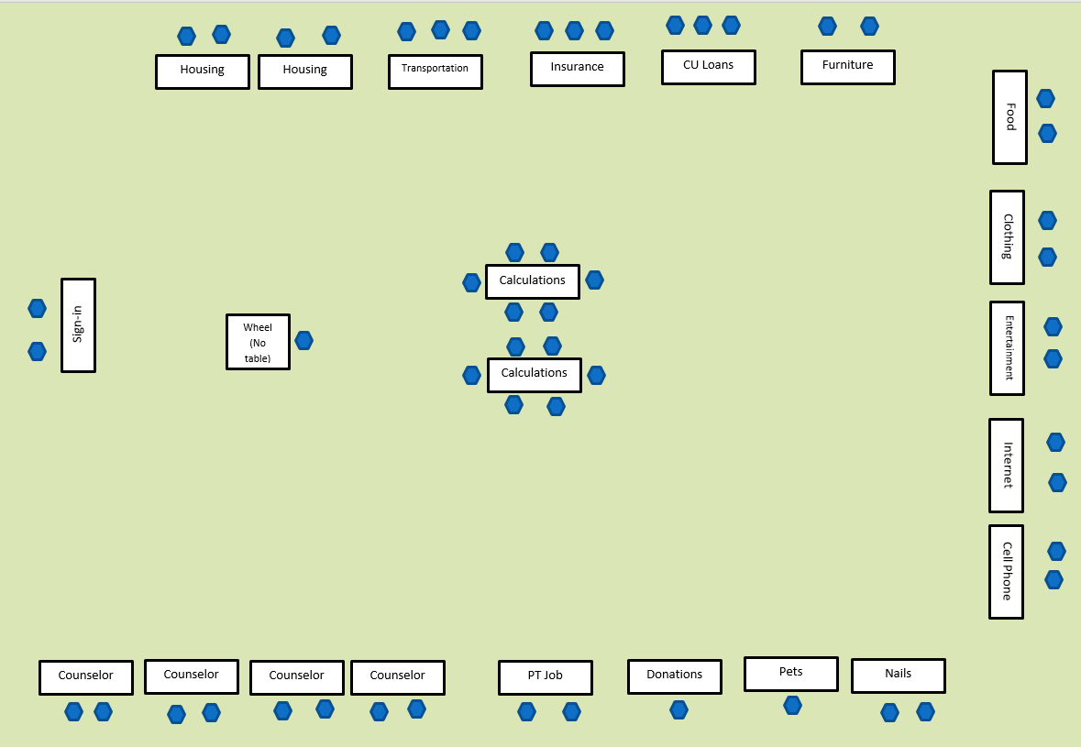
It will be held in the Gym
Notes:
This event will be held in the Gym and have tables set up around the room.
Each table represents a living expense you must purchase when living on your own.
Examples are: Housing, transportation, food, clothing, etc.
You must rotate through the gym and visit each table – a volunteer at the table will provide you with information on the prices of your choices: economical, middle, or luxury.
After visiting every table you spin the Wheel of Reality – it will land on a financial gain or loss such as: car broke down, pay $200, or tax refund receive $500
After you spin the wheel, go to the tables in the middle where you will calculate your expenses and see if you came under budget.
Finally you will visit the Financial Counselors who will review your budget with you.

Slide 4
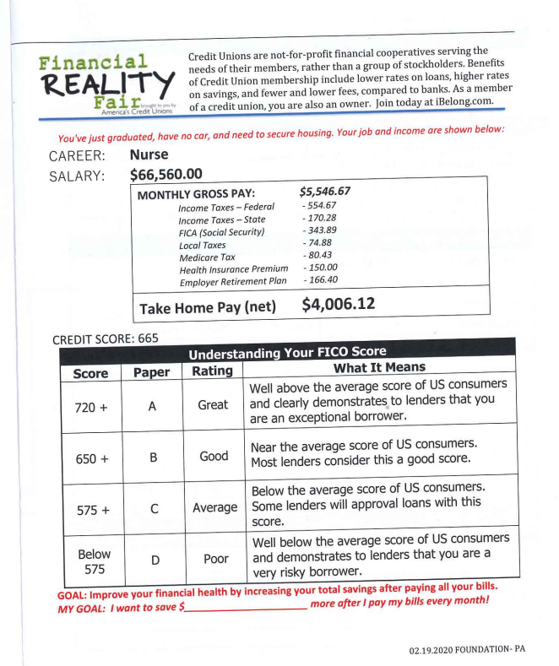
Budget Sheet Front Page
Notes:
Scenario:
You just graduated from college or trade school
A career has been assigned to you on your budget sheet and contains:
Annual salary
Monthly Gross Pay
Minus taxes and benefits (health insurance, 401K)
Monthly Net or “Take Home” Pay - this is the dollar amount you will use when making your budget.
Credit score is provided for you – 665 – this will be used if you take out a car loan.
FYI: Everyone will have the same credit score of 665

Slide 5
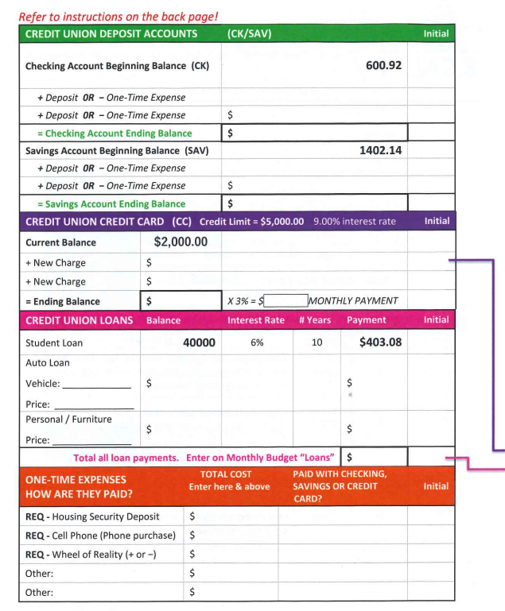
Budget Sheet Page 2
Notes:
This side of the budget sheet has start-up money and debt that you incurred.
(Green) CREDIT UNION DEPOSIT ACCOUNTS:
Everyone starts out with money in their checking and savings account. You can use this when spending money on your monthly expenses as you rotate through the gym making purchases.
*(Purple) CREDIT UNION CREDIT CARD
Everyone has a balance on their credit card of $2,000 with a credit limit of $5,000. Notice this credit card has an excellent rate of 9% interest rate. Other credit cards will have rates up to 25% or higher. You won’t be calculating interest rates for this exercise but you will calculate your monthly payment
You may use your credit card to make purchases during the event. Be sure to write the amounts in this section and add up all your credit card charges.
Since you have a balance on your credit card, your monthly payment is based on 3% of your balance.
Multiply your total charges by 3% and that will be your monthly payment for your credit card debt.
*(Pink) CREDIT UNION LOANS
Everyone has a student loan to pay each month.
You have the option to purchase a car – that monthly loan amount is entered here
You have the option to purchase furniture on credit – that amount is entered here
Add up all your loan amounts and that total amount is entered here
(Red) ONE TIME EXPENSES
You may encounter one time payments, enter those amounts here.
If you select rental for housing a one time security deposit is required and goes here.
Your cell phone purchase is a one time payment so you can enter that here and pay for it using your savings/checking balances or pay on credit card.
You must visit the Wheel of Reality – enter that dollar amount here – be sure to indicate + or -
Notice the credit card and loans have an arrow that indicates you will move those totals onto the next budget page.
These are monthly expenses so they must be included on the budget page.

Slide 6
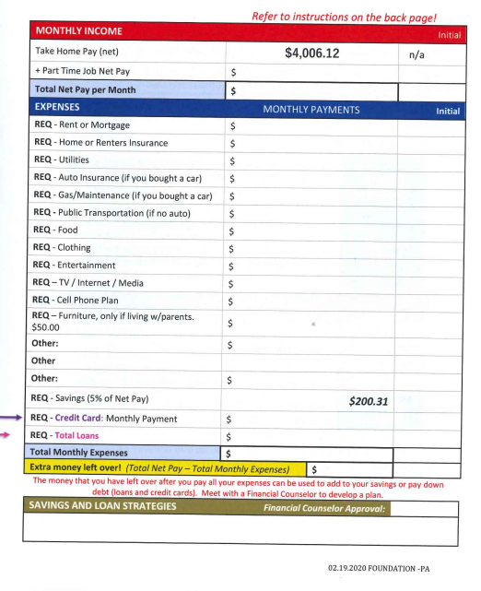
Budget Sheet Page 3
Notes:
Your take home pay is listed at the top of this page
This is where you start making your selections as you go to each booth.
Notice the 2 arrows from the previous page where you move your credit card and loan amounts over, this is where you enter those amounts.
You can also see a required 5% of net pay is put in your budget for savings. It is important to “pay yourself first” and make sure you add a savings deposit every month!
Once every expense is entered, add it all up and see if you came in under budget!

Slide 7
Housing
Living Arrangement | One-Time Charge | Monthly Payment | Utilities
Live at home | 0 | $400 | $40
1 Bedroom/ 1 Bath Apartment | Security Deposit $500 | $1,500 $1,600 (with pet) | $250
2 Bedroom/ 2 Bath Townhouse NO PETS | Security Deposit $2,000 - alone $1,000 – split with a roommate | $2,550 – alone $1,275 – split with a roommate | $400 – alone $200 – split with a roommate
3 Bedroom/ 1 Bath Home | Downpayment $30,000 | $2,000* | $550
* Home Includes: Loan principal of $270,000, interest at 6.47 %, and taxes at 1.25%.
* Does not include required homeowners insurance. This must be purchased at the Insurance Booth.
Notes:
It is recommended you see what your housing options are now because that is the first station you will visit when you get to Reality Fair. This will give you time to think about what option you want to choose. If you choose to have a roommate, select that person and go through the entire fair with your roommate because you will be able to split some of the expenses.
Here are your 4 choices:
Live with Mom and Dad – keep in mind this is not a bad choice when you’re first out on your own. You can save some serious money. But YES, you will pay your parents for living there. You’re a working professional now.
1 Bedroom apartment - requires a security deposit that you must pay upfront AND If you choose to have a pet during Reality Fair, you have an additional fee
2 Bedroom townhouse - requires a security deposit that you must pay upfront AND this choice does not allow pets. But you can have a roommate.
Purchase a home - $30,000 downpayment – you will have to discuss this at the lending table. NO, you can’t have your parents pay for your downpayment
Think about how you want to select your living arrangements so when you go to Reality Fair so you know what to expect.
FYI: You’re allowed to have a roommate. But that only applies if you take the 2 bedroom Townhouse or the Home. No sharing a 1 bedroom apartment with 3 other friends!
You are professional adults and should live accordingly.
So think about your options, discuss it with friends and family. When you go to Reality Fair you can make your choice. Good luck!

Slide 8
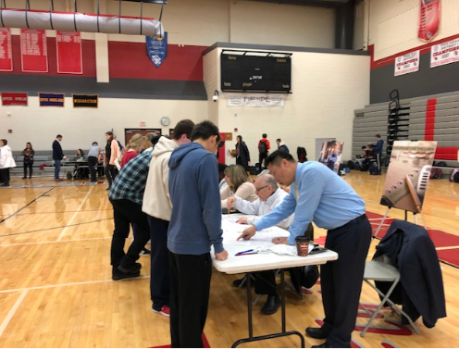
Reality Fair Video
Notes:
(Teacher: To access the YouTube video – when the PowerPoint is in “Slide Show” mode, just click on the photo, the link is embedded.)
This is a video of what Reality Fair looks like
Reality Fair – YouTube (Reality Fair – RiverfrontFCU) https://www.youtube.com/watch?v=D0bhRiBaYRE&t=10s

Slide 9
8:00 – 9:00 Arrival of Credit Union team for set up
9:00 – 9:30 Breakfast and Arrival of Volunteers
9:30 – 10:00 Volunteer Orientation – Room TBD
10:00 – 11:00 Group 1
11:00 – 12:00 Group 2
12:00 – 1:00 Group 3
1:00 – 1:30 Lunch for Volunteers
1:30 – 2:30 Break-down and exit school
Notes:
This is an example of the schedule for the day. You will be brought to the gym with your class.
You have one hour to go through the entire event.
Before you begin, one of the volunteers will provide a brief orientation to help you navigate the booths.
There will be volunteers to help you with any questions – don’t be shy. They are excited to help you learn.

Slide 10
Student Expectations
Be prepared: Have an understanding of Reality Fair of personal budgeting and money management. Also bring a pen or pencil. Calculators will be provided but if you prefer your personal cell phone’s calculator, you may use that.
Be respectful: There will be volunteers from outside of the school. Show respect and say thank-you for volunteering for the day to provide this event for your benefit.
Be engaged: Follow directions of the teachers and volunteers who will help guide you through the event. Be sure to fill in all of the budget sections and complete all calculations. Visit the financial counselors who will review your budget sheet with you.
Be realistic: When selecting your living expenses try to be honest and make sensible decisions that are consistent with your scenario of a newly graduated professional living on your own.
Ask questions: This is a great opportunity to talk to financial professionals. If you’re unsure about anything, everyone there is excited and willing to help you and answer all your questions.
Have fun! This is a hands-on activity that will be interactive and provide real-life experiences of what to expect after graduation and living on your own.
Notes:
Teachers: in the past we had students show up to Reality Fair with no knowledge of the event. It’s important you take time to let them know what to expect.
Thank you for doing this!!

Slide 11
Good Luck!

